Slide 1
Chapter 1: Introduction to Project Management
Information Technology Project Management, Seventh Edition
Last modified by Celeste Ng, in Feb 2023
Note: See the text itself for full citations.

Slide 2
Contents
Why we need projects,
What a project is, when is the end of a project.
Examples of IT projects,
Attributes of projects屬性,
Project management,
The relationship between project專案, program計劃, and portfolio組合management
Source: Celeste Ng, 2018.

Slide 3
Why we need Projects?
Celeste: Improvement to standard process
Celeste: New opportunity for new market
Politic/ Regulation/ Society factor
GDPR 通用數據保護法規 (e-commerce)
Meet regulatory, legal and social requirements
Satisfy stakeholder requests or needs
Economic/ Market factor
Digital transformation
Project
Physical/ Technological factor
Physical/ Technological factor
Create, improve or fix product, processes or services
Implement or change business or technological strategies
Industry 4.0
Mobile app
Celeste: Correct issues or problem
Celeste: New opportunity for new market
Source: PMI, 2017, “A guide to the project management body of knowledge (PMBOK guide),” Sixth edition, Newtown Square, PA: Project Management Institute, Inc.

Slide 4
What Is a Project?
A project is “a temporary endeavor(暫時性投入的努力) undertaken to create a unique product, service, or result” (PMBOK® Guide, Fifth Edition, 2012)
Objective – Projects end結束when their objectives have been reached or the project has been terminated
Size & Duration – Projects can be large or small and take a short or long time to complete
project

Slide 5
When is the end of a project
The end of the project is reached when one or more of the following is true:
The project’s objectives have been achieved;
The objectives will not or cannot be met;
Funding is exhausted or no longer available for allocation to the project;
The need for the project no longer exists (e.g., the customer no longer wants the project completed, a change in strategy or priority ends the project, the organizational management provides direction to end the project);
The human or physical resources are no longer available; or
The project is terminated for legal cause or convenience.
objectives
objectives
Funding
need
resources
legal course
Source: PMI, 2017, “A guide to the project management body of knowledge (PMBOK guide),” Sixth edition, Newtown Square, PA: Project Management Institute, Inc.

Slide 6
Examples of IT Projects
A team of students creates a smartphone application and sells it online
A company develops a driverless car (自動駕駛) –
“autonomous car (driverless car,^{[1]} self-driving car,^{[2]} robotic car^{[3]}) is a vehicle that is capable of sensing its environment and navigating without human input,^{[4]}” Source: https://en.wikipedia.org/wiki/Autonomous_car
Google self-driving car
A small software development team(軟體開發團隊) adds a new feature to an internal software application for the finance department
Integrating with e-Commerce and inventory functions

Slide 7
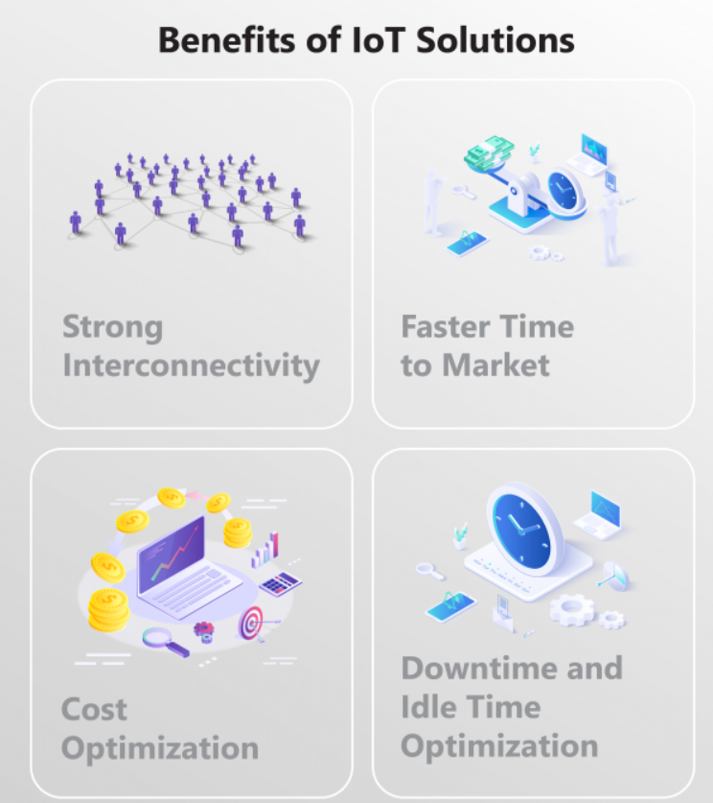
Examples of Strategic Projects
Celeste:
For customer engagement, digital marketing
Mobile apps
Mobile-centric(行動為中心)applications and interfaces project –
“Mobile app to track children on Singapore school buses” - “... school children ... with a small electronic tag小電子標籤that would alert bus drivers, via an app, when a child gets on and off the bus. The tag also acts as an electronic attendance marker. ... An alarm on the driver’s app will also go off if a child misses his stop, or is still on the bus after everyone else has got off. The children’s parents also had a specific app that would push notifications for when the bus was arriving, when their child got on or off the bus, as well as track the bus location on a map” – Source: http://goo.gl/g6YCYk
Internet of things物聯網 project
Physical items connected to the Internet by means of sensors (e.g., “August Smart Lock”)
Cloud computing(雲端運算) project
Amazon Key (all you need – Amazon smart lock, “Key” app --- to lock n unlock door) ---- Oct., 2017
Others:
Research on social media governance process,
Construct a building,
Assembly a car,
Explore new market
IoT
Cloud computing
Photo credit: https://www.qulix.com/about/iot-in-manufacturing/
Source: Celeste Ng, 2018.

Slide 8
Examples of IoT Projects
1. Smart Agriculture System
that can perform and even monitor a host of farming tasks. For instance, you can schedule the system to irrigate [water] a piece of land automatically, or you can spray fertilizers/pesticides on the crops wirelessly through your smartphone 自動灌溉一塊土地，或者你可以在農作物上噴灑化肥/農藥
2. Weather Reporting System
the system is embedded with temperature, humidity, and rain sensors that can monitor the weather conditions and provide live reports of weather statistics. … an always-on, automated system that sends data via a microcontroller to the webserver using a WIFI connection
3. Home Automation System
gives more power to the user to control and manage household appliances from any location in the world
4. Face Recognition Bot
one of the best IoT Projects where the intelligent AI bot is designed to recognize the faces of different people or a single person and also their unique voice.
… system includes facial recognition features like face detection (perceives faces and attribute the same in an image), person identification (matches an individual in your private repository containing hundreds and thousands of people), and also emotion recognition (detects a range of facial expressions including happiness, contempt, neutrality, and fear) … for a robust security system
Source: 2022, https://www.upgrad.com/blog/iot-project-ideas-topics-for-beginners/.

Slide 9
Project Attributes
A project
has a unique purpose
is temporary
is developed using progressive elaboration(逐步發展)
from broad initial plan to specific details, as time passes
requires resources, often from various areas
should have a primary customer or sponsor(專案贊助者)
The project sponsor usually provides the direction and funding經費for the project
involves uncertainty(難以確定)
Supplier went out of business, unplanned team member time off

Slide 10
What is project management?
Project management is the application of
knowledge,
skills技能,
tools, and
techniques技術
to project activities to meet the project requirements.
Project management is accomplished through the appropriate application and integration of the project management processes, skills, tools and techniques identified for the project.
Project management enables organizations to execute projects effectively and efficiently.
knowledge
skills技能
專案管理是關於如何
應用和整合我們將會學到的專案管理流程, 技能, 工具 &技術
tools
techniques技術
Source: PMI, 2017, “A guide to the project management body of knowledge (PMBOK guide),” Sixth edition, Newtown Square, PA: Project Management Institute, Inc.

Slide 11
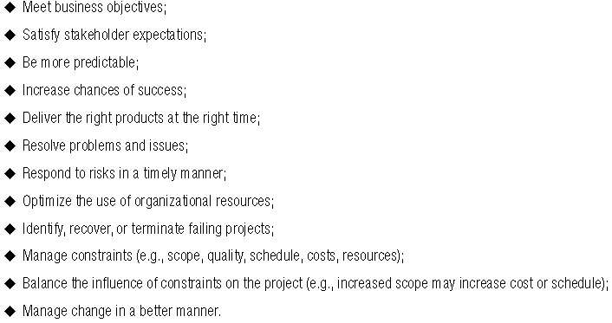
Why project management is important? (1)
project management helps
Effective project management helps to:
Source: PMI, 2017, “A guide to the project management body of knowledge (PMBOK guide),” Sixth edition, Newtown Square, PA: Project Management Institute, Inc.

Slide 12
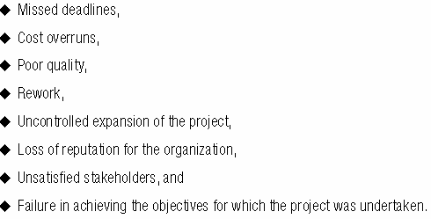
Why project management is important? (2)
absence of project management
Poorly managed projects or the absence of project management may result in:
Source: PMI, 2017, “A guide to the project management body of knowledge (PMBOK guide),” Sixth edition, Newtown Square, PA: Project Management Institute, Inc.

Slide 13
Project Stakeholders
Stakeholders(企業的利害關係人/利益相關者)are the people involved in or affected by project activities
Project Stakeholders include
the project sponsor
the project manager
the project team
support staff(支援人員)
customers
users
suppliers(供應商)
opponents to the project(專案反對者)

Slide 14
Project Management Tools and Techniques
Project management tools and techniques(工具和技術) assist project managers and their teams in various aspects of project management
Some specific ones include
Project charter, scope statement, and WBS (scope)
Gantt charts, network diagrams, critical path analysis關鍵路徑分析, critical chain scheduling關鍵鏈排程(time)
Cost estimates and earned value management實現價值管理
See Table 1-1 for many more

Slide 15
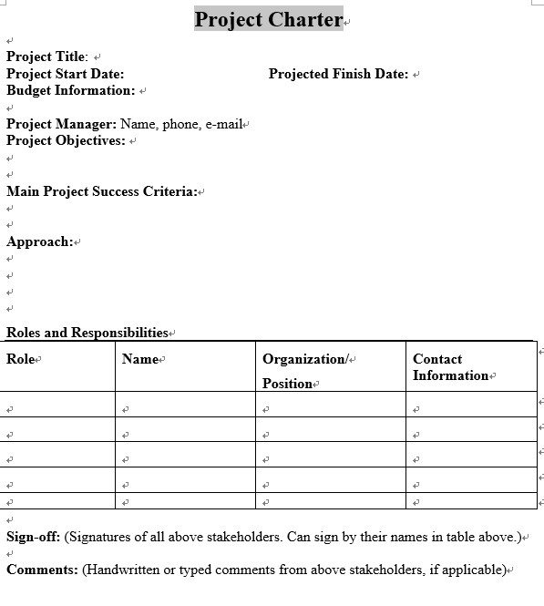
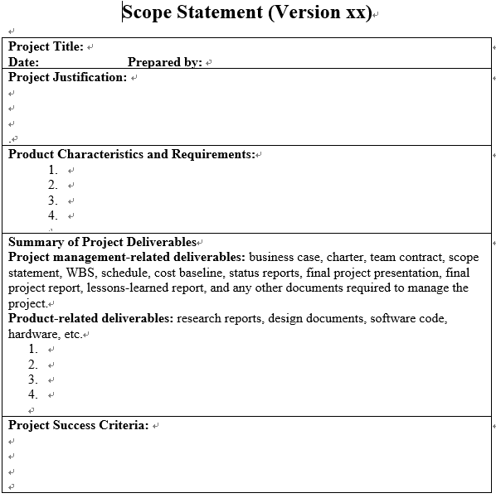
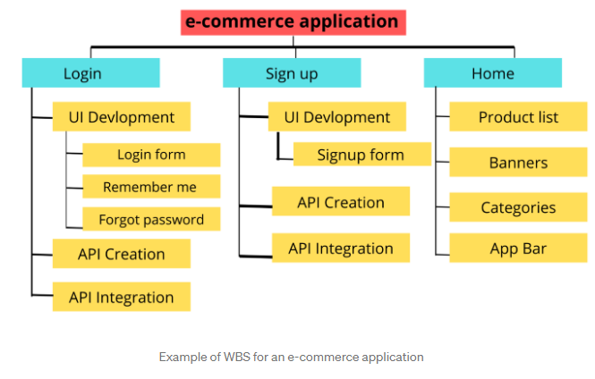
An example of a Project Charter, Scope Statement, WBS
Source: textbook
Source: https://medium.com/@ajaymanshani3/understanding-work-breakdown-structure-9eeb4921543c
Back

Slide 16
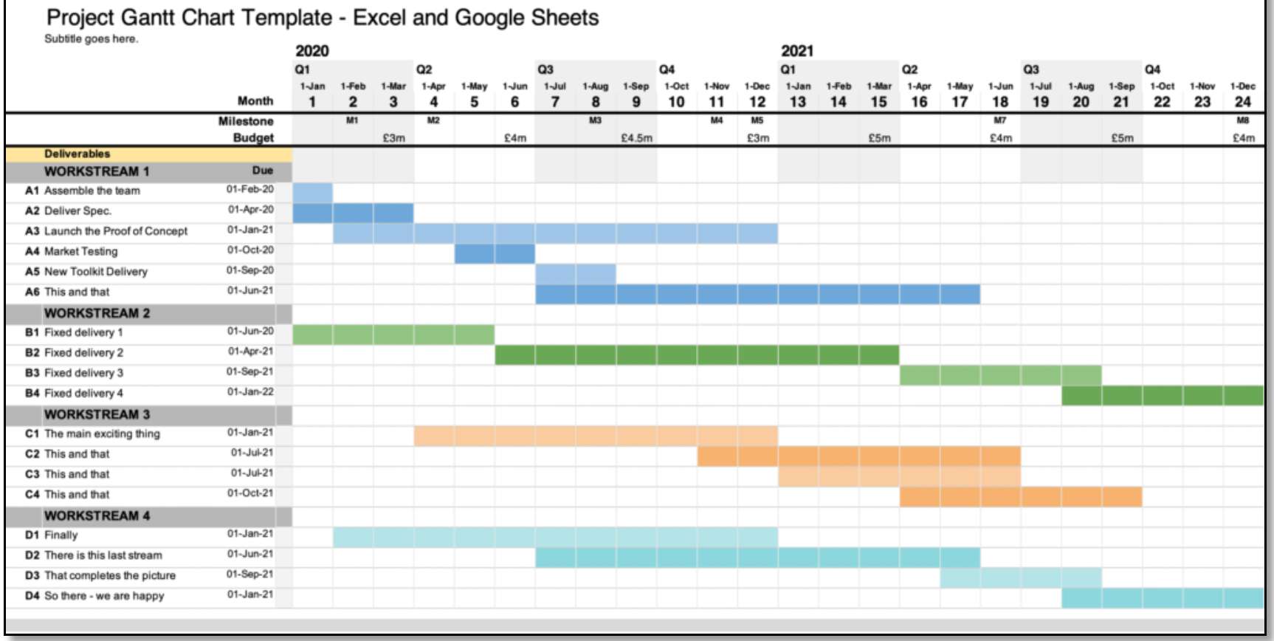
An example of a Gantt Chart
Source: https://business-docs.co.uk/downloads/excel-gantt-chart-template/
Back

Slide 17
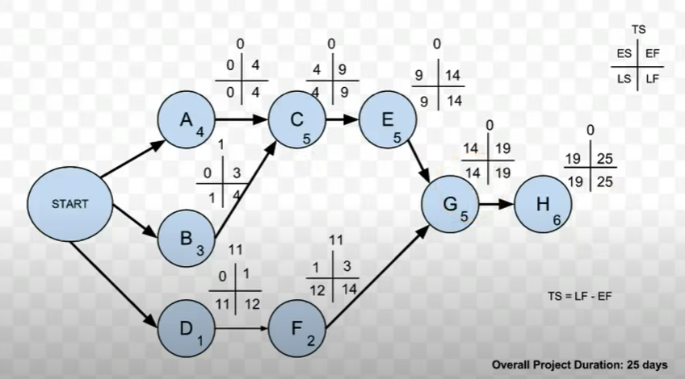
An example of a Network Diagram
Source: https://www.youtube.com/watch?v=URdxhl_8qIE
Back

Slide 18
Project Success
There are several ways to define project success:
The project met scope(專案符合目標/範圍 ), time, and cost goals
The project satisfied the customer/sponsor
The results of the project met its main objective, such as making or saving a certain amount of money, providing a good return on investment(投資回報), or simply making the sponsors happy(贊助商高興)

Slide 19
Program and Project Portfolio Management
A program is “a group of related projects managed in a coordinated way(協調方式管理) to obtain benefits and control not available from managing them individually” (PMBOK® Guide, Fifth Edition, 2012)
A program manager provides leadership and direction for the project managers heading the projects within the program
Examples of common programs in the IT field include infrastructure, applications development, and user support
Celeste: a multinational company’s IT infrastructure migration – from on-premise to hybrid cloud

Slide 20
Project專案 and Program Managers計畫管理師
Project managers work with project sponsors(專案贊助者), project team, and other people involved in a project to meet project goals
Program managers oversee監視programs; often act as bosses for project managers
Project managers
Program managers

Slide 21
Table 1-3 Ten Most Important Skills and Competencies for Project Managers
1. People skills
2. Leadership
3. Listening
4. Integrity(誠信), ethical behavior(道德行為), consistent
5. Strong at building trust
6. Verbal communication
7. Strong at building teams
8. Conflict resolution(解決衝突), conflict management
9. Critical thinking(批判性思考), problem solving
10. Understands, balances priorities(優先權)

Slide 22
THANK YOU!
Celeste SP Ng
Email: celeste@saturn.yzu.edu.tw
Phone: 2614
Website: http://celesteng.mis.yzu.edu.tw/

Slide 23
Project Portfolio Management
As part of project portfolio組合management, organizations group and manage projects and programs as:
a portfolio of investments(投資組合) that contribute to the entire enterprise’s success
Celeste: e.g. to achieve a specific strategic goal

Slide 24
Portfolio, programs and projects
Portfolio
Programs
Projects
Source: PMI, 2017, “A guide to the project management body of knowledge (PMBOK guide),” Sixth edition, Newtown Square, PA: Project Management Institute, Inc.

Slide 25
Portfolio, programs and projects
Source: Celeste SP Ng, 2022

Slide 26
Organizational project management
Celeste: Assume FENC’s strategic goal is … increment in market share by 10% (➔ P/f):
Prog: R&D initiatives; new factories constructions
Operation: textile / fabric manufacturing
Proj: new factory site-A; Mobile APP development
Portfolio
Programs
Projects
Operations
Celeste: Project (temporary) vs operations (is ongoing)
Source: PMI, 2017, “A guide to the project management body of knowledge (PMBOK guide),” Sixth edition, Newtown Square, PA: Project Management Institute, Inc.

Slide 27
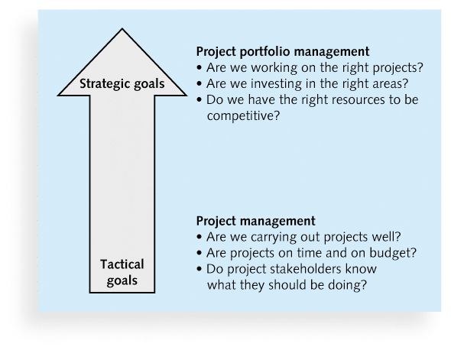
Figure 1-3. Project Management Compared to Project Portfolio Management
strategic and tactical goals -戰略和戰術目標

Slide 28
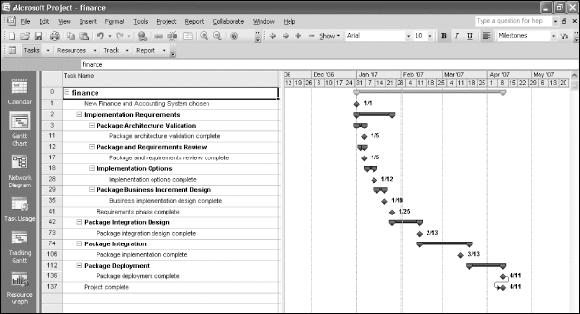
Figure 1-6. Sample Gantt Chart Created with Project 2010
Example of PM TOOLS

Slide 29
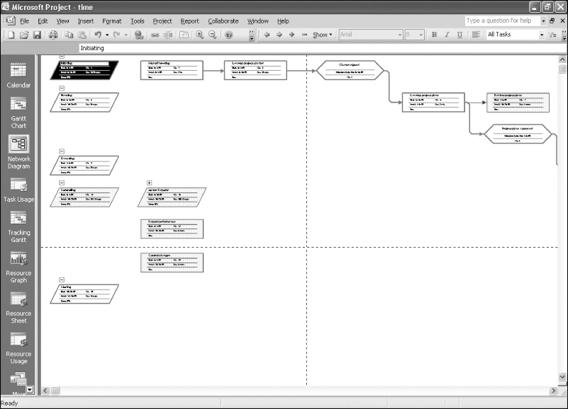
Figure 1-7. Sample Network Diagram(網路圖)Created with Project 2010
Example of PM TOOLS

Slide 30
Recap - Chapter Summary
Explain why we need projects, what a project is, when is the end of a project.
A project is a temporary endeavor undertaken to create a unique product, service, or result
Provide examples of IT projects, list various attributes of projects屬性,
Define the meaning of project management, explain why project management is important, project management framework,
Project management is the application of knowledge, skills, tools, and techniques to project activities to meet project requirements
Discuss the relationship between project專案, program計劃, and portfolio組合management
A project is a temporary endeavor undertaken to create a unique product, service, or result
Project management is the application of knowledge, skills, tools, and techniques to project activities to meet project requirements
Edited by: Celeste Ng, 2018

