Slide 1
Chapter 2: The Project Management and Information Technology Context
Information Technology Project Management, Seventh Edition
Last modified by Celeste Ng, in March 2022
Note: See the text itself for full citations.

Slide 2
Learning Objectives
1. Describe the source of project influences影響源
2. Method to understand organizations, including the:
Four frames架構
Organizational structure組織架構& its influence on projects
Organizational culture組織文化& cultural characteristics
3. Understand the concept of a project phase專案階段 and the project life cycle專案生命週期, and phase gate
4. Recent trends affecting IT Project Management
Organizational Structure
influences
Project
Edited by: Celeste Ng, 2021

Slide 3
1. Project influences (1)
EEF – “refer to conditions, not under the control of the project team, that influence,
constrain, or direct the project”
Categories
Enterprise Environmental Factors (EEFs)
Internal Organizational Process Assets (OPAs)
Sub-categories
Source: PMI, 2017, “A guide to the project management body of knowledge (PMBOK guide),” Sixth edition, Newtown Square, PA: Project Management Institute, Inc.

Slide 4
1. Project influences (1)
Enterprise Environmental Factors (EEFs)
Internal Organizational Process Assets (OPAs)
Source: PMI, 2017, “A guide to the project management body of knowledge (PMBOK guide),” Sixth edition, Newtown Square, PA: Project Management Institute, Inc.

Slide 5
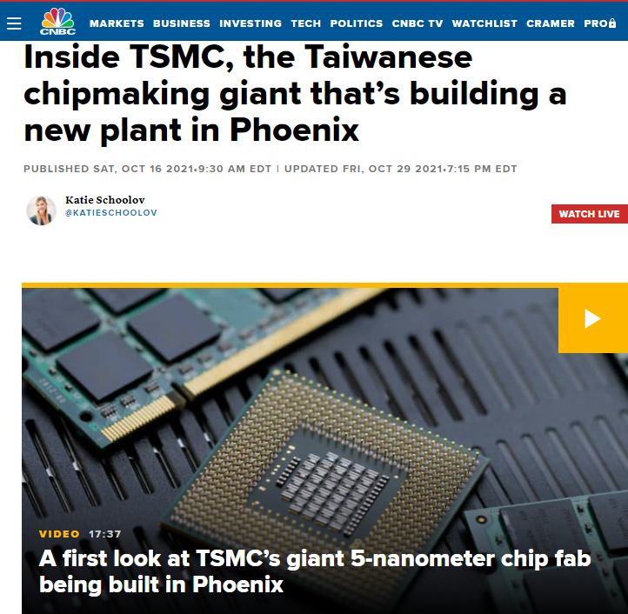
1. Project influences – EEFs: EXTERNAL TO THE ORGANIZATION
Marketplace conditions.
Marketplace conditions.
Examples include competitors, market share brand recognition, and trademarks.
Social and cultural influences and issues.
Examples include political climate, codes of conduct, ethics, and perceptions.
Legal restrictions.
Examples include country or local laws and regulations related to security, data protection, business conduct, employment, and procurement.
Commercial databases.
Examples include benchmarking results, standardized cost estimating data, industry risk study information, and risk databases.
Academic research.
Examples include industry studies, publications, and benchmarking results.
Government or industry standards.
Examples include regulatory agency regulations and standards related to products, production, environment, quality, and workmanship.
Financial considerations.
Examples include currency exchange rates, interest rates, inflation rates, tariffs, and geographic location.
Physical environmental elements.
Examples include working conditions, weather, and constraints.
Social and cultural influences and issues.
Legal restrictions.
Commercial databases.
Academic research.
Government or industry standards.
Financial considerations.
Physical environmental elements.
Source: PMI, 2017, “A guide to the project management body of knowledge (PMBOK guide),” Sixth edition, Newtown Square, PA: Project Management Institute, Inc.

Slide 6
1. Project influences – EEFs: INTERNAL TO THE ORGANIZATION
Organizational culture, structure, and governance.
Examples include vision, mission, values, beliefs, cultural norms, leadership style, hierarchy and authority relationships, organizational style, ethics, and code of conduct.
Geographic distribution of facilities and resources.
Examples include factory locations, virtual teams, shared systems, and cloud computing.
Infrastructure.
Examples include existing facilities, equipment, organizational telecommunications channels, information technology hardware, availability, and capacity.
Information technology software.
Examples include scheduling software tools, configuration management systems, web interfaces to other online automated systems, and work authorization systems.
Resource availability.
Examples include contracting and purchasing constraints, approved providers and subcontractors, and collaboration agreements.
Employee capability.
Examples include existing human resources expertise, skills, competencies, and specialized knowledge.
Organizational culture, structure, and governance.
Geographic distribution of facilities and resources.
Infrastructure.
Information technology software.
Resource availability.
Employee capability.
Source: PMI, 2017, “A guide to the project management body of knowledge (PMBOK guide),” Sixth edition, Newtown Square, PA: Project Management Institute, Inc.

Slide 7
1. Project influences (1)
Enterprise Environmental Factors (EEFs)
Internal Organizational Process Assets (OPAs)
Source: PMI, 2017, “A guide to the project management body of knowledge (PMBOK guide),” Sixth edition, Newtown Square, PA: Project Management Institute, Inc.

Slide 8
1. Project influences: How to understand “it”?
S
y
s
s
t
m
e
i
V
ew
A
p
ch
p
a
r
o

Slide 9
1. A Systems View整體性看法of Project Management (1)
A systems approach系統方法emerged in the 1950s to describe a more analytical分析approach to management and problem solving
Systems are sets of interacting components互相互動成份that work within an environment to fulfill some purpose.
“它傾向整體主義。因為它關心的是整體及其各部分之間的關係。” ---- Source: Wikipedia, 2017, URL: https://zh.wikipedia.org/wiki/
analytical approach
Interacting components

Slide 10
1. Projects Cannot Be Run In Isolation隔离执行
Projects must operate in a broad organizational environment操作在廣泛的組織環境中
Project managers need to use systems thinking系統化的思考:
taking a holistic view採取全面性的看法of carrying out projects進行專案 within the context of the organization

Slide 11
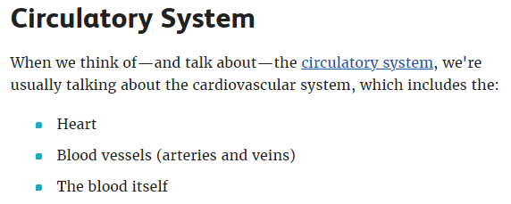
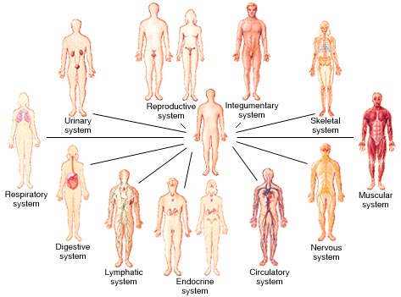
Human Body Organ Systems (人體器官系統) Source: http://anatomyandphysiologyi.com/wp-content/uploads/2013/05/organsystem.jpg
11 systems,
78 organs in human body
Source: https://www.verywellhealth.com/organ-system-1298691
Circulatory - 血液循環系統
Integumentary外皮系統
Skeletal骨架
Endocrine內分泌
Reproductive生殖
Respiratory 呼吸系統
Prepared by: Celeste Ng 2016

Slide 12
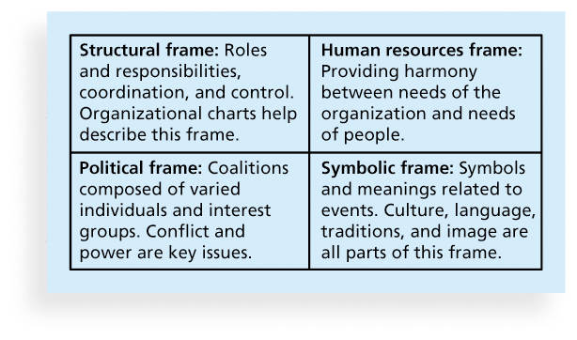
2. Method to understand an organization Figure 2-2. Perspectives on Organizations
Organizational charts
組織結構圖
Providing harmony
提供調和
Political 政治上
Coalitions 聯盟
Conflict 衝突
Power 權力
Symbolic象徵
Traditions傳統
Coordination 協同
Harmony和諧
Organizational chart
organization
people
individuals
Culture,
groups

Slide 13
2. Organizational Structures
3 basic organization structures
Functional功能性: functional managers部門經理report to the CEO執行官
Project專案: program計劃managers report to the CEO
Matrix: middle ground中間地帶between functional and project structures; personnel often report to two or more bosses; structure can be weak, balanced, or strong matrix
Functional功能性
Project專案
Matrix

Slide 14
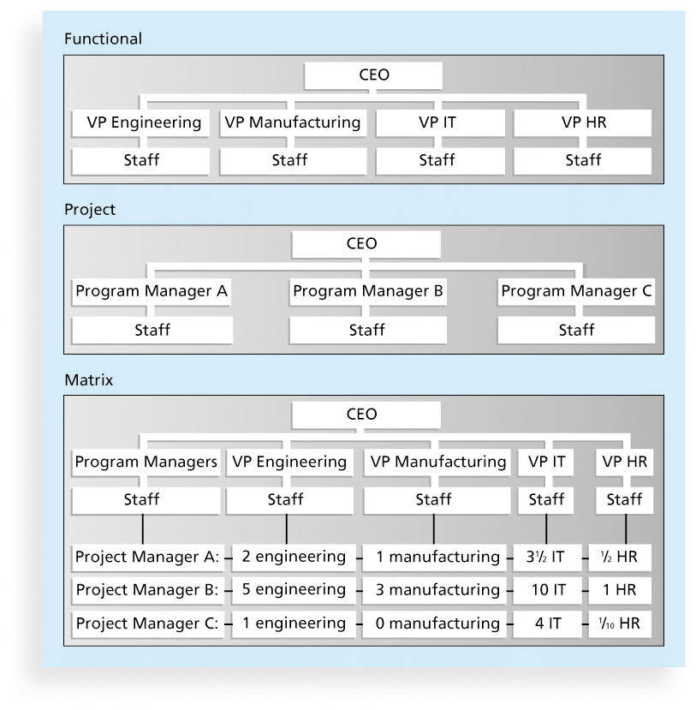
2. Figure 2-3. Functional, Project, and Matrix Organizational Structures
Functional功能性
Vice president副總裁
Project專案
Matrix

Slide 15
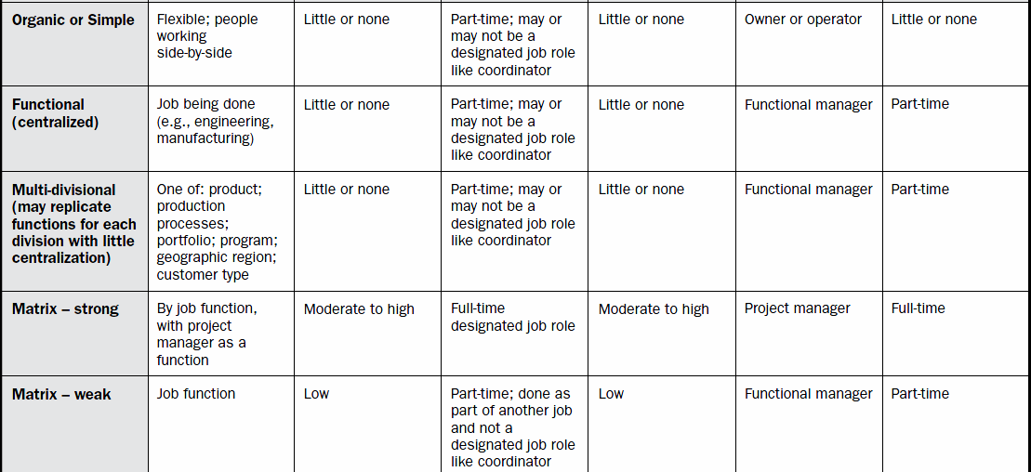
Influence of Organizational Structure on Projects (1)
Source: PMI, 2017, “A guide to the project management body of knowledge (PMBOK guide),” Sixth edition, Newtown Square, PA: Project Management Institute, Inc.

Slide 16
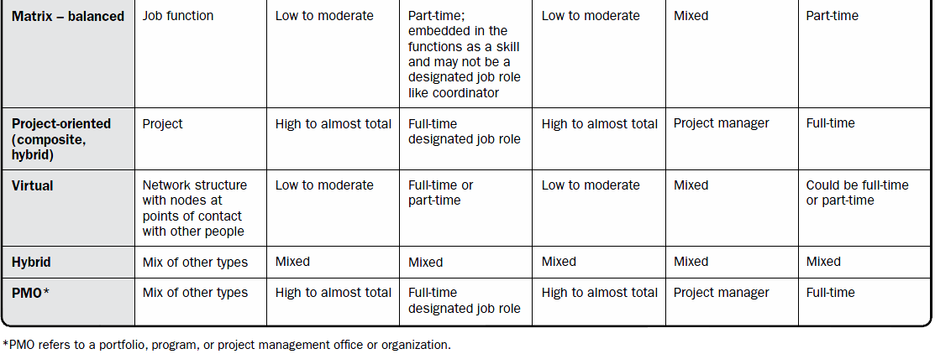
Influence of Organizational Structure on Projects (2)
Source: PMI, 2017, “A guide to the project management body of knowledge (PMBOK guide),” Sixth edition, Newtown Square, PA: Project Management Institute, Inc.

Slide 17
2. Overall: Organizational Structures
Celeste: one-man show
Celeste: Microsoft USA, Microsoft Taiwan, ….
Source: Udemy, 2021

Slide 18
2. Organizational Culture
Organizational culture is a set of shared共享 assumptions, values, and behaviors that characterize the functioning運作 of an organization
assumptions
values
behaviors

Slide 19
2. Ten Characteristics of Organizational Culture (1)
1. Member identity*成員身分
Employee identity with the organization as a whole
2. Group emphasis*強調小組
Work activities are organized around groups
3. People focus關注在人
Management’s decisions take into account the effect of outcomes on people
4. Unit integration*部門整合
The degree to which departments within an organization are encouraged to coordinate with each other
5. Control
Member identity
Group emphasis
People focus
Unit integration
Control
*Project work is most successful in an organizational culture where these items are strong/high and other items are balanced.

Slide 20
2. Ten Characteristics of Organizational Culture (2)
6. Risk tolerance*風險容忍
7. Reward criteria*獎勵標準
8. Conflict tolerance*衝突容忍
9. Means-ends orientation目標導向
The degree to which management focuses on outcomes rather than on techniques and processes.
10. Open-systems focus*開放系統導向
The degree to which the organization monitors and responds to changes in the external environment
Risk tolerance
Reward criteria
Conflict tolerance
Means-ends orientation
Open-systems focus
Refer to “The case of Costco vs GE leadership style – 2018 report on course website ---- #3People-focus, #6Risk-tolerance, #7Reward-criteria

Slide 21
Organizational Culture Examples – Twitter (source: http://www.entrepreneur.com/article/249174)
Founders: Jack Dorsey, Noah Glass, Biz Stone, Evan Williams
Prepared by: Celeste Ng, 2016

Slide 22
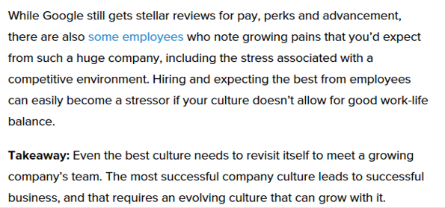
Organizational Culture Examples – Google (source: http://www.entrepreneur.com/article/249174)
financial bonuses金融相關的獎金
Founders: Larry Page, Sergey Brin
Prepared by: Celeste Ng, 2016

Slide 23
Organizational Culture Examples – Facebook (source: http://www.entrepreneur.com/article/249174)
On-site laundry現場洗衣
Outdoor roaming space室外漫步空間
Prepared by: Celeste Ng 2016

Slide 24
Organizational Culture Examples – Adobe (source: http://www.entrepreneur.com/article/249174)
Trust employee信任員工
Risk-taking without fear of penalty冒險，不用擔心受罰
Founders: John Warnock, Charles Geschke
Prepared by: Celeste Ng, 2016

Slide 25
Source: https://www.adobe.com/#

Slide 26
3. Project Phases and the Project Life Cycle
A project life cycle專案生命週期 is a collection of集合project phases階段that defines
what work will be performed in each phase
what deliverables可以做得到的事 will be produced and when
who is involved in each phase, and
how management will control and approve work produced in each phase
A deliverable可交付成果is a product or service produced or provided as part of a project
project phases

Slide 27
3. More on Project Phases
In early phases(初期) of a project life cycle
resource needs are usually lowest
the level of uncertainty不確定性 (risk) is highest
project stakeholders have the greatest opportunity to influence the project 影響項目
In middle phases(中期) of a project life cycle
the certainty of completing a project improves
more resources are needed
The final phase(晚期) of a project life cycle focuses on
ensuring that project requirements were met
the sponsor approves completion of the project主辦單位批准專案完成
early phases
middle phases
final phase

Slide 28
3. The Importance of Project Phases and Management Reviews
A project should successfully pass through each of the project phases in order to continue on to the next
Management reviews管理評審, also called phase exits階段結束or kill points [or phase gates] ,
should occur after each phase
to evaluate the project’s progress, likely success, and continued compatibility持續相容性with organizational goals
Project phase gates

Slide 29
3. The Context of IT Projects – You must understand
Project characteristics: IT projects can be very diverse in terms of size, complexity, products produced, application area應用範圍, and resource requirements
Team member: IT project team members often have diverse backgrounds and skill sets技術
Technology: IT projects use diverse technologies不同技術 that change rapidly. Even within one technology area, people must be highly specialized
Project characteristics
Team member
Technology

Slide 30
THANK YOU!
Celeste SP Ng
Email: celeste@saturn.yzu.edu.tw
Phone: 2614
Website: http://celesteng.mis.yzu.edu.tw/

Slide 31
PMBOK® Guide Key Components in Projects
Project life cycle
Project phase
Phase gate
Process groups
Source: PMI, 2017, “A guide to the project management body of knowledge (PMBOK guide),” Sixth edition, Newtown Square, PA: Project Management Institute, Inc.

Slide 32
4. Recent Trends Affecting IT Project Management
Globalization全球化
Outsourcing
Virtual teams: A virtual team虛擬團隊is a group of individuals who work across time and space using communication technologies通訊技術
Agile project management敏捷式專案管理
[--- different organizational culture]
[--- inter-organization dependency]
[--- different structure of project lifecycle and phases]
Edited by: Celeste Ng, 2021

Slide 33
Agile vs. Waterfall (URL: http://collagenrestores.com/agile-process-diagram-picture/agile-one-stop-project-management-resource-smartsheet/)

Slide 34
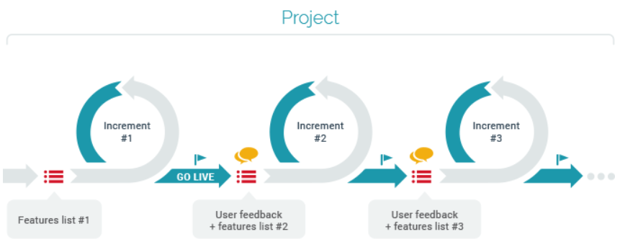
Agile (URL: https://www.openxcell.com/agile-methodology-important-start)
Source: https://whatis.techtarget.com/glossary/DevOps

Slide 35
RECAP - Learning Objectives
1. Describe the source of project influences影響源
2. Understand organizations, including the
Four frames架構 --- structural, symbolic, human resources, & political --- SSHP
Organizational structure & its influence on projects
Organizational culture & cultural characteristics
3. Understand the concept of a project phase專案階段 and the project life cycle專案生命週期, and phase gate
4. Recent trends affecting IT Project Management ---- GOVA
Edited by: Celeste Ng, 2021

