Slide 1
Chapter 3: The Project Management Process Groups: A Case Study
Information Technology Project Management, Seventh Edition
Last modified by Celeste Ng, in March 2022
Note: See the text itself for full citations.

Slide 2
Learning Objectives
1. Describe the five project management process groups專案管理流程群組,
Their typical activities, and the interactions among them (他們的典型活動，以及他們之間的連接)
2. Understand the project management knowledge areas知識領域
3. Understand how the project management process groups relate to the project management knowledge areas專案管理流程群組&知識領域的關聯
Information Technology Project Management, Sixth Edition

Slide 3
Learning Objectives / Contents
The five project management process groups
The project management knowledge areas
@CelesteSPNg

Slide 4
1. Project Management Process Groups
process
A process is a series of actions一連串行動directed toward a particular result
Project management can be viewed as a number of interlinked processes相互關連流程
The project management process groups流程組include
initiating processes啟動流程
planning processes規劃流程
executing processes執行流程
monitoring and controlling processes監控流程
closing processes收尾流程

Slide 5
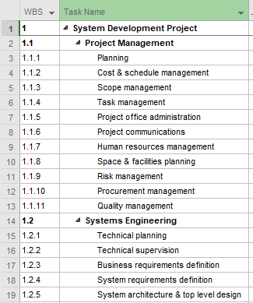
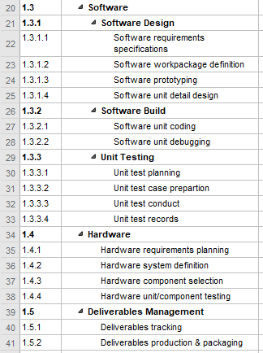
Example of “a process – a series of activities”

Slide 6
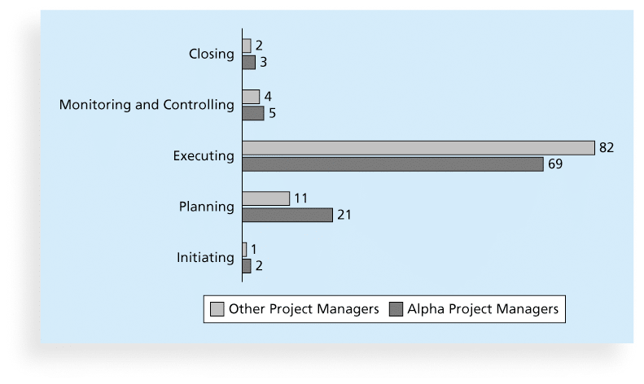
1. Figure 3-1. Percentage of Time Spent on Each Process Group
Suggest that: (1) most time is spent on executing, followed by planning; (2) spending a fair amount of time on planning should lead to lesser time spent in execution

Slide 7
Project Management Process Group (1)
A Project Management Process Group is ---- a logical grouping of project management processes to achieve specific project objectives (專案管理流程的邏輯分組).
Process Groups are independent of project phases. Project management processes are grouped into the following five Project Management Process Groups:
1. Initiating Process Group. Those processes performed to define a new project or a new phase of an existing project by obtaining authorization獲得授權to start the project or phase.
2. Planning Process Group. Those processes required to establish the scope of the project, refine the objectives, and define the course of action required to attain the objectives that the project was undertaken to achieve.
Process groups
More
More
Source: PMI, 2017, “A guide to the project management body of knowledge (PMBOK guide),” Sixth edition, Newtown Square, PA: Project Management Institute, Inc.

Slide 8
Project Management Process Group (2)
Process groups
Process Groups ….. are grouped into the following five Project Management Process Groups:
3. Executing Process Group. Those processes performed to complete the work defined in the project management plan to satisfy the project requirements.
4. Monitoring and Controlling Process Group. Those processes required to track, review, and regulate the progress and performance of the project; identify any areas in which changes to the plan are required; and initiate the corresponding changes.
5. Closing Process Group. Those processes performed to formally complete or close the project, phase, or contract.
More
More
More
Source: PMI, 2017, “A guide to the project management body of knowledge (PMBOK guide),” Sixth edition, Newtown Square, PA: Project Management Institute, Inc.

Slide 9
Project Management Process Groups
INITIATING
Define
Authorize
CLOSING
PLANNING
MONITORING
& CONTROLLING
@CelesteSPNg
EXECUTING
Track
Review
Source:

Slide 10
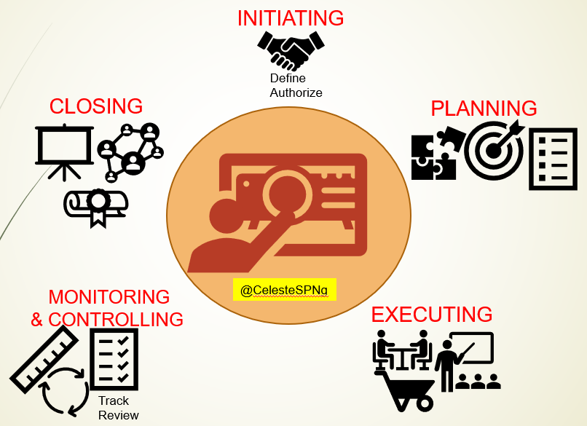
Project Management Process Groups: Outputs (for your project)
Project Charter
Stakeholder Register
Stakeholder Management Strategy
Business Case
Project Management Plan
>>Team Contract
>> List of Prioritized Risks
Lesson Learnt
Final Project Report
Milestone Reports
Performance Report
Change Request
Source:

Slide 11
Project Management Knowledge Area (1)
What?: PITTO
A Knowledge Area is an identified area of project management defined by its knowledge requirements and described in terms of its component processes, practices, inputs, outputs, tools, and techniques.知識要求描述為 PITTO
The ten Knowledge Areas described in this guide are:
1. Project Integration Management. Includes the processes and activities to identify, define, combine, unify, and coordinate the various processes and project management activities within the Project Management Process Groups. (統一、協調各個流程&專案管理活動)
2. Project Scope Management. Includes the processes required to ensure the project includes all the [project] work required, and only the work required, to complete the project successfully.
Knowledge areas
processes
practices
inputs
outputs
tools
techniques
More
Source: PMI, 2017, “A guide to the project management body of knowledge (PMBOK guide),” Sixth edition, Newtown Square, PA: Project Management Institute, Inc.

Slide 12
Project Management Knowledge Area (2)
Knowledge areas
What?: PITTO
The ten Knowledge Areas described in this guide are (continued):
3. Project Schedule Management. Includes the processes required to manage the timely completion of the project.
4. Project Cost Management. Includes the processes involved in planning, estimating, budgeting, financing, funding, managing, and controlling costs so the project can be completed within the approved budget.
5. Project Quality Management. Includes the processes for incorporating the organization’s quality policy regarding planning, managing, and controlling project and product quality requirements, in order to meet stakeholders’ expectations.
6. Project Resource Management. Includes the processes to identify, acquire, and manage the resources needed for the successful completion of the project.
Obj: PEMC
Source: PMI, 2017, “A guide to the project management body of knowledge (PMBOK guide),” Sixth edition, Newtown Square, PA: Project Management Institute, Inc.

Slide 13
Project Management Knowledge Area (3)
What?: PITTO
Obj: PEMC
Knowledge areas
The ten Knowledge Areas described in this guide are (continued):
7. Project Communications Management. Includes the processes required to ensure timely and appropriate planning, collection, creation, distribution, storage, retrieval, management, control, monitoring, and ultimate disposition of project information .
8. Project Risk Management. Includes the processes of conducting risk management planning, identification, analysis, response planning, response implementation, and monitoring risk on a project.
9. Project Procurement Management. Includes the processes necessary to purchase or acquire products, services, or results needed from outside the project team.
10. Project Stakeholder Management. Includes the processes required to identify the people, groups, or organizations that could impact or be impacted by the project, to analyze stakeholder expectations and their impact on the project, and to develop appropriate management strategies for effectively engaging stakeholders in project decisions and execution.
More
Source: PMI, 2017, “A guide to the project management body of knowledge (PMBOK guide),” Sixth edition, Newtown Square, PA: Project Management Institute, Inc.

Slide 14
Project Management Process Groups and Knowledge Areas Mapping (1)
There are processes from each knowledge area under the “planning” and “monitoring and controlling” process groups.
“planning”
“monitoring and controlling”
Source: PMI, 2017, “A guide to the project management body of knowledge (PMBOK guide),” Sixth edition, Newtown Square, PA: Project Management Institute, Inc.

Slide 15
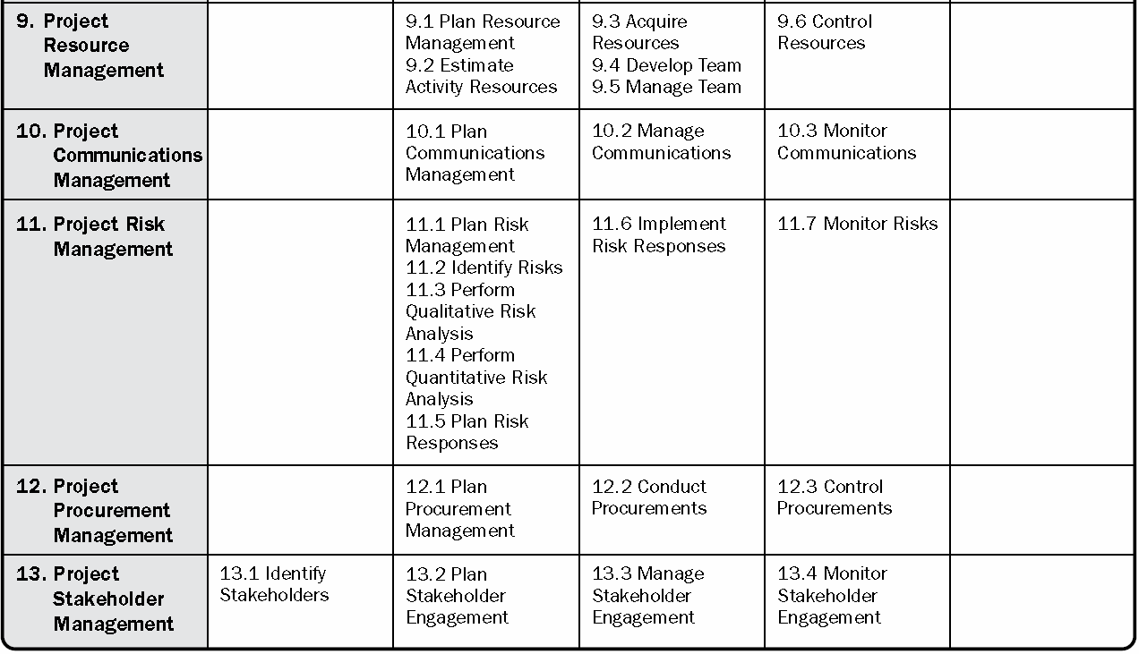
Project Management Process Groups and Knowledge Areas Mapping (2)
“Initiating” process group = 2 processes
“Planning” process group = 24 processes
“Executing” process group = 10 processes
“Monitoring and controlling” process groups = 12 processes
“Closing” process group = 1 process
Source: PMI, 2017, “A guide to the project management body of knowledge (PMBOK guide),” Sixth edition, Newtown Square, PA: Project Management Institute, Inc.

Slide 16
Recap today’s lecture – Summary
Describe the five project management process groups專案管理流程群組, the typical activity for each, and the interactions連接/互動 among them
Understand the project management knowledge areas知識領域
Understand how the project management process groups relate to the project management knowledge areas專案管理流程群組知識領域關聯

Slide 17
PMBOK® Guide Key Components in Projects
Project life cycle
Project phase
Phase gate
Process groups
Back
Source: PMI, 2017, “A guide to the project management body of knowledge (PMBOK guide),” Sixth edition, Newtown Square, PA: Project Management Institute, Inc.

Slide 18
1. Project Initiation (1)
Initiating啟動 a project includes recognizing確認 and starting a new project or project phase
The main goal is to formally select and start off projects
Table 3-3 shows the project initiation knowledge areas, processes, and outputs
Develop project charter: 制定專案章程
Stakeholder :利害相關者
Stakeholder register:利害關係人記錄
Next

Slide 19
1. Project Charter: An Example
Source: https://everhour.com/blog/project-charter/

Slide 20
1. Project Initiation (2): Stakeholder Register
Position:職務
Project Role:專案角色
Stakeholder register:利害關係人記錄
Back

Slide 21
1. Project Initiation (3): Stakeholder Management Strategy策略
Contents are often sensitive, so do not publish this document.
Back

Slide 22
1. Business Case: An Example
Source: https://www.knowledgetrain.co.uk/business-analysis/business-analyst-course/how-to-write-a-business-case
Back

Slide 23
2. Project Planning (1)
The main purpose of project planning規劃 is to guide execution指導(專案的)執行
Every knowledge area includes planning information (see Table 3-7 on pages 101-102)
Key outputs主要產出 included in the JWD project include:
Project Management Plan
A team contract契約
A project scope statement專案範疇說明書
A work breakdown structure (WBS)工作分解結構
A project schedule專案進度表, in the form of a Gantt chart 甘特圖with all dependencies附屬物 and resources entered
A list of prioritized risks風險優先排序(part of a risk register)
Etc. ……..
Outputs
Back

Slide 24
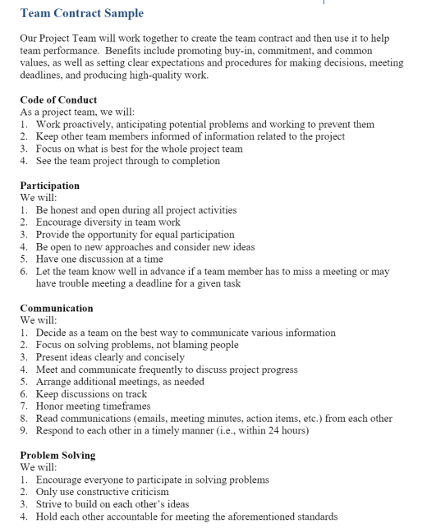
2. Contracts
Source: https://www.michaelkaechele.com/effective-group-contracts-in-pbl/
Source: https://studylib.net/doc/15812666/team-contract-sample

Slide 25
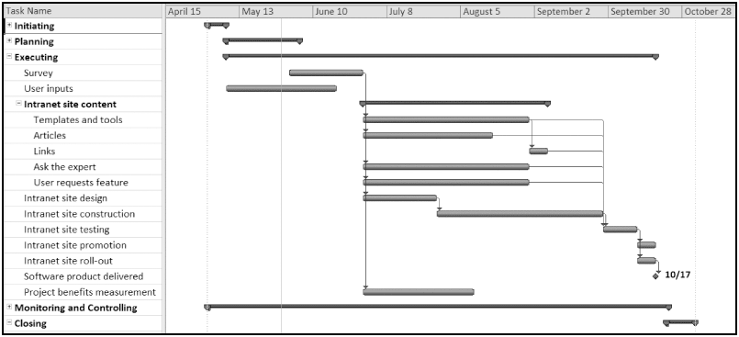
2. Project Planning (2): JWD Consulting Intranet Site Project Baseline Gantt Chart內部網站專案基準線甘特圖
Back

Slide 26
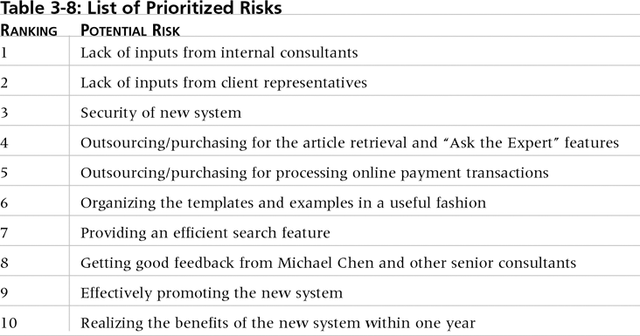
2. Project Planning (3): List of Prioritized Risks風險優先排序
Inputs:輸入
Client representatives:客戶代表
Outsourcing: 委外
Templates:範本
Example:舉例
Search feature:搜尋功能
Promoting:推廣
Back

Slide 27
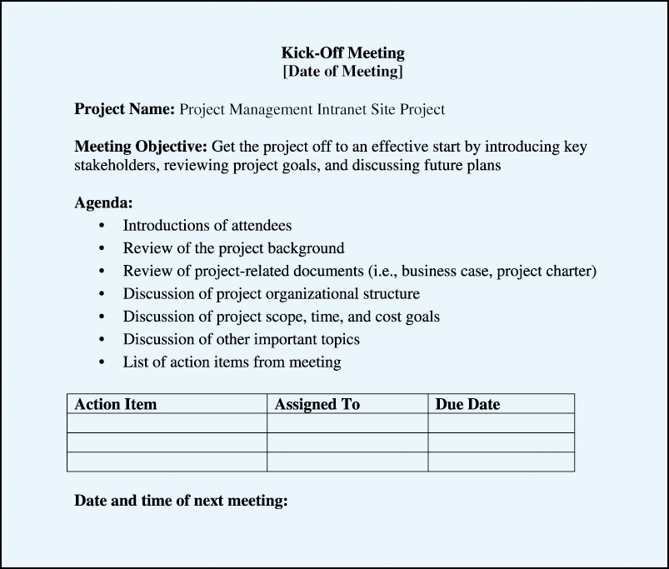
2. Project Planning (4): Kick-off Meeting Agenda專案啟動會議議程 [after planning process group]
Back

Slide 28
3. Project Executing專案執行
Usually takes the most time and resources to perform project execution
Project managers must use their leadership skills 領導能力to handle the many challenges挑戰 that occur during project execution
Table 3-11 on p. 111 lists the executing processes and outputs. Many project sponsors and customers focus on deliverables related to providing the products, services, or results desired from the project
Key outputs主要產出: A milestone report里程碑報告(example on pp. 112-113) can help focus on completing major milestones
Outputs
Back

Slide 29
3. Project Executing: Part of Milestone Report (partial)
Back

Slide 30
4. Project Monitoring and Controlling專案監督和控管
Involves measuring測量 progress toward project objectives, monitoring deviation from the plan監控計畫的偏差, and taking correction actions採取修正動作
Affects all other process groups流程組 and occurs during all phases of the project life cycle所有專案生命週期階段
Key Outputs include performance reports績效報告, change requests, and updates to various plans
Outputs

Slide 31
4. Performance Report
Source: https://www.techno-pm.com/2021/08/performance-reporting-in-project-management.html

Slide 32
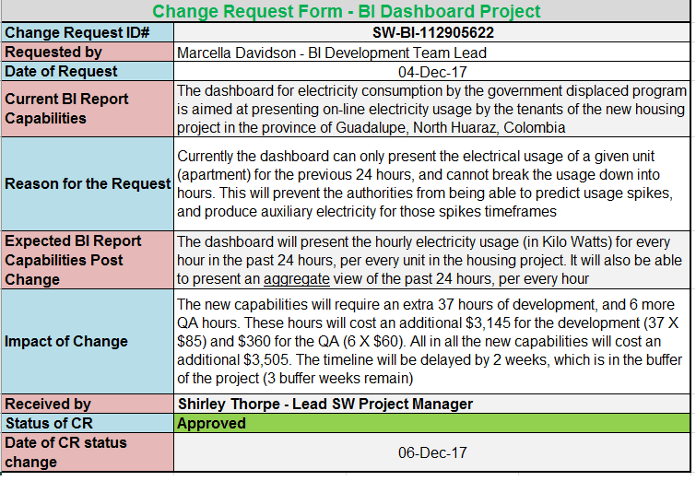
4. Change Request
Source: https://shop.techno-pm.com/blogs/news/change-request-template

Slide 33
5. Project Closing專案收尾
Involves gaining stakeholder and customer acceptance of the final products and services客戶接受最終專案的產品和服務
Even if projects are not completed, they should be closed out to learn from the past
Outputs include project files and lessons-learned reports → part of organizational process assets (吸收經驗的報告 → 組織流程資產)
Most projects also include a final report and presentation to the sponsor/senior management (包括:最後的報告和簡報)
Outputs

Slide 34
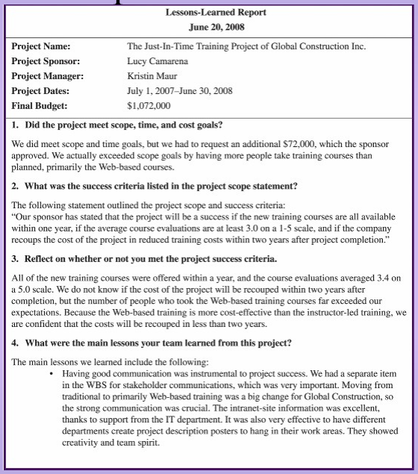
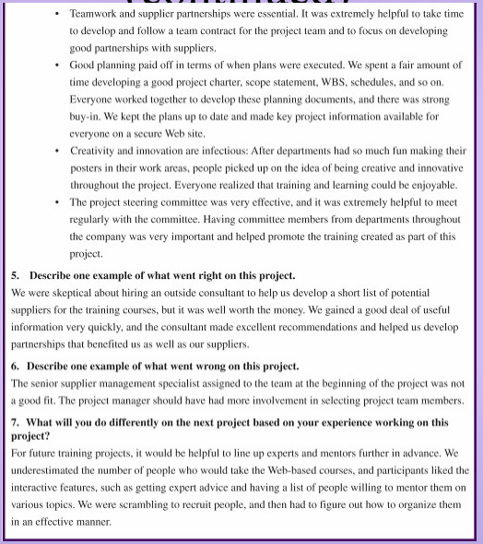
5. Lesson Learnt
Source: https://jrm4.com/FSU_Courses/LIS4910/schwalbe-closeout.pdf

Slide 35
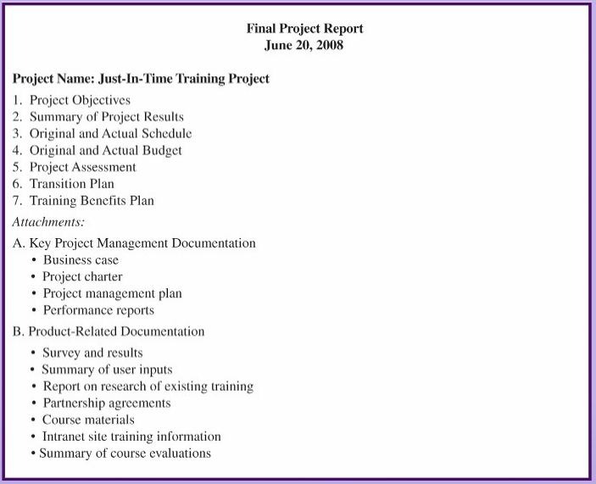
5. Final Project Report
Source: https://jrm4.com/FSU_Courses/LIS4910/schwalbe-closeout.pdf

Slide 36
Project Management Process Groups
INITIATING
Define
Authorize
CLOSING
PLANNING
MONITORING
& CONTROLLING
@CelesteSPNg
EXECUTING
Track
Review
Source:

Slide 37
Project integration management
Project integration management - processes that coordinate all project management knowledge areas throughout a project’s life(在整個專案的生命週期中支援協調所有專案管理知識領域的流程), including:
developing the project charter,
developing the project management plan,
directing and managing the project,
[managing project knowledge ]
monitoring and controlling the project,
providing integrated change control, and
closing the project.
Project integration management
開發專案章程
開發專案管理計劃
管理專案知識
提供專案綜合變更控制
結束專案
Back

Slide 38
Question is …
Back

Slide 39
Project stakeholder management
Project stakeholder management – [processes that]
identify 鑑定 all people or organizations affected by a project,
analyze stakeholder expectations, and
effectively engage吸引參與stakeholders in project decisions throughout the life of a project.
Project stakeholder management
Back

