Slide 1
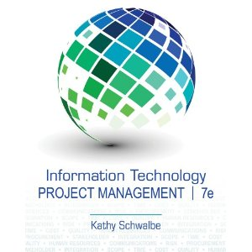
Chapter 4: Project Integration Management
Information Technology Project Management, Seventh Edition
Last modified by Celeste Ng, in March 2022
Note: See the text itself for full citations.

Slide 2
Learning Objectives
Describe an overall framework for project integration management專案整合管理的總體架構
Process & practices,
Inputs,
Outputs,
Tools & techniques

Slide 3
Project Management Process Groups and Knowledge Areas Mapping (1)
Reminder
There are processes from each knowledge area under the “planning” and “monitoring and controlling” process groups.
“planning”
“monitoring and controlling”
Source: PMI, 2017, “A guide to the project management body of knowledge (PMBOK guide),” Sixth edition, Newtown Square, PA: Project Management Institute, Inc.

Slide 4
The Project Integration Management processes are: (1)
開發專案章程
4.1 Develop Project Charter—The process of developing a document that formally authorizes正式批准the existence of a project and provides the project manager with the authority to apply organizational resources to project activities.
4.2 Develop Project Management Plan—The process of defining, preparing, and coordinating all plan components and consolidating them協調所有的規劃工作 into an integrated project management plan.
4.3 Direct and Manage Project Work—The process of leading and performing the work defined in the project management plan and implementing approved changes to achieve the project’s objectives.
4.4 Manage Project Knowledge—The process of using existing knowledge and creating new knowledge to achieve the project’s objectives and contribute to organizational learning.
開發專案管理計畫
指導與管理專案相關的工作
管理專案相關的知識
Source: PMI, 2017, “A guide to the project management body of knowledge (PMBOK guide),” Sixth edition, Newtown Square, PA: Project Management Institute, Inc.

Slide 5
The Project Integration Management processes are: (2)
監控與控制專案相關的工作
4.5 Monitor and Control Project Work—The process of tracking監督, reviewing, and reporting overall progress to meet the performance objectives defined in the project management plan.
4.6 Perform Integrated Change Control—The process of reviewing all change requests; approving changes and managing changes to deliverables, organizational process assets, project documents, and the project management plan; and communicating the decisions.
4.7 Close Project or Phase—The process of finalizing完成 all activities for the project, phase, or contract.
進行整合變更控制
結束專案
Source: PMI, 2017, “A guide to the project management body of knowledge (PMBOK guide),” Sixth edition, Newtown Square, PA: Project Management Institute, Inc.

Slide 6
Source: PMI, 2017, “A guide to the project management body of knowledge (PMBOK guide),” Sixth edition, Newtown Square, PA: Project Management Institute, Inc.

Slide 7
4.1 DEVELOP PROJECT CHARTER (1)
Develop Project Charter—The process of developing a document that formally authorizes正式批准the existence of a project and provides the project manager with the authority to apply organizational resources to project activities.
EEF – “refer to conditions, not under the control of the project team, that influence,
constrain, or direct the project”
Source: PMI, 2017, “A guide to the project management body of knowledge (PMBOK guide),” Sixth edition, Newtown Square, PA: Project Management Institute, Inc.

Slide 8
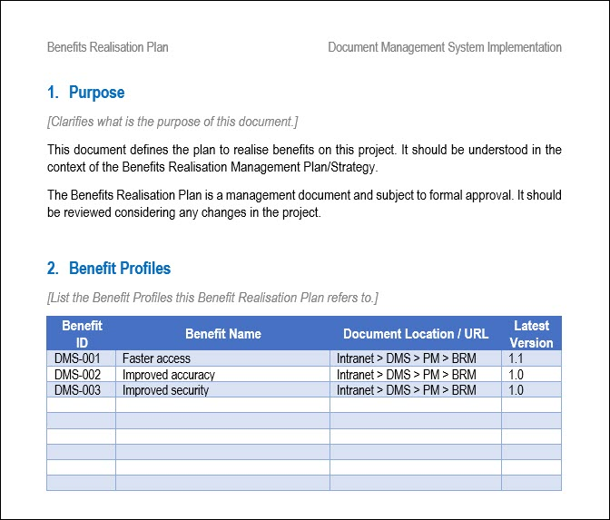
4.1 Benefit Management Plan
Source: https://www.techno-pm.com/2021/08/benefits-realisation-plan.html

Slide 9
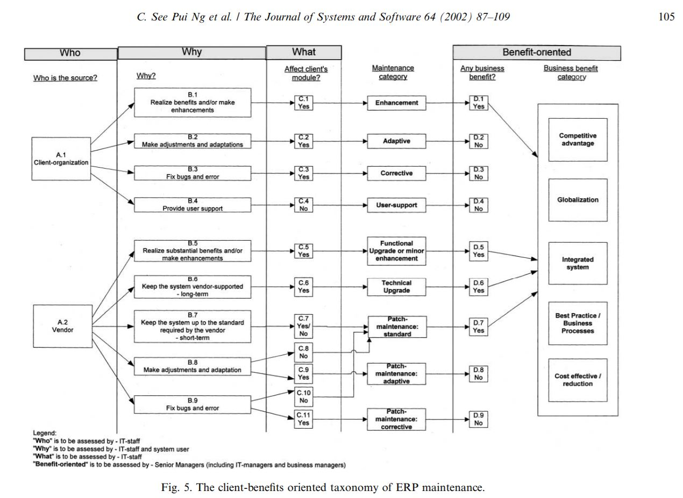
Business “benefits” examples
Source: Ng, C.S.-P., 2013. "An Exploratory Study Of Metrics Used In Measuring The Impacts Of Utilizing Social Networking Services On Business Performance," The 9th International Conference on Knowledge Community, Taipei, Taiwan.
Source: Ng, C.S.-P., G.G. Gable, and T. Chan, 2002. "An ERP-client Benefits-oriented Maintenance Taxonomy." Journal of Systems and Software, 64(2), pp. 87-109, 15 November 2002.

Slide 10
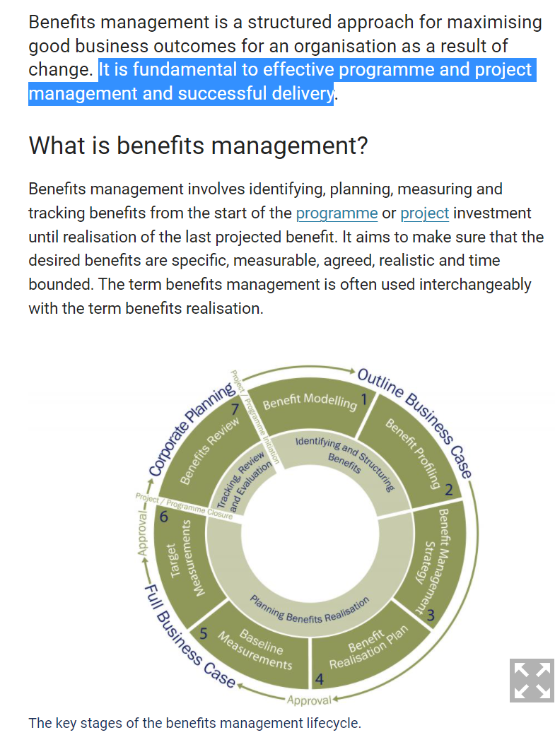
Benefit Management Lifecycle & Relationship in Organization
Source: https://www.pmi.org/learning/library/benefits-realization-management-project-success-9653
Source: https://www.finance-ni.gov.uk/articles/programme-and-project-benefits-management
Source: https://www.finance-ni.gov.uk/articles/programme-and-project-benefits-management

Slide 11
4.1 DEVELOP PROJECT CHARTER (2)
It documents the high-level information on the project and on the product, service, or result the project is intended to satisfy, such as:
Project purpose;
Measurable project objectives and related success criteria;
High-level requirements;
High-level project description, boundaries, and key deliverables;
Overall project risk;
Summary milestone schedule;
Preapproved financial resources;
Key stakeholder list;
Project approval requirements (i.e., what constitutes project success, who decides the project is successful, and
who signs off on the project);
Project exit criteria (i.e., what are the conditions to be met in order to close or to cancel the project or phase);
Assigned project manager, responsibility, and authority level; and
Name and authority of the sponsor or other person(s) authorizing the project charter.
At a high level, the project charter ensures a common understanding by the stakeholders of the key deliverables, milestones, and the roles and responsibilities of everyone involved in the project.
Source: PMI, 2017, “A guide to the project management body of knowledge (PMBOK guide),” Sixth edition, Newtown Square, PA: Project Management Institute, Inc.

Slide 12
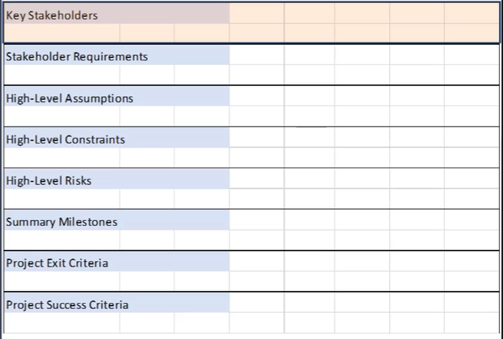
4.1 DEVELOP PROJECT CHARTER (2)
Source: PMP Certification Course from Udemy, 2021

Slide 13
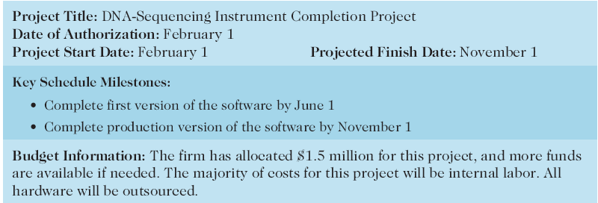
Table 4-1. Project Charter for the DNA-Sequencing Instrument Completion Project

Slide 14
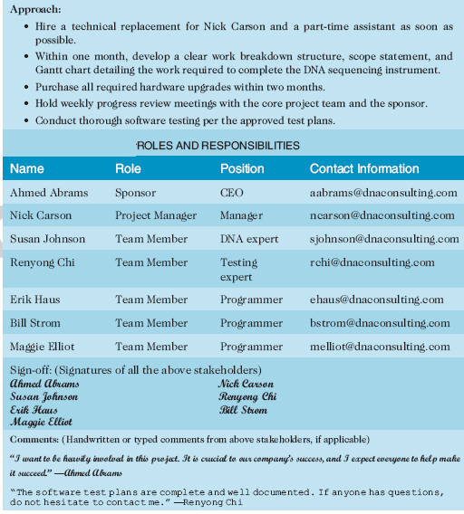
Table 4-1. Project Charter (cont.)

Slide 15
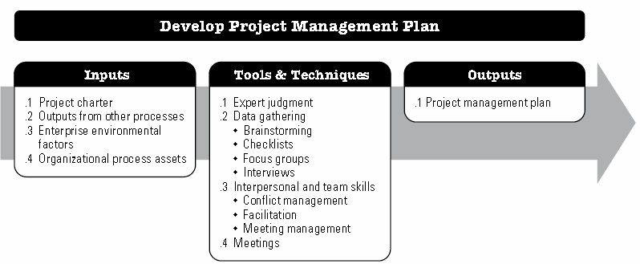
4.2 DEVELOP PROJECT MANAGEMENT PLAN(1)
The key benefit of this process is the production of a comprehensive document that defines the basis of all project work and how the work will be performed.
Source: PMI, 2017, “A guide to the project management body of knowledge (PMBOK guide),” Sixth edition, Newtown Square, PA: Project Management Institute, Inc.

Slide 16
4.2 DEVELOP PROJECT MANAGEMENT PLAN(2)
Source: PMI, 2017, “A guide to the project management body of knowledge (PMBOK guide),” Sixth edition, Newtown Square, PA: Project Management Institute, Inc.

Slide 17
4.2 DEVELOP PROJECT MANAGEMENT PLAN(2) – simplified
Source: PMP Certification Course from Udemy, 2021

Slide 18
4.2 CHANGE MANAGEMENT PLAN
Source: PMP Certification Course from Udemy, 2021

Slide 19
4.2 Scope management plan
Source: PMI, 2017, “A guide to the project management body of knowledge (PMBOK guide),” Sixth edition, Newtown Square, PA: Project Management Institute, Inc.

Slide 20
4.3 DIRECT AND MANAGE PROJECT WORK (1)
The key benefit of this process is that it provides overall management of the project work and deliverables, thus improving the probability of project success.
Source: PMI, 2017, “A guide to the project management body of knowledge (PMBOK guide),” Sixth edition, Newtown Square, PA: Project Management Institute, Inc.

Slide 21
4.3 DIRECT AND MANAGE PROJECT WORK (2)
Source: PMI, 2017, “A guide to the project management body of knowledge (PMBOK guide),” Sixth edition, Newtown Square, PA: Project Management Institute, Inc.

Slide 22
4.3 DIRECT AND MANAGE PROJECT WORK (2) – issue log
Source: PMP Certification Course from Udemy, 2021

Slide 23
4.3 DIRECT AND MANAGE PROJECT WORK (2)
- Overview (up to here)
Source: PMP Certification Course from Udemy, 2021

Slide 24
4.4 MANAGE PROJECT KNOWLEDGE (1)
The key benefits of this process are that prior organizational knowledge is leveraged to produce or improve the project outcomes, and knowledge created by the project is available to support organizational operations and future projects or phases.
Source: PMI, 2017, “A guide to the project management body of knowledge (PMBOK guide),” Sixth edition, Newtown Square, PA: Project Management Institute, Inc.

Slide 25
4.4 MANAGE PROJECT KNOWLEDGE (2)
Source: PMI, 2017, “A guide to the project management body of knowledge (PMBOK guide),” Sixth edition, Newtown Square, PA: Project Management Institute, Inc.

Slide 26
4.4 Lesson Learnt Register
Source: PMP Certification Course from Udemy, 2021

Slide 27
4.5 MONITOR AND CONTROL PROJECT WORK (1)
The key benefits of this process are that it allows stakeholders to understand the current state of the project, to recognize the actions taken to address any performance issues, and to have visibility into the future project status with cost and schedule forecasts.
Source: PMI, 2017, “A guide to the project management body of knowledge (PMBOK guide),” Sixth edition, Newtown Square, PA: Project Management Institute, Inc.

Slide 28
4.5 MONITOR AND CONTROL PROJECT WORK (2)
Source: PMI, 2017, “A guide to the project management body of knowledge (PMBOK guide),” Sixth edition, Newtown Square, PA: Project Management Institute, Inc.

Slide 29
4.5 MONITOR AND CONTROL PROJECT WORK (2)
Source: PMP Certification Course from Udemy, 2021

Slide 30
4.5 Performance Report

Slide 31
4.5 Change Request

Slide 32
4.6 PERFORM INTEGRATED CHANGE CONTROL (1)
The key benefit of this process is that it allows for documented changes within the project to be considered in an integrated manner while addressing overall project risk, which often arises from changes made without consideration of the overall project objectives or plans.
Source: PMI, 2017, “A guide to the project management body of knowledge (PMBOK guide),” Sixth edition, Newtown Square, PA: Project Management Institute, Inc.

Slide 33
4.6 PERFORM INTEGRATED CHANGE CONTROL (2)
Source: PMI, 2017, “A guide to the project management body of knowledge (PMBOK guide),” Sixth edition, Newtown Square, PA: Project Management Institute, Inc.

Slide 34
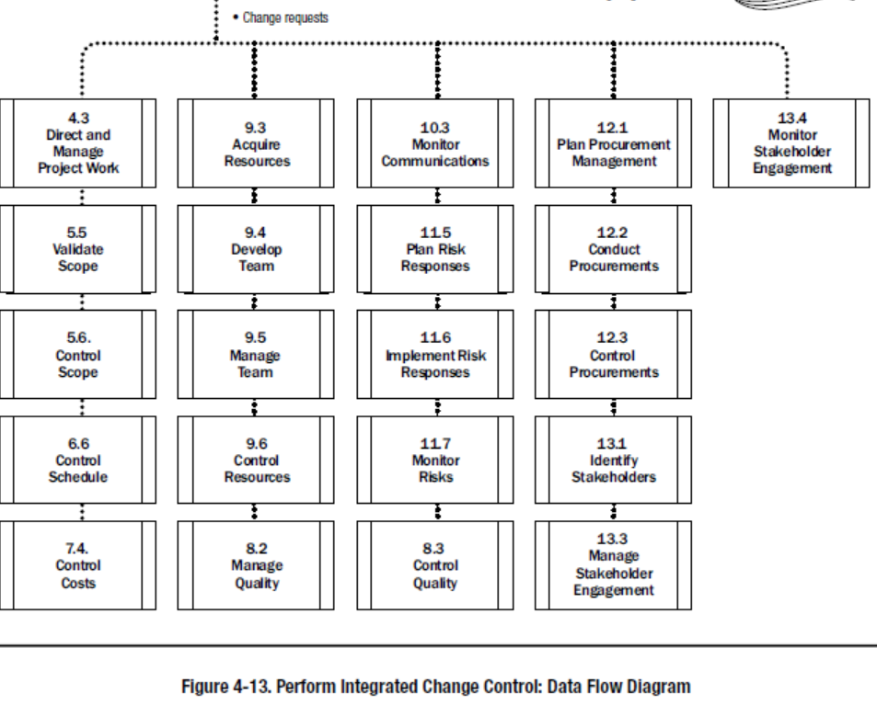
4.6 PERFORM INTEGRATED CHANGE CONTROL (3)
Source: PMI, 2017, “A guide to the project management body of knowledge (PMBOK guide),” Sixth edition, Newtown Square, PA: Project Management Institute, Inc.

Slide 35
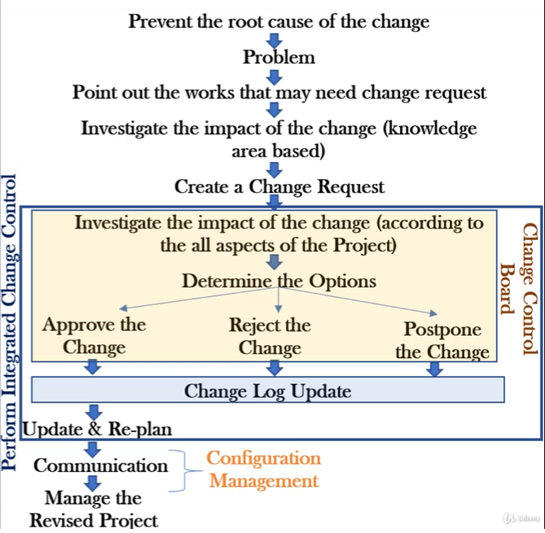
4.6 PERFORM INTEGRATED CHANGE CONTROL (4) – simplified
Source: PMP Certification Course from Udemy, 2021

Slide 36
4.7 CLOSE PROJECT OR PHASE (1)
The key benefits of this process are the project or phase information is archived, the planned work is completed, and organizational team resources are released to pursue new endeavors.
Source: PMI, 2017, “A guide to the project management body of knowledge (PMBOK guide),” Sixth edition, Newtown Square, PA: Project Management Institute, Inc.

Slide 37
4.7 CLOSE PROJECT OR PHASE
Source: PMP Certification Course from Udemy, 2021

Slide 38
4.7 CLOSE PROJECT OR PHASE (2)
Source: PMI, 2017, “A guide to the project management body of knowledge (PMBOK guide),” Sixth edition, Newtown Square, PA: Project Management Institute, Inc.

Slide 39
Recap today’s lecture – Summary
Discuss different project selection methods專案選擇方法
Basic idea - SP
Methods – 5
Need – will need $;
Categorizing – POD;
Financial model – NPV, ROI, PBack;
Weighted scoring model
Balanced scorecard
Project integration management involves coordinating all of the other knowledge areas throughout a project’s life cycle. Main processes include:
4.1 Develop Project Charter
4.2 Develop Project Management Plan
4.3 Direct指導 and Manage Project Work
4.4 Manage Project Knowledge
4.5 Monitor and Control Project Work
4.6 Perform Integrated Change Control進行整合變更控制
4.7 Close Project or Phase結束專案

Slide 40
Using Software to Assist in Project Integration Management
Several types of software can be used to assist in project integration management
Documents can be created with word processing文件處理 software
Presentations are created with presentation software簡報軟體
Tracking can be done with spreadsheets表格程式 or databases資料庫
Communication software like e-mail信件 and Web authoring網站編寫 tools facilitate communications
Project management software can pull everything together and show detailed and summarized information
Business Service Management (BSM) tools track the execution of business process flows

Slide 41
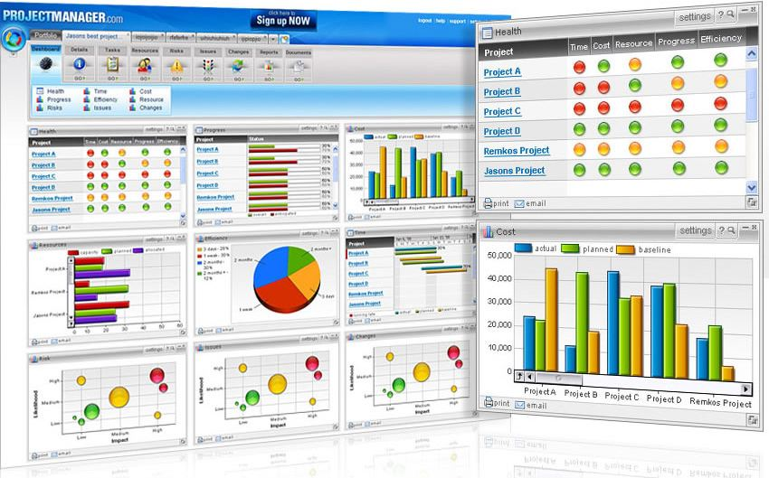
Figure 4-9. Sample Portfolio投資組合Management Software Screen
Source: www.projectmanager.com

