Slide 1
Chapter 7 – Project Cost Management
Direct quotes from source: PMI, 2017, “A guide to the project management body of knowledge (PMBOK guide),” Sixth edition, Newtown Square, PA: Project Management Institute, Inc.
Prepared by: Celeste Ng, 2018

Slide 2
Learning Objectives
Describe an overall framework for project cost management專案時間管理的總體架構
process & practices, inputs, outputs, tools & techniques
7.1 Plan Cost Management
7.2 Estimate Costs
7.3 Determine Budget
7.4 Control Costs
(7.1 Plan Cost Management – Output) – Cost management plan
(7.2 Estimate Costs – Tool) – Analo, Para, 3-point, bottom, data
(7.3 Determine Budget – Output) – Cost baseline
(7.4 Control Costs – Tool) – Data analysis (EVA, VA, TA, RA)

Slide 3
The Project Cost Management processes
Project Cost Management includes the processes involved in planning, estimating, budgeting, financing, funding, managing, and controlling costs so that the project can be completed within the approved budget.
The Project Cost Management processes are:
7.1 Plan Cost Management—The process of defining how the project costs will be estimated, budgeted, managed, monitored, and controlled.
7.2 Estimate Costs—The process of developing an approximation of the monetary resources needed開發所需的金錢資源的近似值to complete project work.
7.3 Determine Budget—The process of aggregating the estimated costs of individual activities or work packages to establish an authorized cost baseline (基準).
7.4 Control Costs—The process of monitoring the status of the project to update the project costs and manage changes to the cost baseline.
Source: PMI, 2017, “A guide to the project management body of knowledge (PMBOK guide),” Sixth edition, Newtown Square, PA: Project Management Institute, Inc.

Slide 4
Project Cost Management Overview
Source: PMI, 2017, “A guide to the project management body of knowledge (PMBOK guide),” Sixth edition, Newtown Square, PA: Project Management Institute, Inc.

Slide 5
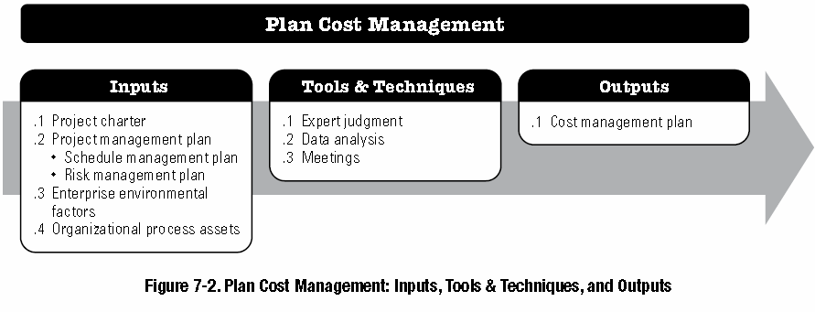
7.1 PLAN COST MANAGEMENT (1)
The key benefit of this process is that it provides guidance and direction指導和方向 on how the project costs will be managed throughout the project.
Source: PMI, 2017, “A guide to the project management body of knowledge (PMBOK guide),” Sixth edition, Newtown Square, PA: Project Management Institute, Inc.

Slide 6
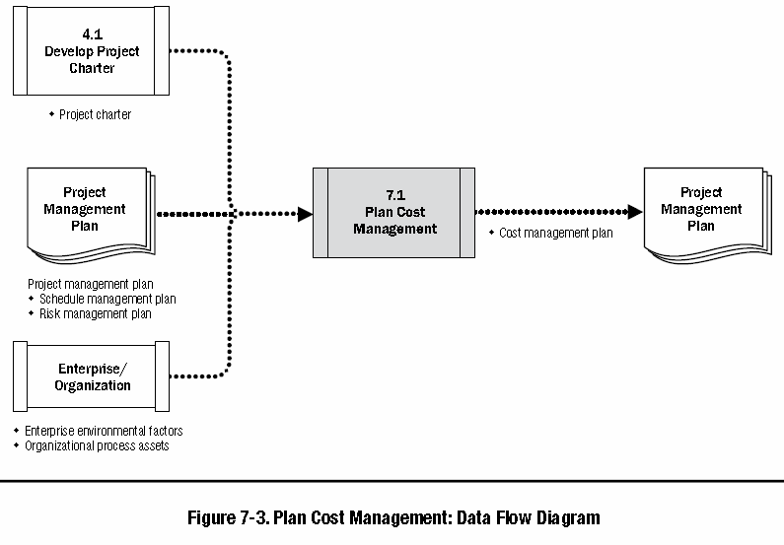
7.1 PLAN COST MANAGEMENT (2)
Enterprise environmental factors :
Organizational culture and structure
Market conditions
Currency exchange rates for project costs
Organizational process assets:
Financial controls procedures
Historical information and lessons learned repository
Financial databases; and
Existing formal and informal cost estimating and budgeting-related policies, procedures, and guidelines.
Source: PMI, 2017, “A guide to the project management body of knowledge (PMBOK guide),” Sixth edition, Newtown Square, PA: Project Management Institute, Inc.

Slide 7
7.1 Output - COST MANAGEMENT Plan
Cost management plan can establish the following:
Units of measure. … such as staff hours, staff days, or weeks for time measures;
Level of precision精確度. … degree to which cost estimates will be rounded up or down (e.g., US$995.59 to US$1,000)
Level of accuracy準確性. The acceptable range (e.g., ±10%) used in determining realistic cost estimates
Description of cost management processes
Control thresholds控制閾值. Variance thresholds差異閾值for monitoring cost performance
Rules of performance measurement. Earned value management (EVM) rules of performance measurement
Reporting formats
Source: PMI, 2017, “A guide to the project management body of knowledge (PMBOK guide),” Sixth edition, Newtown Square, PA: Project Management Institute, Inc.

Slide 8
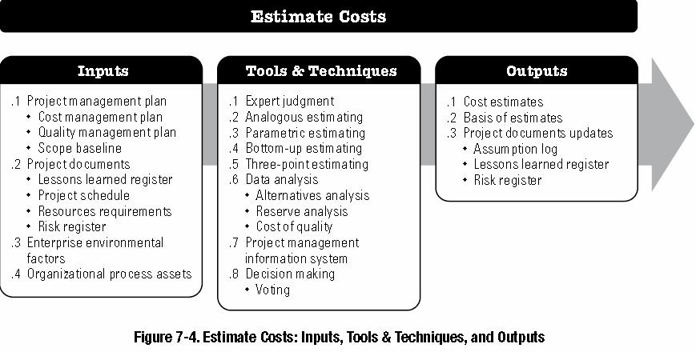
7.2 ESTIMATE COSTS (1)
The key benefit of this process is that it determines the monetary resources required for the project.
Source: PMI, 2017, “A guide to the project management body of knowledge (PMBOK guide),” Sixth edition, Newtown Square, PA: Project Management Institute, Inc.

Slide 9
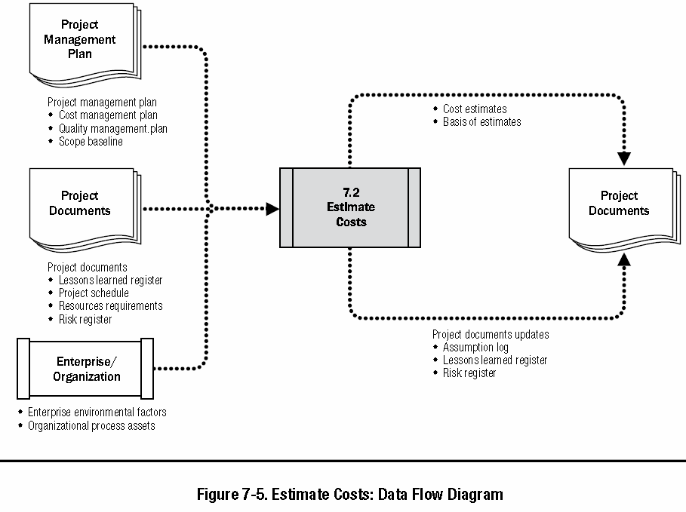
7.2 ESTIMATE COSTS (2)
Enterprise environmental factors :
- Market conditions. … Regional and/or global supply and demand conditions greatly influence resource costs.
- Published commercial information. Resource cost rate information is often available from commercial databases that track skills and human resource costs, and provide standard costs for material and equipment.
- Exchange rates and inflation.
Organizational process assets:
- Cost estimating policies,
- Cost estimating templates,
- Historical information and lessons learned repository.
Source: PMI, 2017, “A guide to the project management body of knowledge (PMBOK guide),” Sixth edition, Newtown Square, PA: Project Management Institute, Inc.

Slide 10
7.2 ESTIMATE COSTS (3)
The accuracy of a project estimate will increase as the project progresses through the project life cycle. For example,
A project in the initiation phase may have a rough order of magnitude (ROM) estimate粗略的數量級（ROM）估計in the range of −25% to +75%.
In the middle of the project, budget estimates -- could narrow the range of accuracy to −10% to +25%.
Later in the project, as more information is known, definitive estimates確定的估計could narrow the range of accuracy to −5% to +10%.
Costs are estimated for all resources that will be charged to the project. This includes but is not limited to
labor, materials, equipment, services, and facilities, as well as
special categories such as an inflation allowance通貨膨脹津貼, cost of financing, or contingency costs應急成本.
Source: PMI, 2017, “A guide to the project management body of knowledge (PMBOK guide),” Sixth edition, Newtown Square, PA: Project Management Institute, Inc.

Slide 11
7.2 TOOLS AND TECHNIQUES (1)
(1) ANALOGOUS ESTIMATING:
Analogous estimating is a technique for estimating the duration or cost of an activity or a project using historical data from a similar activity or project.
Analogous duration estimating is frequently used to estimate project cost when there is a limited amount of detailed information about the project.
Analogous estimating is generally less costly and less time-consuming than other techniques, but it is also less accurate.
(2) PARAMETRIC ESTIMATING參數化模型:
Parametric estimating is an estimating technique in which an algorithm is used to calculate cost or duration based on historical data and project parameters.
This technique can produce higher levels of accuracy depending on the sophistication and underlying data built into the model.
Parametric schedule estimates can be applied to a total project or to segments of a project, in conjunction with other estimating methods.
Source: PMI, 2017, “A guide to the project management body of knowledge (PMBOK guide),” Sixth edition, Newtown Square, PA: Project Management Institute, Inc.

Slide 12
7.2 TOOLS AND TECHNIQUES (2)
(3) THREE-POINT ESTIMATING:
The accuracy of single-point cost estimates may be improved by considering estimation uncertainty and risk.
Using three-point estimates helps define an approximate range for an activity’s cost:
Most likely (cM). The cost of the activity, based on realistic effort assessment for the required work and an predicted expenses.
Optimistic (cO). The cost based on analysis of the best-case scenario for the activity.
Pessimistic (cP). The cost based on analysis of the worst-case scenario for the activity.
Depending on the assumed distribution假定分佈of values within the range of the three estimates, the expected cost, cE, can be calculated. One commonly used formula is triangular distribution:
cE = (cO + cM + cP) / 3.
Triangular distribution is used when there is insufficient historical data or when using judgmental data. Cost estimates based on three points with an assumed distribution假定分佈provide an expected cost and clarify the range of uncertainty around the expected cost.
Source: PMI, 2017, “A guide to the project management body of knowledge (PMBOK guide),” Sixth edition, Newtown Square, PA: Project Management Institute, Inc.

Slide 13
7.2 TOOLS AND TECHNIQUES (3)
(4) BOTTOM-UP ESTIMATING:
Bottom-up estimating is a method of estimating project duration or cost by aggregating the estimates of the lower level components of the WBS
(5) DATA ANALYSIS - Reserve analysis儲備分析
Cost estimates may include contingency reserves (sometimes called contingency allowances) to account for cost uncertainty. Contingency reserves are the budget within the cost baseline that is allocated for identified risks.
Contingency reserves應急儲備 are often viewed as the part of the budget intended to address the known unknowns that can affect a project.
For example, rework for some project deliverables could be anticipated, while the amount of this rework is unknown.
Contingency reserves may be estimated to account for this unknown amount of rework.
Source: PMI, 2017, “A guide to the project management body of knowledge (PMBOK guide),” Sixth edition, Newtown Square, PA: Project Management Institute, Inc.

Slide 14
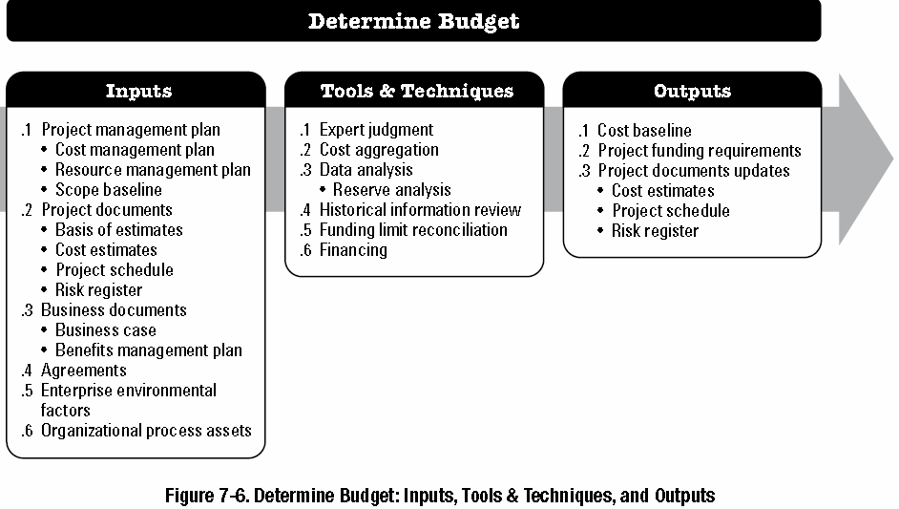
7.3 DETERMINE BUDGET (1)
The key benefit of this process is that it determines the cost baseline against which project performance can be monitored and controlled.
Source: PMI, 2017, “A guide to the project management body of knowledge (PMBOK guide),” Sixth edition, Newtown Square, PA: Project Management Institute, Inc.

Slide 15
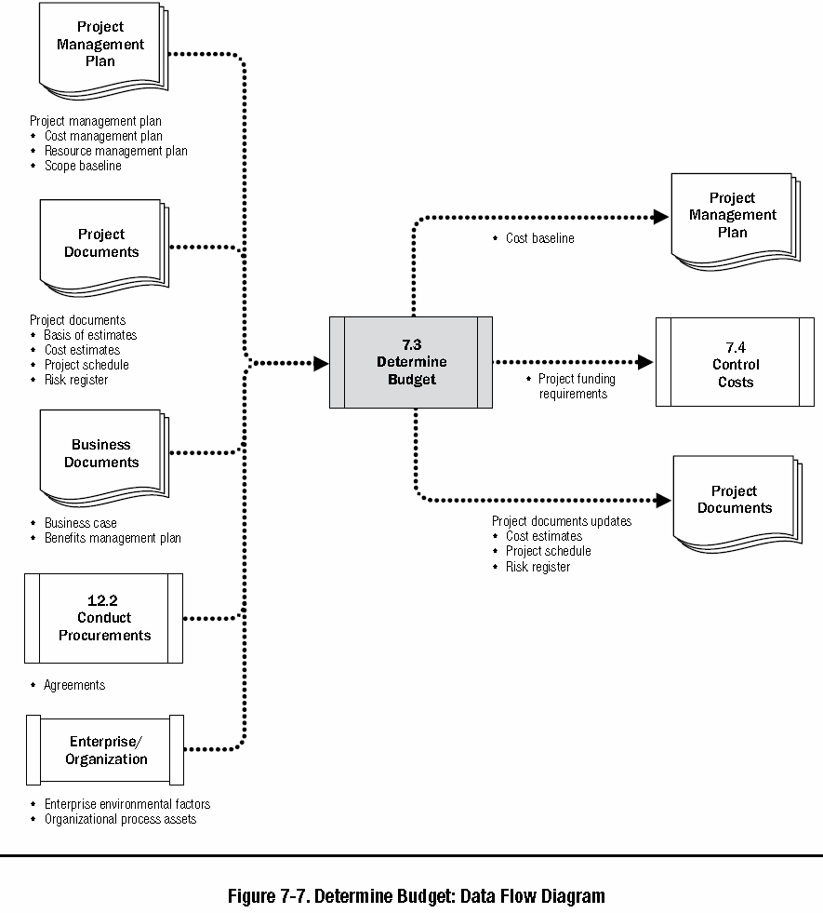
7.3 DETERMINE BUDGET (2)
Source: PMI, 2017, “A guide to the project management body of knowledge (PMBOK guide),” Sixth edition, Newtown Square, PA: Project Management Institute, Inc.

Slide 16
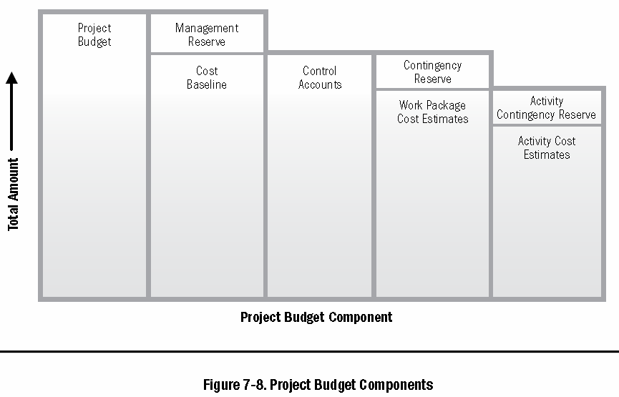
7.3 Output – cost baseline
Cost estimates for the various project activities, along with any contingency reserves (see Section 7.2.2.6) for these activities, are aggregated into their associated
work package costs. The work package cost estimates, along with any contingency reserves estimated for the work packages, are aggregated into
control accounts. The summation of the control accounts make up the
cost baseline.
Source: PMI, 2017, “A guide to the project management body of knowledge (PMBOK guide),” Sixth edition, Newtown Square, PA: Project Management Institute, Inc.

Slide 17
7.3 Output – cost baseline

Slide 18
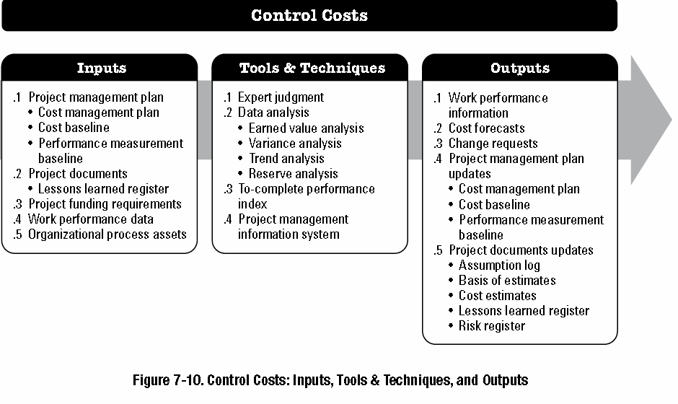
7.4 CONTROL COSTS (1)
The key benefit of this process is that the cost baseline is maintained成本基準得以維持throughout the project.
Source: PMI, 2017, “A guide to the project management body of knowledge (PMBOK guide),” Sixth edition, Newtown Square, PA: Project Management Institute, Inc.

Slide 19
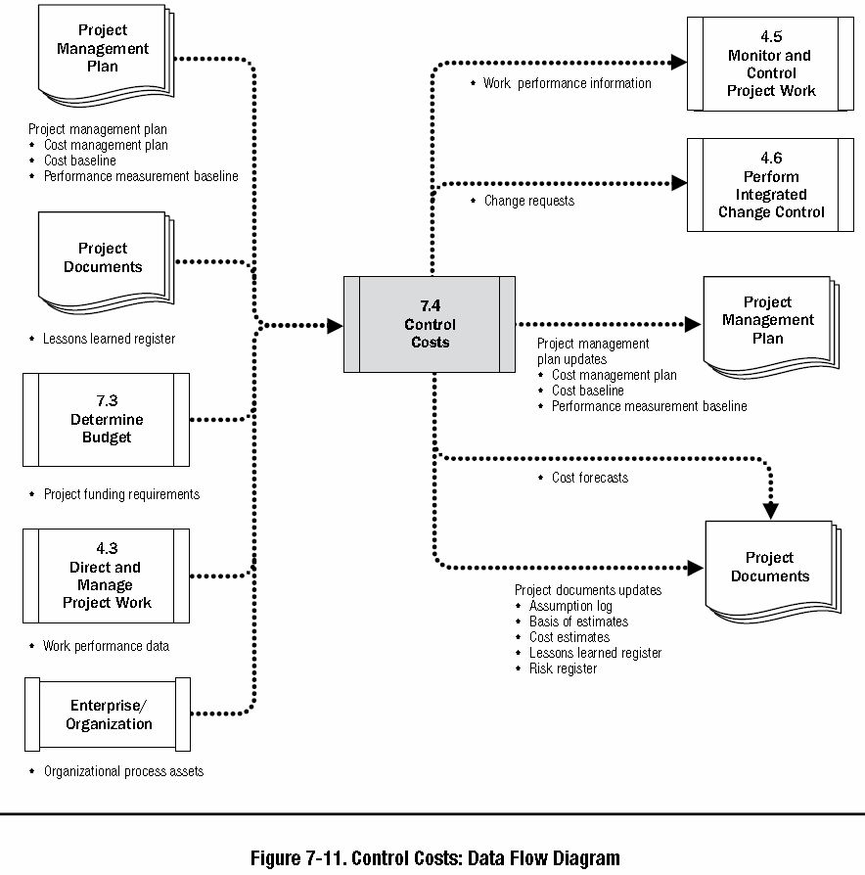
7.4 CONTROL COSTS (2)
The Schedule Forecasts are prepared as a result of the Control Schedule process
The Cost Forecasts are prepared as a result of the Control Cost process
Source: PMI, 2017, “A guide to the project management body of knowledge (PMBOK guide),” Sixth edition, Newtown Square, PA: Project Management Institute, Inc.

Slide 20
7.4 TOOLS AND TECHNIQUES – EVA
Earned value analysis (EVA). Earned value analysis compares the performance measurement baseline to the actual schedule and cost performance.
EVM develops and monitors three key dimensions for each work package and control account:
Planned value (PV)計畫值- is the authorized budget assigned to scheduled work. It is the authorized budget planned for the work to be accomplished安排好工作的預算成本for an activity or work breakdown structure (WBS) component, not including management reserve. The total of the PV is sometimes referred to as the performance measurement baseline (PMB). The total planned value for the project is also known as budget at completion (BAC).
Earned value (EV)實獲值is a measure of work performed expressed in terms of the budget authorized for that work實際完成工作的預算成本. It is the budget associated with the authorized work that has been completed. The EV is often used to calculate the percent complete of a project.
Actual cost (AC) is the realized cost incurred for the work performed完成工作的實際成本on an activity during a specific time period. It is the total cost incurred in accomplishing the work that the EV measured.
Source: PMI, 2017, “A guide to the project management body of knowledge (PMBOK guide),” Sixth edition, Newtown Square, PA: Project Management Institute, Inc.

Slide 21
7.4 TOOLS AND TECHNIQUES – VA (1)
Variance analysis, as used in EVM, is the explanation for cost (CV = EV – AC), schedule (SV = EV – PV), and variance at completion (VAC = BAC – EAC) variances.
Schedule variance (SV) is a measure of schedule performance expressed as the difference between the earned value and the planned value. It is the amount by which the project is ahead or behind the planned delivery date, at a given point in time. It is a measure of schedule performance on a project. Equation: SV = EV – PV
Cost variance (CV) is the amount of budget deficit or surplus at a given point in time, expressed as the difference between earned value and the actual cost. It is a measure of cost performance on a project. It is equal to the earned value (EV) minus the actual cost (AC).
The CV is particularly critical because it indicates the relationship of physical performance to the costs spent. Negative CV is often difficult for the project to recover. Equation: CV = EV – AC.
Source: PMI, 2017, “A guide to the project management body of knowledge (PMBOK guide),” Sixth edition, Newtown Square, PA: Project Management Institute, Inc.

Slide 22
7.4 TOOLS AND TECHNIQUES – VA (2)
Variance analysis, as used in EVM, is the explanation for cost (CV = EV – AC), schedule (SV = EV – PV), and variance at completion (VAC = BAC – EAC) variances.
Schedule performance index (SPI) is a measure of schedule efficiency expressed as the ratio of earned value to planned value. It measures how efficiently the project team is accomplishing the work.
An SPI value less than 1.0 indicates less work was completed than was planned. An SPI greater than 1.0 indicates that more work was completed than was planned. Since the SPI measures all project work, the performance on the critical path also needs to be analyzed to determine whether the project will finish ahead of or behind its planned finish date. The SPI is equal to the ratio of the EV to the PV. Equation: SPI = EV/PV.
Cost performance index (CPI) is a measure of the cost efficiency of budgeted resources, expressed as a ratio of earned value to actual cost.
A CPI value of less than 1.0 indicates a cost overrun for work completed. A CPI value greater than 1.0 indicates a cost underrun of performance to date. The CPI is equal to the ratio of the EV to the AC. Equation: CPI = EV/AC
Source: PMI, 2017, “A guide to the project management body of knowledge (PMBOK guide),” Sixth edition, Newtown Square, PA: Project Management Institute, Inc.

Slide 23
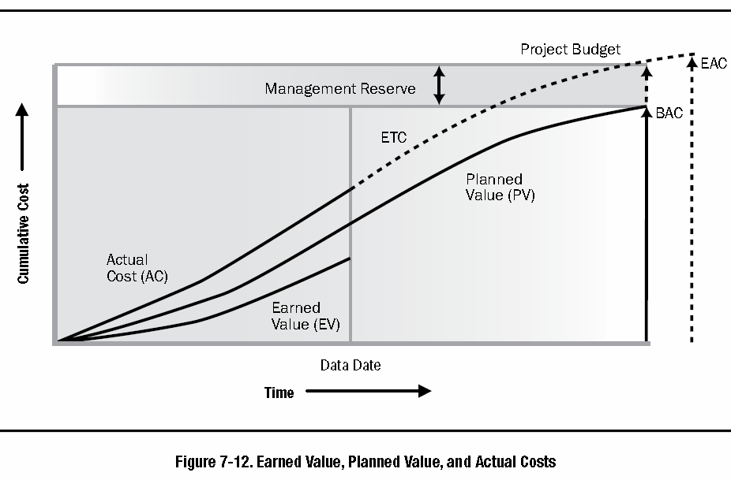
7.4 TOOLS AND TECHNIQUES – TA
Trend analysis examines project performance over time to determine if performance is improving or deteriorating.
Graphical analysis techniques are valuable for understanding performance to date and for comparison to future performance goals in the form of BAC versus estimate at completion (EAC) and completion dates.
Examples of the trend analysis techniques include but are not limited to: Charts, forecasting
Source: PMI, 2017, “A guide to the project management body of knowledge (PMBOK guide),” Sixth edition, Newtown Square, PA: Project Management Institute, Inc.

Slide 24
7.4 TOOLS AND TECHNIQUES – EVA: formulas
Cost Variance, CV = EV – AC
Schedule Variance, SV = EV – PV
Cost Performance Index, CPI = EV/AC
Schedule Performance Index, SPI = EV/PV
BAC is estimated at the very beginning of the project; but, EAC is at any time during the project execution.
Estimate at Completion, EAC:
1. EAC = BAC/CPI
2. EAC = AC + (BAC – EV)
3. EAC = AC + (BAC – EV)/ (CPI x SPI)
4. EAC = AC + New Cost Estimation
Smaller TCPI – high probability of completion within budget; a “future performance”
To-Complete Performance Index, TCPI
TCPI = (BAC – EV)/(BAC – AC) ---- (the CPI rate to complete the project within the original budget)
Estimate to Complete, ETC:
ETC = EAC – AC ---- (money spent until the forecasted budget is reached, by the end of the project)
If an CPI is negative (=not good!); then we need the future cost performance,
TCPI value to be greater than 1.
Variance at Completion , VAC:
VAC = BAC – EAC ---- (amount of money spent under or over the budget, by the end of the project)

Slide 25
7.4 TOOLS AND TECHNIQUES
The Schedule Forecasts are prepared as a result of the Control Schedule process
The Cost Forecasts are prepared as a result of the Control Cost process

Slide 26
Recap today’s lecture – Summary
Describe an overall framework for project cost management專案時間管理的總體架構
process & practices, inputs, outputs, tools & techniques
7.1 Plan Cost Management
7.2 Estimate Costs
7.3 Determine Budget
7.4 Control Costs
(7.1 Plan Cost Management – Output) – Cost management plan
(7.2 Estimate Costs – Tool) – Analo, Para, 3-point, bottom, data
(7.3 Determine Budget – Output) – Cost baseline
(7.4 Control Costs – Tool) – Data analysis (EVA, VA, TA, RA)

