Slide 1
Chapter 8: Project Quality Management
Information Technology Project Management, Seventh Edition
Note: See the text itself for full citations.

Slide 2
Learning Objectives
Define project quality management and understand how quality relates to various aspects of IT projects
Understand the tools and techniques for quality control, such as the Seven Basic Tools of Quality, statistical sampling統計抽樣, Six Sigma六標準差, and testing測試
Describe how leadership and the cost of quality, relate to improving quality in IT projects

Slide 3
What Went Wrong?
In 1986, two hospital patients died after receiving fatal doses of radiation from a Therac 25 machine after a software problem caused the machine to ignore calibration data
In one of the biggest software errors in banking history, Chemical Bank mistakenly deducted about $15 million from more than 100,000 customer accounts
In August 2008, the Privacy Rights Clearinghouse stated that more than 236 million data records of U.S. residents have been exposed due to security breaches since January 2005
In March 2012, Consumer Reports listed several recalls on its Web site in less than 10 days, including LED lights overheating, five different models of cars having problems

Slide 4
What Is Project Quality?
The International Organization for Standardization (ISO) defines quality as “the degree to which a set of inherent characteristics fulfils requirements”以其中一組原有特性來滿足要求的程度(ISO9000:2000)
Other experts define quality based on:
Conformance to requirements符合要求 : The project’s processes and products meet written specifications
Fitness for use適用性: A product can be used as it was intended

Slide 5
What Is Project Quality Management?
Project quality management ensures that the project will satisfy the needs for which it was undertaken
Processes include:
1.Planning quality management: Identifying which quality standards are relevant to the project and how to satisfy them; a metric is a standard of measurement指標是測量的標準
2.Performing quality assurance保證: Periodically evaluating overall project performance to ensure the project will satisfy the relevant quality standards
3.Performing quality control: Monitoring specific project results to ensure that they comply with the relevant quality standards

Slide 6
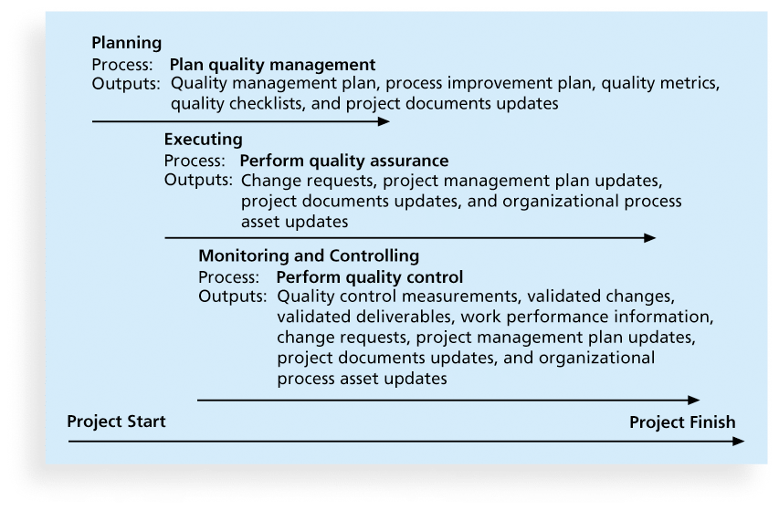
Figure 8-1. Project Quality Management Summary

Slide 7
1.Planning Quality品質規劃
Implies the ability to anticipate situations and prepare actions預測的情況，並準備採取行動to bring about the desired outcome
Important to prevent defects by:
Selecting proper materials合適的資料
Training and indoctrinating訓練 people in quality
Planning a process過程that ensures the appropriate outcome

Slide 8
Scope Aspects of IT Projects
Functionality is the degree to which a system performs 系統績效its intended function
Features are the system’s special characteristics特色that appeal to users
System outputs are the screens and reports the system generates
Performance addresses how well a product or service performs the customer’s intended use客戶的預定用途
Reliability is the ability of a product or service to perform產品或服務來執行的能力as expected under normal conditions
Maintainability addresses the ease of performing maintenance on a product

Slide 9
2.Performing Quality Assurance保證
Quality assurance includes all the activities related to satisfying the relevant quality standards滿足相關的品量標準for a project
Another goal of quality assurance is continuous quality improvement不斷提高服務品質
Benchmarking基準化分析法generates ideas for quality improvements by comparing specific project practices or product characteristics to those of other projects or products within or outside the performing organization
A quality audit品質審計is a structured review of specific具體審查 quality management activities that help identify lessons learned查明取得的經驗that could improve performance on current or future projects

Slide 10
3.Controlling Quality
The main outputs of quality control are:
Acceptance decisions驗收的決定
Rework重做
Process adjustments
There are Seven Basic Tools of Quality品管七大手法that help in performing quality control

Slide 11
(1)Cause-and-Effect Diagrams
Cause-and-effect diagrams trace complaints about quality problems back to the responsible production operations
They help you find the root cause of a problem找到問題的根源
Also known as fishbone or Ishikawa diagrams
Can also use the 5 whys technique使用5個為什麼方法where you repeated ask the question “Why” (five is a good rule of thumb) to peel away the layers of symptoms that can lead to the root cause

Slide 12
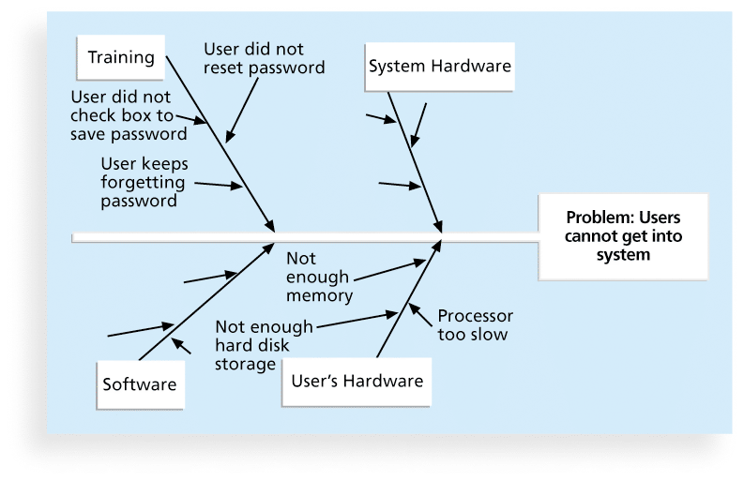
(1)Figure 8-2. Sample Cause-and-Effect Diagram

Slide 13
(2)Quality Control Charts
A control chart控製圖is a graphic display of data that illustrates the results of a process over time在一段時間的結果
The main use of control charts is to prevent defects, rather than to detect or reject them
Quality control charts allow you to determine whether a process is in control or out of control
When a process is in control在控制, any variations任意變化in the results of the process are created by random events透過隨機事件建立; processes that are in control do not need to be adjusted
When a process is out of control不受控制, variation差異s in the results of the process are caused by non-random events由非隨機事件引起; you need to identify the causes of those non-random events and adjust the process to correct or eliminate them

Slide 14
(2)The Seven Run Rule
You can use quality control charts and the seven run rule to look for patterns in data
The seven run rule states that if seven data points in a row如果在連續七個數據點are all below the mean, above the mean, or are all increasing or decreasing, then the process needs to be examined for non-random problems

Slide 15
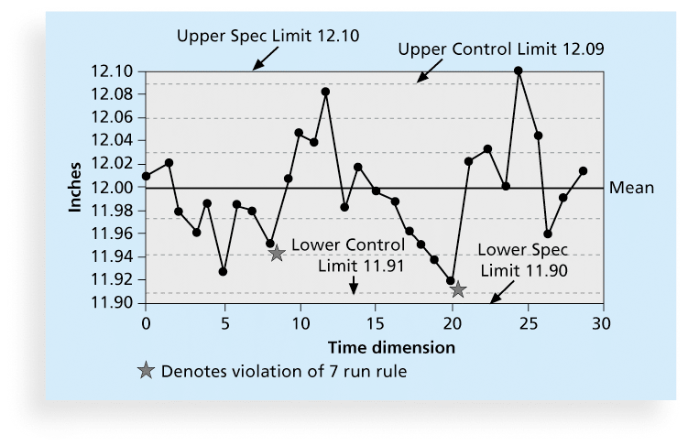
(2)Figure 8-3. Sample Quality Control Chart

Slide 16
(3)Checksheet檢查清單
A checksheet is used to collect and analyze data
It is sometimes called a tally sheet or checklist工作表或清單, depending on its format
In the example in Figure 8-4, most complaints arrive via text message, and there are more complaints on Monday and Tuesday than on other days of the week
This information might be useful in improving the process for handling complaints改善投訴方面的資訊

Slide 17
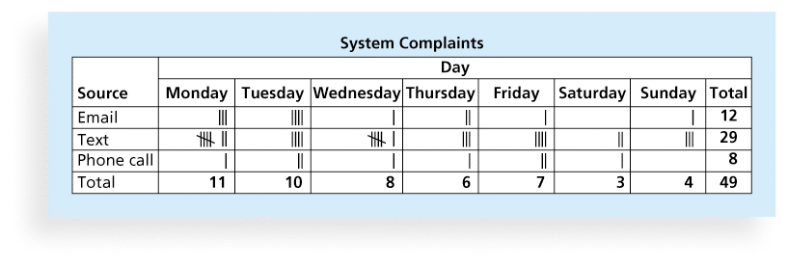
(3)Figure 8-4. Sample Checksheet

Slide 18
(4)Scatter diagram散點圖
A scatter散Sàn點diagram helps to show if there is a relationship between two variables兩個變量之間的關係
The closer data points are to a diagonal line, the more closely the two variables are related

Slide 19
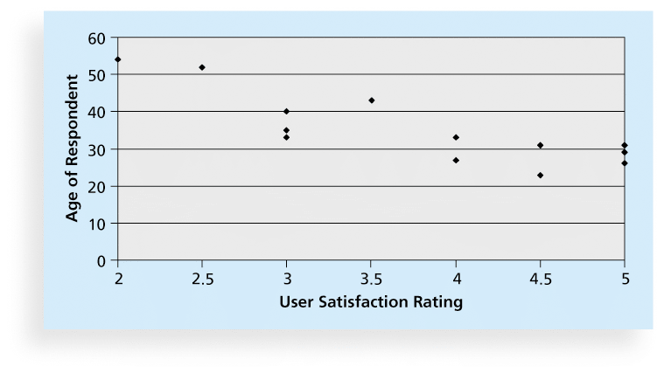
(4)Figure 8-5. Sample Scatter Diagram

Slide 20
(5)Histograms直方圖
A histogram is a bar graph of a distribution of variables變量的分佈
Each bar represents an attribute or characteristic of a problem or situation一個問題的特徵或屬性, and the height of the bar represents its frequency

Slide 21
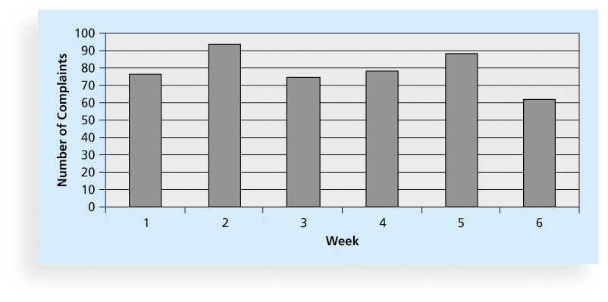
(5)Figure 8-6. Sample Histogram

Slide 22
(6)Pareto Charts
A Pareto chart帕累托圖is a histogram that can help you identify and prioritize problem areas可以幫助您確定和優先問題領域
Pareto analysis is also called the 80-20 rule, meaning that 80 percent of problems are often due to 20 percent of the causes80％的問題往往是由於20％的原因

Slide 23
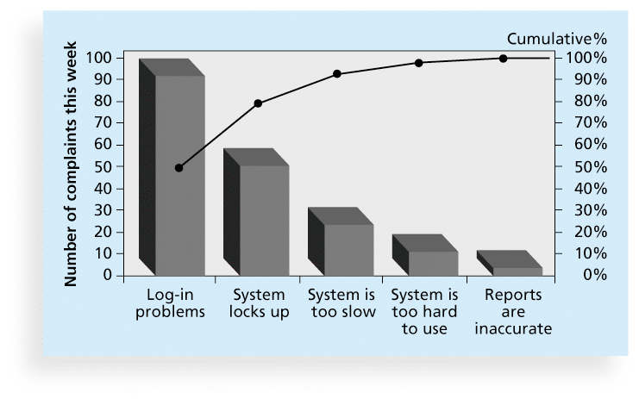
(6)Figure 8-7. Sample Pareto Chart

Slide 24
(7)Flowcharts
Flowcharts流程圖are graphic displays of the logic and flow of processes that help you analyze how problems occur分析如何出現問題and how processes can be improved
They show activities, decision points, and the order of how information is processed

Slide 25
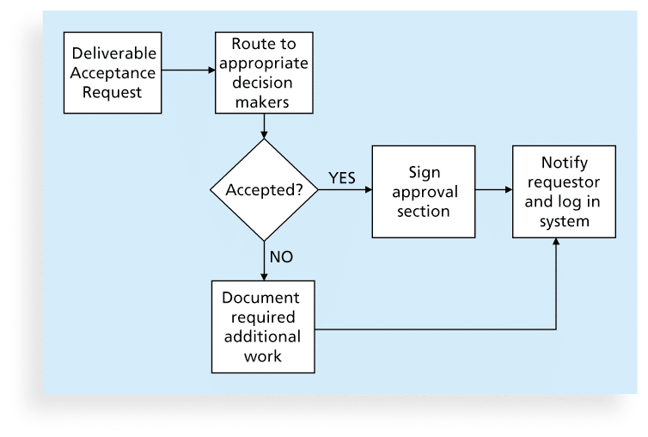
(7)Figure 8-8. Sample Flowchart

Slide 26
(8)Run (Line) Charts
A run chart displays the history and pattern of variation歷史記錄和變異模式of a process over time.
You can use run charts to perform trend analysis and forecast future outcomes圖表進行趨勢分析和預測未來的結果based on historical results

Slide 27
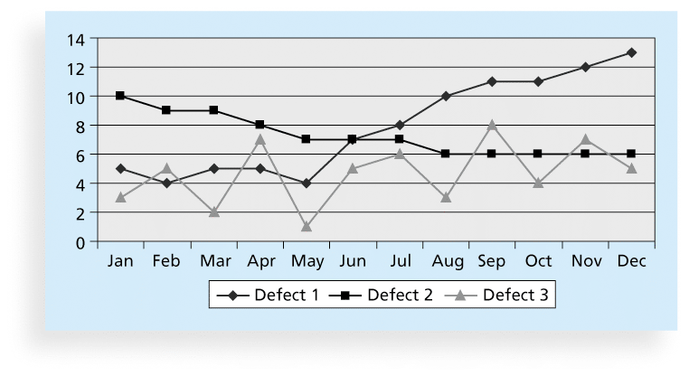
(8)Figure 8-9. Sample Run Chart
Defect 缺點

Slide 28
Testing
Many IT professionals think of testing as a stage that comes near the end of IT product development
Testing should be done during almost every phase of the IT product development life cycle

Slide 29
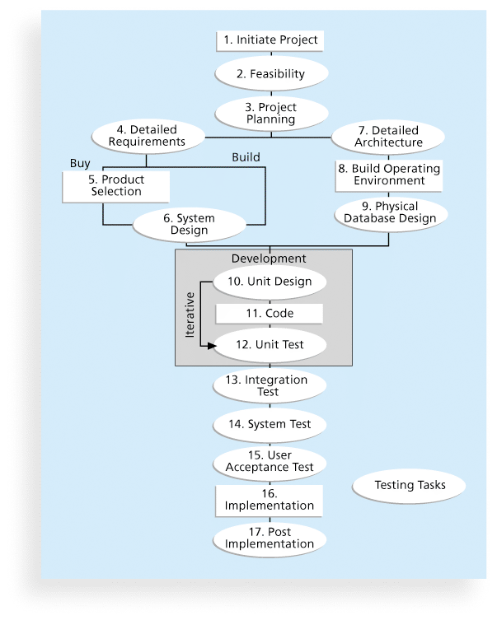
Figure 8-11. Testing Tasks in the Software Development Life Cycle

Slide 30
Types of Tests
Unit testing 單元測試tests each individual component (often a program) to ensure it is as defect-free無缺陷as possible
Integration testing整合測試occurs between unit and system testing to test functionally grouped components
System testing tests the entire system as one entity
User acceptance testing用戶接受度測試is an independent test獨立測試performed by end users prior to accepting the delivered system

Slide 31
Global Issues
Many car manufacturers are proud to show and sell their electric cars (Audi, Cadillac, Chevrolet, etc.), but many people might wonder if these cars are safe
Fortunately, ISO has updated a standard on safety features in electric and hybrid cars油電混合車 to prevent electricity-related injuries用電有關的傷害
ISO 6469-3:2011, Electrically propelled road vehicles電動道路車輛– protection of persons against electric shock觸電事故, will help the global market for electric cars

Slide 32
Improving Information Technology Project Quality
Several suggestions for improving quality for IT projects include:
Establish leadership that promotes quality領導能促進品量
Understand the cost of quality
Focus on organizational influences and workplace factors that affect quality
Follow maturity models

Slide 33
The Cost of Quality
The cost of quality is the cost of conformance plus the cost of nonconformance
Conformance一致性means delivering products that meet requirements and fitness for use
Cost of nonconformance不一致性means taking responsibility for failures or not meeting quality expectations
A study reported that software bugs cost the U.S. economy $59.6 billion each year and that one third of the bugs could be eliminated by an improved testing infrastructure

Slide 34
Five Cost Categories Related to Quality
Prevention cost: Cost of planning and executing a project so it is error-free or within an acceptable error range
Appraisal評價cost: Cost of evaluating processes and their outputs to ensure quality
Internal failure cost: Cost incurred to correct an identified defect before the customer receives the product
External failure cost: Cost that relates to all errors not detected and corrected before delivery to the customer
Measurement and test equipment costs: Capital cost of equipment used to perform prevention and appraisal activities

Slide 35
Chapter Summary
Project quality management ensures that the project will satisfy the needs for which it was undertaken
Main processes include:
Plan quality
Perform quality assurance
Perform quality control

