Slide 1
Chapter 9: Project Human Resource Management
Information Technology Project Management, Seventh Edition
Note: See the text itself for full citations.

Slide 2
Learning Objectives
Define project human resource management and understand its processes
Summarize key concepts for managing people主要概念來管理人員 by understanding the related theories
Discuss human resource management planning and be able to create a human resource plan, project organizational chart專案組織結構圖, responsibility assignment matrix責任分配矩陣, and resource histogram資源直方圖
Understand important issues involved in project staff acquisition工作人員採集and explain the concepts of resource assignments資源分配, resource loading資源負荷, and resource leveling資源調配

Slide 3
The Importance of Human Resource Management
Many corporate executives have said, “People are our most important asset”
People determine the success and failure of organizations and projects

Slide 4
Implications含意for the Future of IT Human Resource Management
Proactive積極organizations are addressing workforce工作人員needs by
improving benefits福利
Redefining重新定義 work hours and incentives獎勵措施
finding future workers

Slide 5
Global Issues
Many people enjoy using Facebook, Twitter, and other social media sites. Some companies even encouraged workers to use these tools. A 2011 survey, however, shows that companies have changed their tune改變原本步調 after realizing that worker productivity often suffers員工工作效率影響due to social media and other distraction
Psychologists have even created a term—Internet addiction disorder網絡成癮Yǐn(IAD)—for the increasingly common addiction to Web-based activity. Many children suffer from this disorder, especially in Asian countries like China, Taiwan, and South Korea

Slide 6
What is Project Human Resource Management?
Making the most effective use of the people involved with a project
Processes include
1. Planning human resource management: identifying and documenting文檔化project roles, responsibilities, and reporting relationships上下級關係
2. Acquiring取得the project team: getting the needed personnel assigned調/指派to and working on the project
3. Developing開發the project team: building individual and group skills發展技能to enhance project performance
4. Managing the project team: tracking team member performance, motivating team members, providing timely feedback 見解, resolving issues and conflicts衝突, and coordinating changes to help enhance project performance

Slide 7
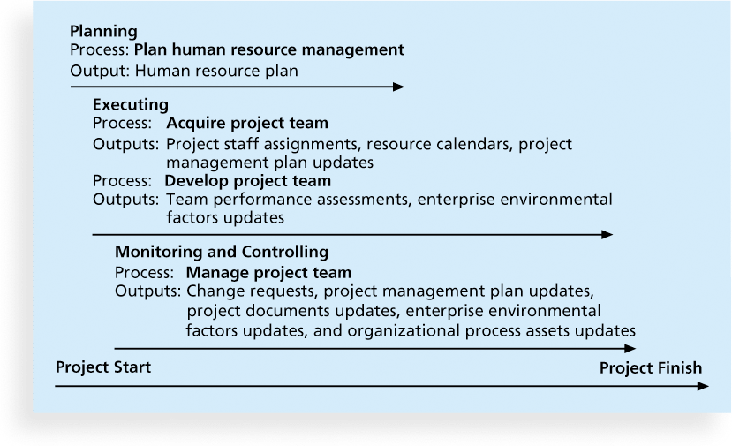
Figure 9-1. Project Human Resource Management Summary
Project staff assignment專案員工分配
Team performance assessment團隊績效評估

Slide 8
Keys to Managing People
Psychologists心理學家and management theorists have devoted much research and thought to the field of managing people at work
Important areas related to project management include
motivation動機theories
influence and power影響力和權力
effectiveness效力

Slide 9
Intrinsic and Extrinsic Motivation動機
How does intrinsic motivation at work differ from extrinsic motivation at work?
Intrinsic內在 motivation causes people to participate in an activity for their own enjoyment自我享受
Extrinsic外在 motivation causes people to do something for a reward or to avoid a penalty獎勵或避免懲罰
For example, some children take piano lessons for intrinsic motivation (they enjoy it) while others take them for extrinsic motivation (to get a reward or avoid punishment)

Slide 10
Maslow’s Hierarchy of Needs馬斯洛的需求層次
Maslow developed a hierarchy of needs which states that people’s behaviors are guided or motivated by a sequence of needs人的行為是由動機需求順序引導的

Slide 11
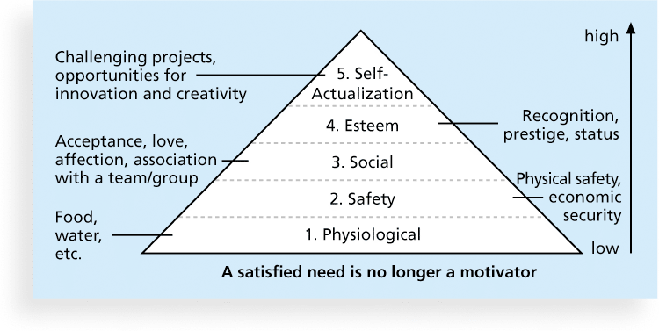
Figure 9-2. Maslow’s Hierarchy of Needs
Self-actualization:自我實踐
Physiological:生理學
Recognition , prestige , status:認同，聲望，地位

Slide 12
Herzberg’s Motivational and Hygiene Factors赫茨伯格的激勵因素和保健因素
What are the two types of factors considered in Frederick Herzberg worker motivation theory?
Frederick Herzberg wrote several famous books and articles about worker motivation. He distinguished between
motivational factors激勵jīlì因素:
produce job satisfaction工作滿意度achievement成就,
Examples include recognition認可, the work itself, responsibility, advancement進步, and growth
hygiene factors保健因素:
cause dissatisfaction引起不滿if not present, but do not motivate workers to do more.
Examples include larger salaries, more supervision監督, and a more attractive work environment更具吸引力的工作環境

Slide 13
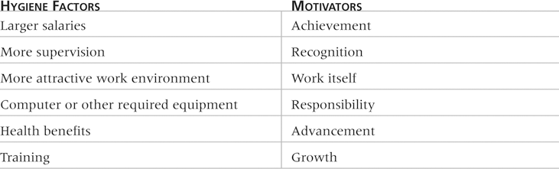
Table 9-1: Examples of Herzberg’s Hygiene Factors and Motivators
Hygiene factors保健因子
Achievement成就
Health benefits健康福利
Training訓練

Slide 14
McClelland’s Acquired-Needs Theory
Specific needs are acquired or learned over time and shaped by life experiences, including:
Achievement (nAch): Achievers成就/成功者like challenging projects挑戰性專案 with achievable goals and lots of feedback大量的回饋
Affiliation聯系(nAff): People with high nAff desire harmonious relationships和諧的關係and need to feel accepted by others, so managers should try to create a cooperative work environment協同的工作環境for them
Power權力: (nPow): People with a need for power desire either personal power (not good) or institutional power體制化的權力(good for the organization). Provide institutional power seekers with management opportunities管理機會
** A person’s motivation and effectiveness in a job function is influenced by these three needs. --- Source: http://www.netmba.com/mgmt/ob/motivation/mcclelland/

Slide 15
McGregor’s Theory X and Y 麥格雷戈的X和Y理論
Theory X (classical systems theory): assumes workers dislike and avoid work工作者嫌棄工作, so managers must use coercion強迫, threats and various control schemes管制計劃to get workers to meet objectives
Theory Y (human relations theory): assumes individuals consider work as natural自然 as play or rest and enjoy the satisfaction of esteem尊重and self-actualization needs自我實現的需要

Slide 16
Theory Z
Introduced in 1981 by William Ouchi and is based on the Japanese approach to motivating workers, emphasizing
Trust, quality, collective decision making集體決策, and cultural values
Theory X and Theory Y – how management views employees
Theory Z – describes how workers views management
Workers can be trusted to do their jobs to their utmost ability, as long as management can be trusted to support them and look after their well-being福利.

Slide 17
Thamhain and Wilemon’s Ways to Have Influence on Projects
What are the 9 ways of having influence on project?
1. Authority: the legitimate合法hierarchical right等級權to issue orders發號施令
2. Assignment分配: the project manager's perceived ability to influence a worker's later work assignments
3. Budget: the project manager's perceived ability to authorize others' use of授權他人使用discretionary funds自由支配資金
4. Promotion: the ability to improve a worker's position
5. Money: the ability to increase a worker's pay and benefits

Slide 18
Thamhain and Wilemon’s Ways to Have Influence on Projects (cont’d)
6. Penalty: the project manager's ability to cause punishment
7. Work challenge: the ability to assign work that capitalizes on a worker's enjoyment of doing a particular task
8. Expertise: the project manager's perceived special knowledge that others deem important
9. Friendship: the ability to establish friendly personal relationships between the project manager and others

Slide 19
Ways to Influence that Help and Hurt Projects
Projects are more likely to succeed when project managers influence with
expertise專業知識
work challenge工作挑戰
Projects are more likely to fail when project managers rely too heavily on
authority權力
Money金錢
Penalty懲罰

Slide 20
Power
Power is the potential ability潛在能力to influence behavior to get people to do things they would not otherwise do
Types of power include
Coercive強制 – using punishments, threats or other negative approaches
Legitimate合法 – based on a position of authority
Expert專業 – using personal knowledge and expertise
Reward獎勵 – using incentives
Referent所指對象– based on a person’s own charisma個人的人格魅力

Slide 21
Covey and Improving Effectiveness
Project managers can apply Covey’s 7 habits to improve effectiveness on projects
Be proactive要積極主動
Begin with the end in mind – focus on main purpose
Put first things first – doing things that are important, but not urgent
Think win/win
Seek first to understand, then to be understood – empathic listening (listening with the intent to understand)
Synergize協同 – creating collaborative products rather than a collection of individual efforts
Sharpen the saw – renew yourself physically, spiritually, mentally and socially身體上，精神上，心理上和社會上

Slide 22
Empathic Listening and Rapport
Good project managers are empathic listeners同理心聽眾 - they listen with the intent to understand
Before you can communicate with others, you have to have rapport 關係– a relation of harmony, conformity一致, accord協議, or affinity親和
Mirroring鏡像is the matching of certain behaviors of the other person, a technique to help establish rapport
IT professionals need to develop empathic listening and other people skills to improve relationships with users and other stakeholders

Slide 23
1.Developing the Human Resource Plan
Involves identifying and documenting確認並記錄project roles, responsibilities, and reporting relationships上下級關係
Contents include
project organizational charts
staffing人員配置management plan
responsibility assignment matrixes責任分配矩陣
resource histograms資源直方圖

Slide 24
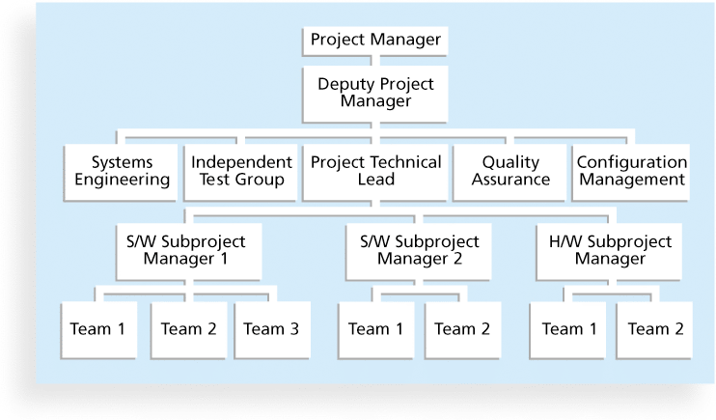
Figure 9-3. Sample Organizational Chart for a Large IT Project

Slide 25
Responsibility Assignment Matrices
A responsibility assignment matrix責任分配矩陣(RAM) is a matrix that maps對應 the work of the project as described in the WBS工作分解結構裡面的工作to the people responsible for performing the work as described in the organizational breakdown structure組織分解結構裡面的人的角色(OBS).
=>工作分解結構裡面的工作對應組織分解結構裡面的人的角色

Slide 26
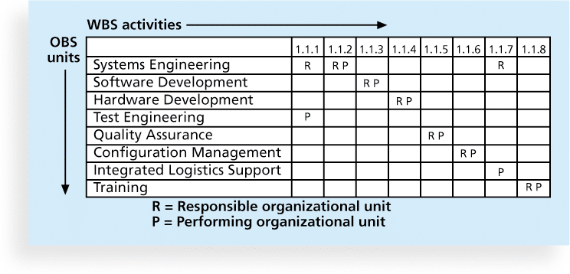
Figure 9-5. Sample Responsibility Assignment Matrix (RAM)

Slide 27
Table 9-2. Sample RACI Chart
R = responsibility有責任 (who does the task?)
A = accountability負責, only one A per task (who signs off on the
task and has authority for it?)
C = consultation咨詢 (who has information to complete the task?)
I = informed (person need to be notified of task status)
Note that some people reverse the definitions of responsible and accountable.

Slide 28
Staffing Management Plans and Resource Histograms
A staffing management plan人員配備管理計劃describes when and how people will be added to and taken off the project team被調離專案團隊
A resource histogram直方圖is a column chart that shows the number of resources assigned to a project over time

Slide 29
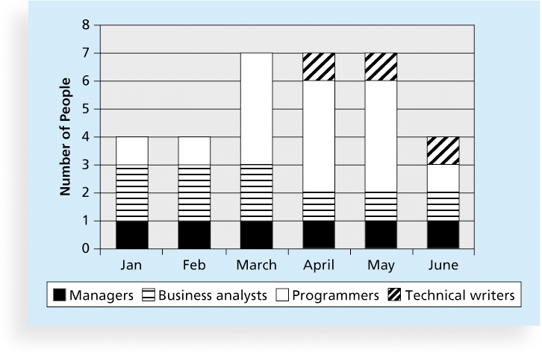
Figure 9-6. Sample Resource Histogram

Slide 30
2.Acquiring獲取the Project Team
Acquiring qualified people for teams is crucial
The project manager who is the smartest person on the team has done a poor job of recruiting招募!
It’s important to assign the appropriate type指定相應的類型and number of people to work on projects at the appropriate times

Slide 31
Resource Loading資源負荷
Resource loading資源負載(工作負荷)refers to the amount of individual resources an existing schedule requires during specific time periods
Helps project managers develop a general understanding of the demands a project專案需求 will make on the organization’s resources and individual people’s schedules
Overallocation資源過度分配means more resources than are available are assigned to perform work at a given time

Slide 32
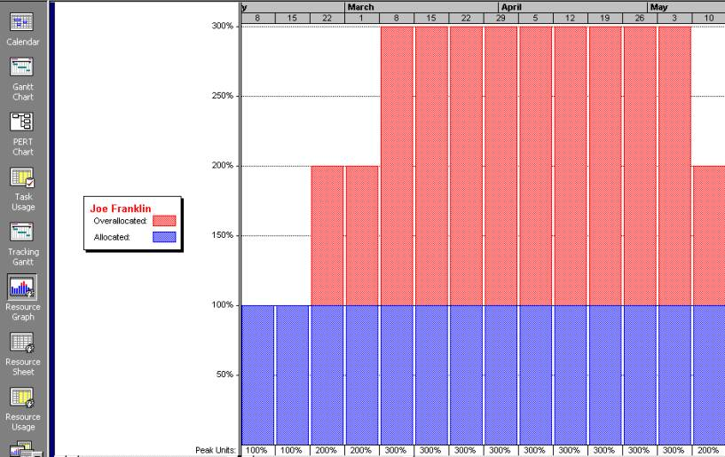
Figure 9-7. Sample Histogram Showing an Overallocated Individual

Slide 33
Resource Leveling資源調配
Resource leveling is a technique for resolving resource conflicts解決資源衝突的技術by delaying tasks延遲任務
The main purpose of resource leveling is to create a smoother distribution of resource資源的分配更順暢usage and reduce overallocation過度分配

Slide 34
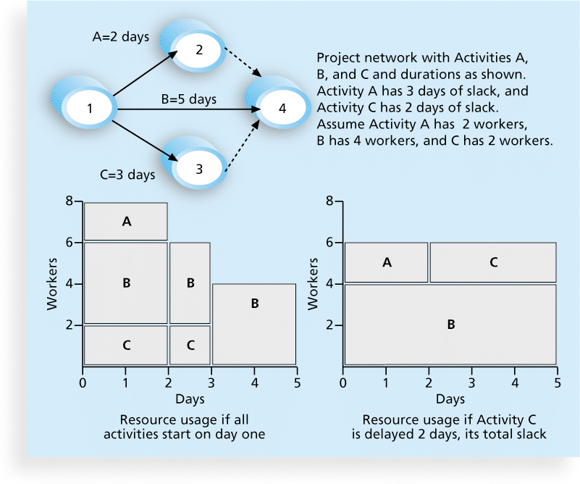
Figure 9-8. Resource Leveling Example

Slide 35
Benefits of Resource Leveling資源調配
When resources are used on a more constant basis, they require less management
It may enable project managers to use a just-in-time inventory type of policy即時庫存政策for using subcontractors or other expensive resources
It results in fewer problems for project personnel and accounting department
It often improves morale情緒 – fewer problem for project personnel, additional work and confusion

Slide 36
3.Developing開發 the Project Team
The main goal of team development is to help people work together more effectively人們一起工作更有效to improve project performance
It takes teamwork團隊合作 to successfully complete most projects

Slide 37
Tuckman Model of Team Development團隊發展階段模型
Forming形成期 – involves the introduction of team members
Storming風暴期、動盪期 – occurs when team members have different opinions for how the team operate
Norming規範期 - occurs when team members have developed a common working method
Performing執行期、績效期 - occurs when the emphasis is on reaching the team’s goal
Adjourning解散期 – involves the break-up of the team after it successfully completes the work

Slide 38
Training
Training can help people understand themselves, each other, and how to work better in teams
Team building建立最佳團隊activities include
physical challenges身體的挑戰
psychological preference indicator tools心理偏好指標工具

Slide 39
Meyers-Briggs Type Indicator (MBTI) 邁爾斯-布里格斯性格分類指標
MBTI is a popular tool for determining personality preferences個性喜好and helping teammates隊友understand each other
Four dimensions include:
Extrovert/Introvert (E/I)外向/內向 – signifies whether you draw energy from other people or from yourself
Sensation/Intuition (S/N)感覺/直覺 – the manner is which you gather infromation
Thinking/Feeling (T/F)思考/感覺 – objective vs. subjective judgment
Judgment/Perception (J/P)判斷/知覺 – attitude towards structure
NTs or rationals are attracted to technology fields
IT people vary most from the general population in not being extroverted or sensing

Slide 40
Social Styles Profile
People are perceived as behaving行為 primarily in one of four zones, based on their assertiveness and responsiveness自信和反應能力:
Drivers驅動 -
Expressives表達能力
Analyticals分析能力
Amiables親合
People on opposite corners相對角(drivers and amiables, analyticals and expressives) may have difficulties getting along相處

Slide 41
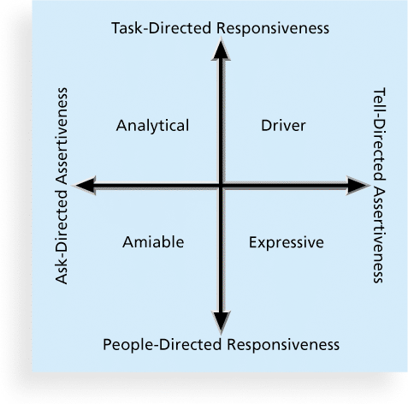
Figure 9-9. Social Styles

Slide 42
DISC Profiles
Also uses a four-dimensional四維空間 model of normal behavior
Dominance支配型
Influence影響型
Steadiness穩健型
Compliance分析型
People in opposite quadrants相對象限can have problems understanding each other

Slide 43
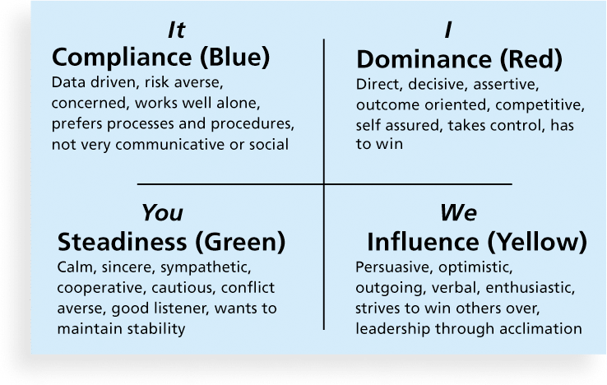
Figure 9-10. The DISC Profile
Risk averse風險規避
Assertive武斷的
Self assured自我放心
Sympathetic有同情心
Persuasive有說服力的
Enthusiastic熱心
acclimation鍛煉

Slide 44
Reward and Recognition獎勵和認可Systems
Team-based reward and recognition systems can promote teamwork
Focus on rewarding teams for achieving specific goals注重團隊獎勵為實現特定目標
Allow time for team members to mentor and help each other to meet project goals and develop human resources

Slide 45
4.Managing the Project Team
Project managers must lead their teams帶領他們的團隊in performing various project activities
After assessing team performance and related information, the project manager must decide
if changes should be requested to the project
if corrective or preventive actions should be recommended
if updates are needed to the project management plan or organizational process assets.

Slide 46
Tools and Techniques for Managing Project Teams
Observation and conversation觀察與交談
Project performance appraisals專案績效評估
Interpersonal skills人際交往能力
Conflict management衝突管理

Slide 47
Conflict Handling Modes
Confrontation對抗 : Directly face a conflict using a problem-solving approach
Compromise和解: Use a give-and-take approach
Smoothing平滑處理: De-emphasize areas of difference and emphasize areas of agreement
Forcing強制 : The win-lose approach
Withdrawal撤Chè離: Retreat or withdraw from an actual or potential disagreement意見不合
Collaborating協作: Decision makers incorporate different viewpoints and insights to develop consensus and commitment把不同的觀點和見解，發展共識和承諾

Slide 48
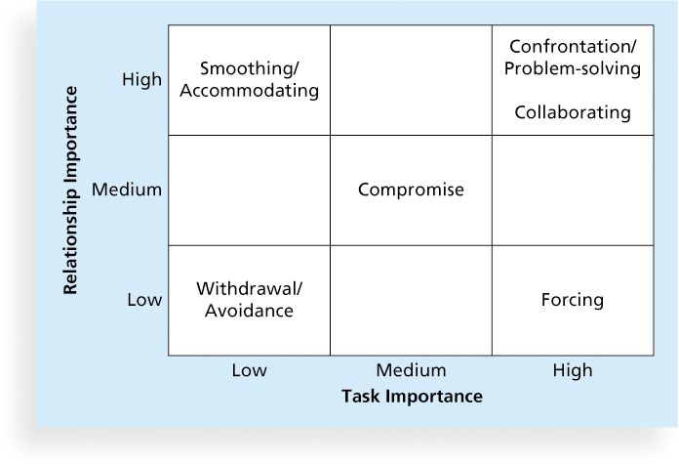
Figure 9-11. Conflict Handling Modes

Slide 49
Conflict Can Be Good
Conflict often produces important results, such as new ideas, better alternatives, and motivation to work harder and more collaboratively
Groupthink: Conformance to the values or ethical standards of a group. Groupthink can develop if there are no conflicting viewpoints
Research suggests that task-related conflict任務相關衝突often improves team performance, but emotional conflict often depresses team performance

Slide 50
Five Dysfunctions功能障礙of a Team
Patrick Lencioni, author of several books on teams, says that “Teamwork remains the one sustainable competitive advantage that has been large untapped”*
The five dysfunctions of teams are
Absence of trust
Fear of conflict
Lack of commitment
Avoidance of accountability責任迴避
Inattention to results
*Lencioni, Patrick, “Overcoming the Five Dysfunctions of a Team,” Jossey-Bass: San Francisco, CA (2005), p. 3.

Slide 51
General Advice on Teams
Be patient and kind with your team
Fix the problem修復問題instead of blaming people
Establish regular, effective meetings
Allow time for teams to go through the basic team-building stages
Limit the size of work teams工作團隊的規模to three to seven members

Slide 52
General Advice on Teams (cont’d)
Plan some social activities to help project team members and other stakeholders get to know each other better
Stress team identity強調團隊的身份
Nurture培養team members and encourage them to help each other
Take additional actions to work with virtual team members

Slide 53
Using Software to Assist in Human Resource Management
Software can help in producing RAMS and resource histograms
Project management software includes several features related to human resource management such as
Assigning resources
Identifying potential resource shortages or underutilization
Leveling resources

Slide 54
Project Resource Management Involves Much More Than Using Software
Project managers must
Treat people with consideration and respect
Understand what motivates them
Communicate carefully with them
Focus on your goal of enabling project team實現專案團隊members to deliver their best work

Slide 55
Chapter Summary
Project human resource management includes the processes required to make the most effective use of the people involved with a project
Main processes include
Plan human resource management
Acquire project team
Develop project team
Manage project team

