Slide 1
Chapter 10: Project Communications Management
Information Technology Project Management, Seventh Edition
Note: See the text itself for full citations.

Slide 2
Learning Objectives
Understand the importance of good communications良好溝通的重要性on projects and the need to develop soft skills開發軟技能
Review key concepts related to communications
與溝通有關的關鍵概念
Explain how to create a communications management plan
Describe how to manage communications
Discuss methods for controlling communications
List various methods for improving project communications

Slide 3
Importance of Good Communications
The greatest threat to many projects is a failure to communicate失敗的溝通
Our culture does not portray IT professionals IT專業人士as being good communicators良好溝通
Research shows that IT professionals must be able to communicate effectively to succeed in their positions
Strong verbal and non-technical skills口頭和非專業技能are a key factor in career advancement事業發展for IT professionals

Slide 4
Project Communications Management Processes
1.Planning communications management: Determining the information and communications needs of the stakeholders
2.Managing communications: Creating, distributing發佈, storing, retrieving, and disposing of project communications處理專案溝通based on the communications management plan
3.Controlling communications: Monitoring and controlling project communications to ensure that stakeholder communication needs are met

Slide 5
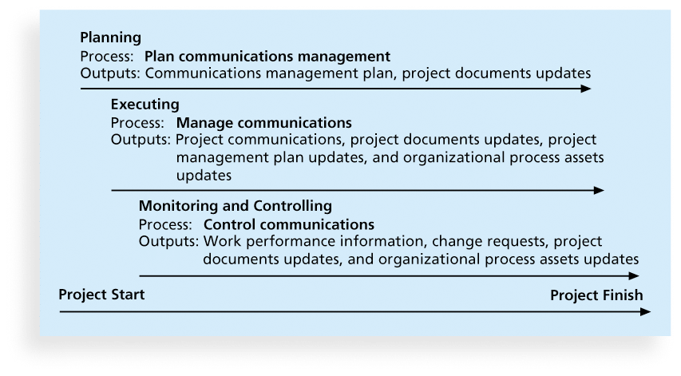
Figure 10-1. Project Communications Management Summary

Slide 6
Keys to Good Communications
Project managers say they spend as much as 90 percent of their time communicating
Need to focus on group and individual communication needs
Use formal and informal methods for communicating
Distribute important information分配重要的資訊in an effective and timely manner
Set the stage for communicating bad news設置階段為溝通壞消息
Determine the number of communication channels溝通渠道

Slide 7
Understanding Group and Individual Communication Needs
People are not interchangeable parts
As illustrated in Brooks’ book The Mythical Man-Month, you cannot assume that a task originally scheduled to take two months of one person’s time can be done in one month by two people
Nine women cannot produce a baby in one month!

Slide 8
Importance of Face-to-Face Communication
Research says that in a face-to-face interaction:
58 percent of communication is through body language身體語言.
35 percent of communication is through how the words are said
7 percent of communication is through the content or words that are spoken
Pay attention to more than just the actual words someone is saying
A person’s tone of voice人的聲音和語氣and body language say a lot about how he or she really feels

Slide 9
Personal Preferences Affect Communication Needs
Introverts個性內向者like more private communications, while extroverts外向的人like to discuss things in public
Intuitive直觀people like to understand the big picture, while sensing感知people need step-by-step details
Thinkers思考者want to know the logic behind decisions, while feeling people直覺者 want to know how something affects them personally
Judging people直覺者 are driven to meet deadlines按時完成任務while perceiving people知覺者 need more help in developing and following plans

Slide 10
Encouraging More Face-to-Face Interactions
Short, frequent meetings頻繁的會議are often very effective in IT projects
Stand-up meetings force people to focus on what they really need to communicate
Some companies have policies策略preventing the use of e-mail between certain hours or even entire days of the week

Slide 11
Distributing Information in an Effective and Timely Manner傳播有效和即時的訊息
Don’t bury隱藏crucial information
Don’t be afraid to report bad information
Oral communication口頭溝通via meetings and informal talks helps bring important information—good and bad—out into the open

Slide 12
Other Communication Considerations
Rarely does the receiver interpret a message exactly as the sender intended
Geographic location地理位置and cultural background affect the complexity of project communications
Different working hours
Language barriers
Different cultural norms文化規範

Slide 13
Determining the Number of Communications Channels溝通渠道的數量
As the number of people involved increases, the complexity of communications increases because there are more communications channels or pathways through which people can communicate.
人們可以透過某些途徑溝通
Number of communications channels = n(n-1)
2 where n is the number of people involved

Slide 14
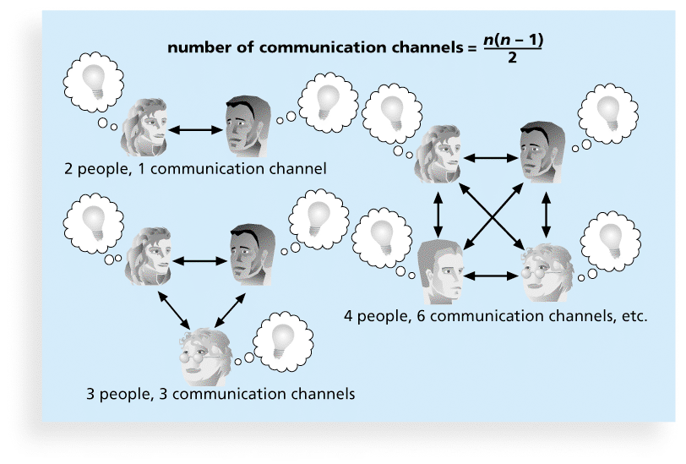
Figure 10-2. The Impact of the Number of People on Communications Channels

Slide 15
1.Planning Communications Management
Every project should include some type of communications management plan, a document that guides project communications
The communications management plan varies with the needs of the project, but some type of written plan should always be prepared某種類型的書面計劃應該隨時準備
For small projects, the communications management plan can be part of the team contract
For large projects, it should be a separate document

Slide 16
Communications Management Plan Contents
1. Stakeholder communications requirements利益相關者的溝通需求
2. Information to be communicated, including format, content, and level of detail詳細程度
3. Who will receive the information and who will produce it
4. Suggested methods or technologies for conveying the information
5. Frequency of communication
6. Escalation procedures for resolving issues上報程序解決問題
7. Revision procedures修訂程序for updating the communications management plan
8. A glossary of common terminology通用術語詞彙Cíhuì表

Slide 17
Table 10-1. Sample Stakeholder Analysis for Project Communications

Slide 18
2.Managing Communications
Managing communications is a large part of a project manager’s job
Getting project information to the right people at the right time and in a useful format is just as important as developing the information in the first place
Important considerations重要的考慮因素include the use of technology, the appropriate methods and media to use, and performance reporting績效報告

Slide 19
Using Technology to Enhance Creation and Distribution
Technology can facilitate the process of creating and distributing information, when used properly
It is important to select the appropriate communication method and media選擇合適的溝通方法

Slide 20
Classifications for Communication Methods
Interactive communication互動溝通交流: Two or more people interact to exchange information via meetings, phone calls, or video conferencing. Most effective way to ensure common understanding
Push communication推動溝通: Information is sent溝通資訊通過 or pushed to recipients without their request他們沒有需求 via reports, e-mails, faxes, voice mails, and other means. Ensures that the information is distributed, but does not ensure that it was received or understood
Pull communication拉動溝通: Information is sent to recipients at their request via Web sites, bulletin boards, e-learning, knowledge repositories知識庫like blogs, and other means

Slide 21
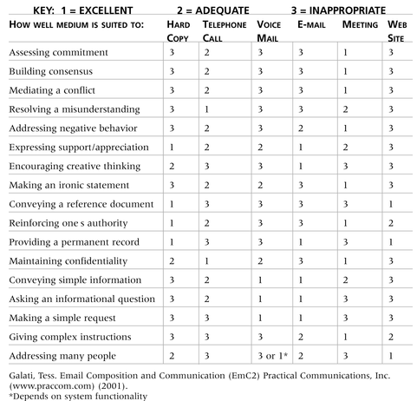
Table 10-2. Media Choice Table

Slide 22
Reporting Performance績效報告
Performance reporting keeps stakeholders informed about how resources are being used to achieve project objectives
Status reports現狀報告describe where the project stands 專案進度at a specific point in time
Progress reports進度報告describe what the project team has accomplished during a certain period of time
Forecasts預測predict future project status and progress based on past information and trends

Slide 23
3.Controlling Communications
The main goal of controlling communications is to ensure the optimal flow of information throughout the entire project life cycle確保資料在整個專案生命週期的優化的流動
The project manager and project team should use their various reporting systems, expert judgment, and meetings to assess how well communications are working. If problems exist, the project manager and team need to take action, which often requires changes to the earlier processes of planning and managing project communications
It is often beneficial to have a facilitator from outside外部推動者 the project team assess how well communications are working

Slide 24
Suggestions for Improving Project Communications
Develop better communication skills溝通技巧
Run effective meetings有效的會議
Use e-mail and other technologies effectively
Use templates範本 for project communications

Slide 25
Developing Better Communication Skills
Most companies spend a lot of money on technical training for their employees, even when employees might benefit more from communications training
Individual employees are also more likely to enroll voluntarily in classes to learn the latest technology than in classes that develop soft skills
As organizations become more global, they realize they must invest in ways to improve communication with people from different countries and cultures來自不同國家和文化背景的人
It takes leadership領導能力to improve communication

Slide 26
Media Snapshot
Communications technology, such as using e-mail and searching the Web, should help improve project communications, but it can also cause conflict引起衝突
How? Cyberslackers混水摸魚者 are people who should be working, but instead spend their time online doing non-work-related activities, such as annoying friends or co-workers by sending unimportant e-mails
A study by Websense suggested that employees are using the Web more and more for personal reasons個人原因, and it is costing U.S. companies $178 billion annually, or $5,000 per employee
A 2008 survey found that more than a quarter of U.S. employers have fired workers for misusing濫用e-mail and one-third have fired workers for misusing the Internet on the job

Slide 27
Running Effective Meetings
Determine if a meeting can be avoided
Define the purpose and intended outcome of the meeting確定會議的目的和預期結果
Determine who should attend the meeting
Provide an agenda議程to participants before the meeting
Prepare handouts and visual aids講義和視覺輔助, and make logistical arrangements ahead of time
Run the meeting professionally運行專業會議
Set the ground rules for the meeting設置會議的基本規則
Build relationships建立良好關係

Slide 28
Using E-Mail, Instant Messaging, Texting, and Collaborative Tools Effectively
Make sure that e-mail, instant messaging, texting, or collaborative tools協作工具are an appropriate medium適當媒介for what you want to communicate
Be sure to send information to the right people
Use meaningful subject lines使用有意義的主題and limit the content of emails to one main subject, and be as clear and concise as possible
Be sure to authorize the right people to share and edit your collaborative documents

Slide 29
Sample Collaborative Tools試樣協作工具
A SharePoint portal allows users to create custom Web sites to access documents存取文件and applications stored on shared devices存儲在共享設備上的應用
Google Docs allow users to create, share, and edit documents, spreadsheets電子表格, and presentations簡報online
A wiki維基百科is a Web site designed to enable anyone who accesses it to contribute or modify Web page content

Slide 30
Using Templates for Project Communications
Many technical people are afraid to ask for help
Providing examples and templates範例和範本for project communications saves time and money
Organizations can develop their own templates, use some provided by outside organizations, or use samples from textbooks
Recall that research shows that companies that excel in project management make effective use of template公司擅長於專案管理運用有效的範例

Slide 31
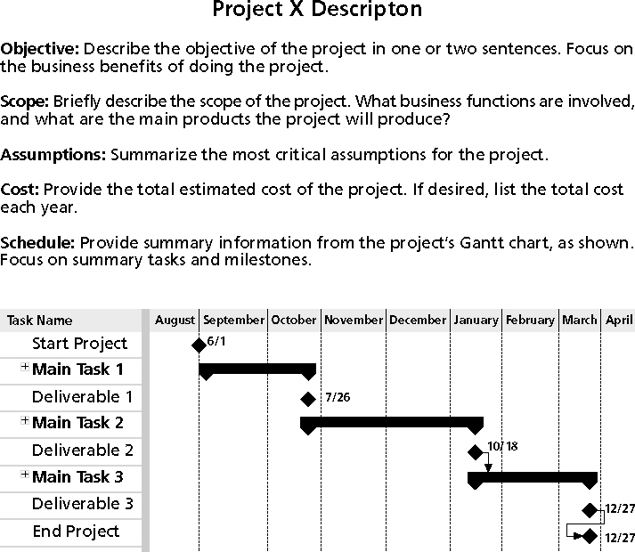
Figure 10-3. Sample Template for a Project Description (corrected from p. 427)

Slide 32
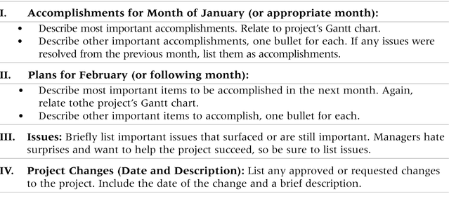
Table 10-3. Sample Template for a Monthly Progress Report

Slide 33
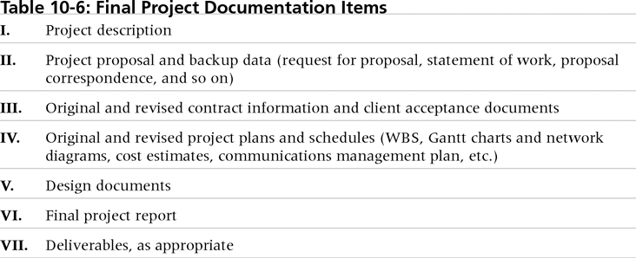
Table 10-4. Final Project Documentation Items

Slide 34
Lessons Learned Reports總結經驗報告
The project manager and project team members should each prepare a lessons-learned report
A reflective statement反射陳述that documents important things an individual learned from working on the project
The project manager often combines information from all of the lessons-learned reports into a project summary report
See template and sample in Chapter 3

Slide 35
Project Archives專案檔案
It is also important to organize and prepare project archives
Project archives are a complete set of organized project records一套完整的有組織的專案記錄that provide an accurate history of the project歷史紀錄
These archives can provide valuable information for future projects as well

Slide 36
Project Web Sites
Many project teams create a project Web site to store important product documents儲存重要產品資料and other information
Can create the site using various types of software, such as enterprise project management software

Slide 37
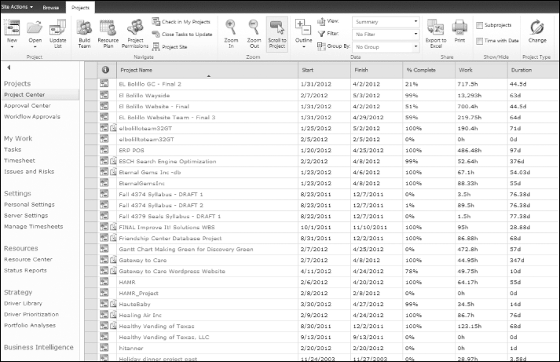
Figure 10-4. Microsoft’s Project Web Application Master Project Summary Screen

Slide 38
Chapter Summary
The goal of project communications management is to ensure timely and appropriate generation, collection, dissemination, storage, and disposition of project information
Main process include:
Plan communications management
Manage communications
Control communications

