Slide 1
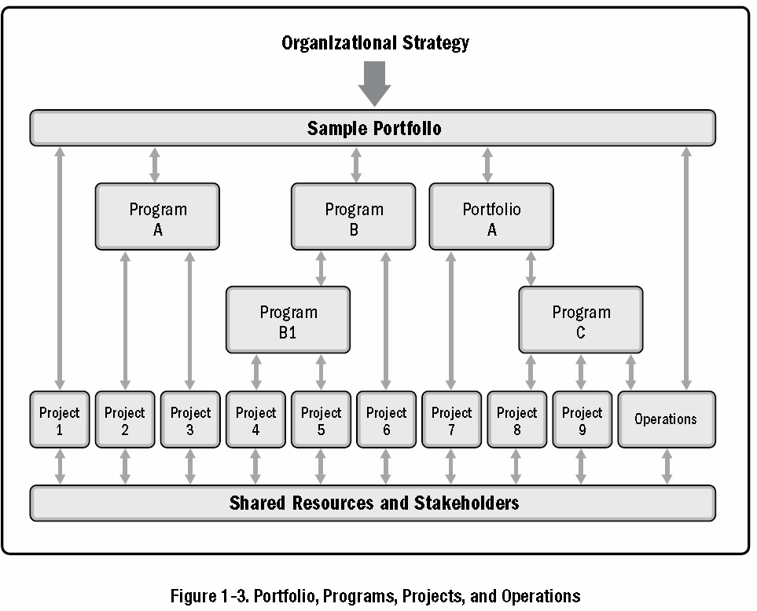
Portfolio, programs and projects
Portfolio
Programs
Projects
Source: PMI, 2017, “A guide to the project management body of knowledge (PMBOK guide),” Sixth edition, Newtown Square, PA: Project Management Institute, Inc.

Slide 2
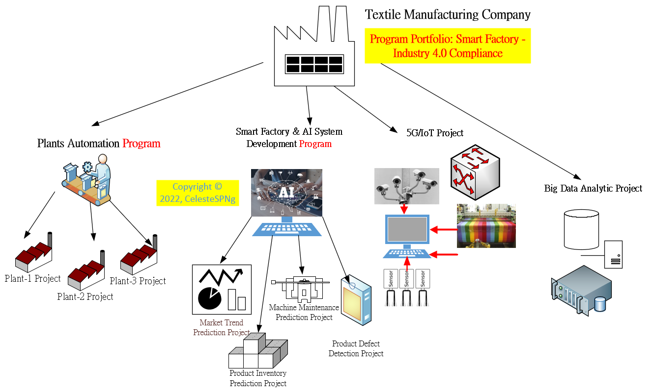
Portfolio, programs and projects
Source: Celeste SP Ng, 2022

Slide 3
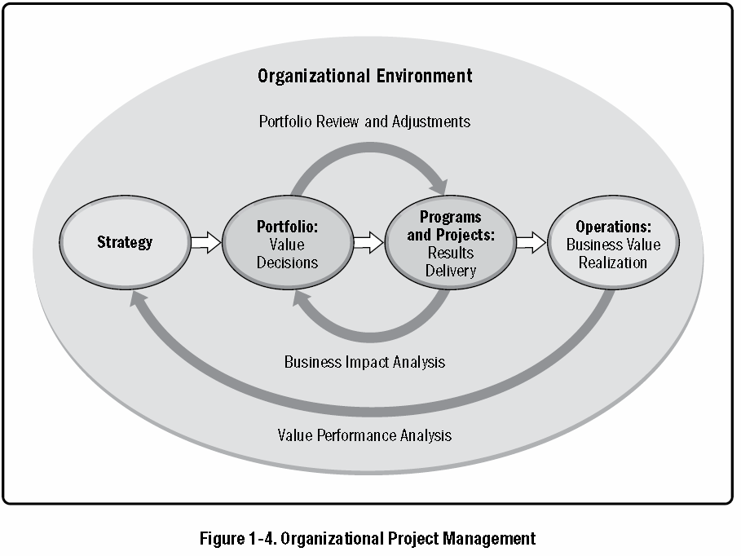
Organizational project management
Celeste: Assume FENC’s strategic goal is … increment in market share by 10% (➔ P/f):
Prog: R&D initiatives; new factories constructions
Operation: textile / fabric manufacturing
Proj: new factory site-A; Mobile APP development
Portfolio
Programs
Projects
Operations
Celeste: Project (temporary) vs operations (is ongoing)
Source: PMI, 2017, “A guide to the project management body of knowledge (PMBOK guide),” Sixth edition, Newtown Square, PA: Project Management Institute, Inc.

Slide 4
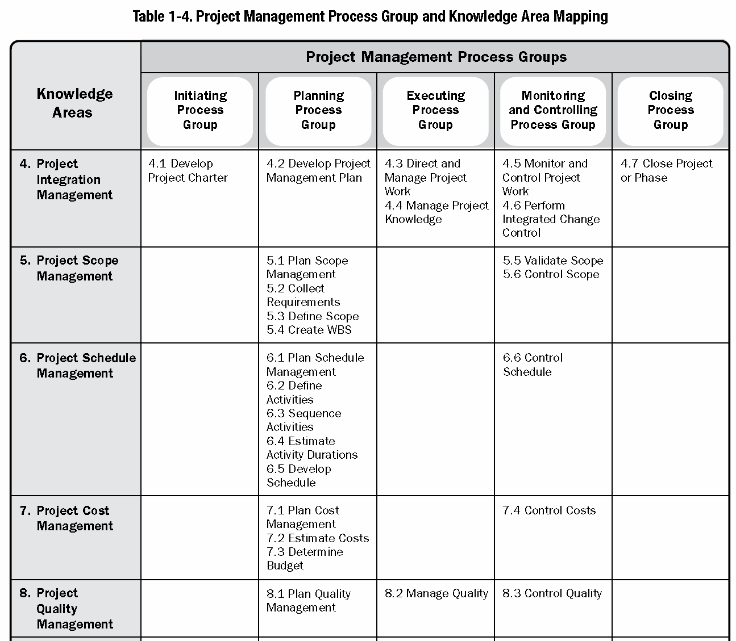
Project Management Process Groups and Knowledge Areas Mapping (1)
There are processes from each knowledge area under the “planning” and “monitoring and controlling” process groups.
“planning”
“monitoring and controlling”
Source: PMI, 2017, “A guide to the project management body of knowledge (PMBOK guide),” Sixth edition, Newtown Square, PA: Project Management Institute, Inc.

Slide 5
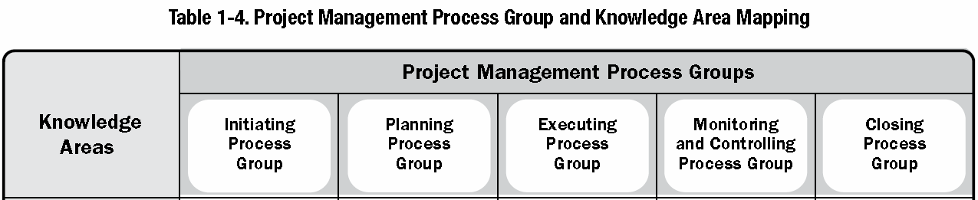
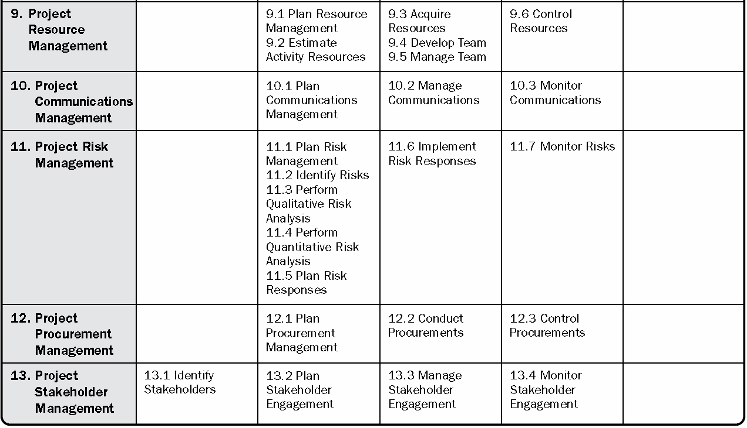
Project Management Process Groups and Knowledge Areas Mapping (2)
“Initiating” process group = 2 processes
“Planning” process group = 24 processes
“Executing” process group = 10 processes
“Monitoring and controlling” process groups = 12 processes
“Closing” process group = 1 process
Source: PMI, 2017, “A guide to the project management body of knowledge (PMBOK guide),” Sixth edition, Newtown Square, PA: Project Management Institute, Inc.

Slide 6
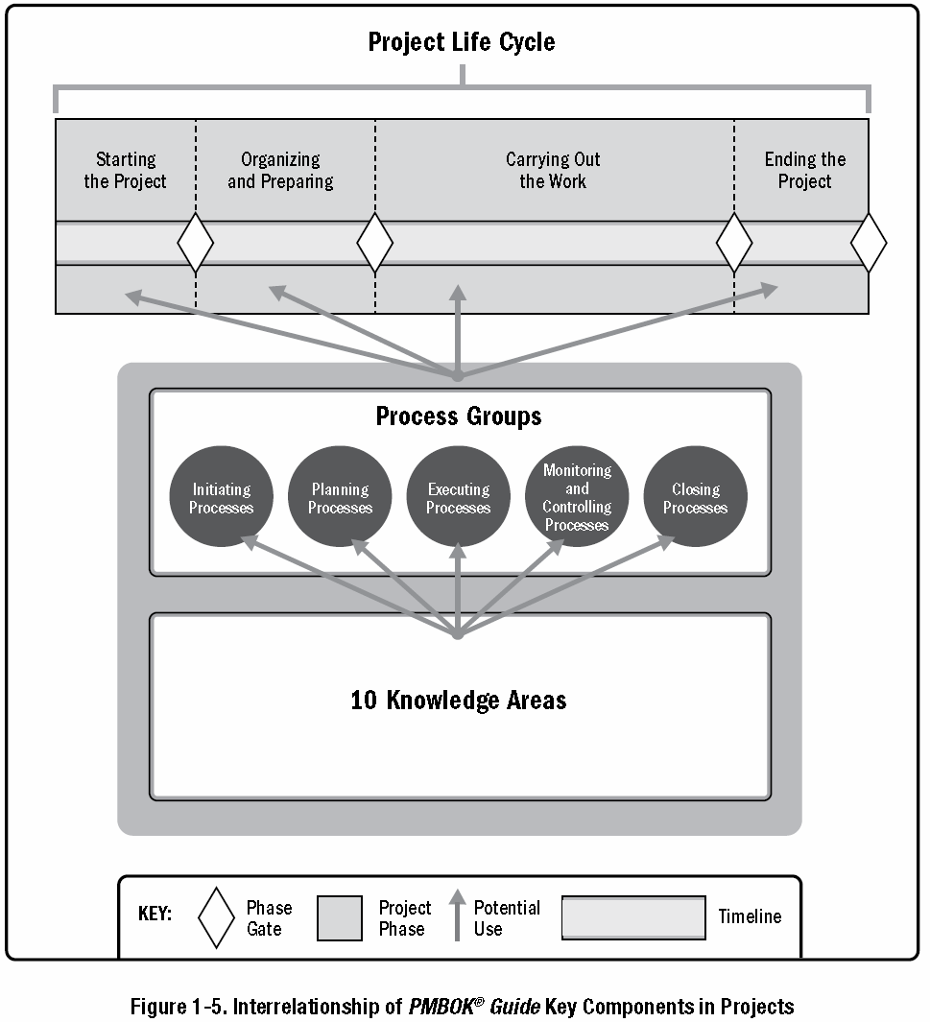
PMBOK® Guide Key Components in Projects
Project life cycle
Project phase
Phase gate
Process groups
Source: PMI, 2017, “A guide to the project management body of knowledge (PMBOK guide),” Sixth edition, Newtown Square, PA: Project Management Institute, Inc.

Slide 7
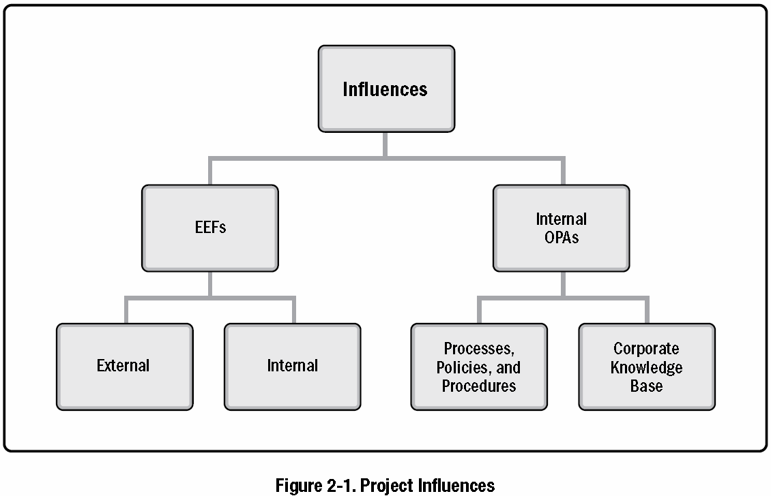
1. Project influences (1)
EEF – “refer to conditions, not under the control of the project team, that influence,
constrain, or direct the project”
Categories
Enterprise Environmental Factors (EEFs)
Internal Organizational Process Assets (OPAs)
Sub-categories
Source: PMI, 2017, “A guide to the project management body of knowledge (PMBOK guide),” Sixth edition, Newtown Square, PA: Project Management Institute, Inc.

Slide 8
1. Project influences (1)
Enterprise Environmental Factors (EEFs)
Internal Organizational Process Assets (OPAs)
Source: PMI, 2017, “A guide to the project management body of knowledge (PMBOK guide),” Sixth edition, Newtown Square, PA: Project Management Institute, Inc.

Slide 9
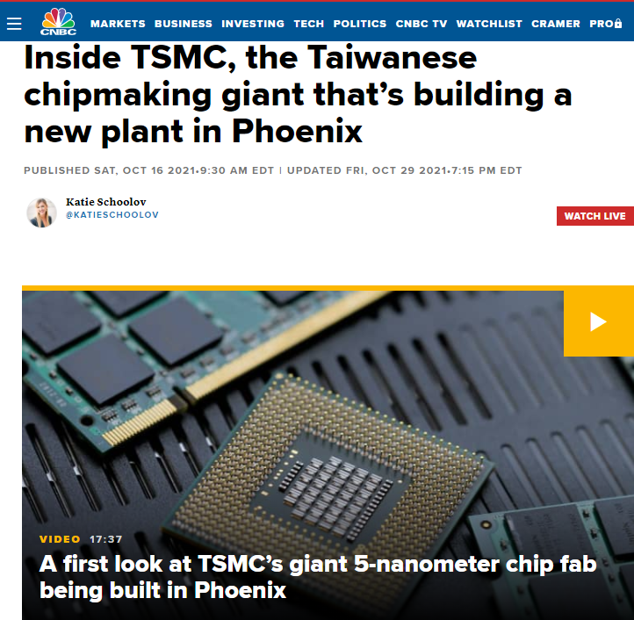
1. Project influences – EEFs: EXTERNAL TO THE ORGANIZATION
Marketplace conditions.
Marketplace conditions.
Examples include competitors, market share brand recognition, and trademarks.
Social and cultural influences and issues.
Examples include political climate, codes of conduct, ethics, and perceptions.
Legal restrictions.
Examples include country or local laws and regulations related to security, data protection, business conduct, employment, and procurement.
Commercial databases.
Examples include benchmarking results, standardized cost estimating data, industry risk study information, and risk databases.
Academic research.
Examples include industry studies, publications, and benchmarking results.
Government or industry standards.
Examples include regulatory agency regulations and standards related to products, production, environment, quality, and workmanship.
Financial considerations.
Examples include currency exchange rates, interest rates, inflation rates, tariffs, and geographic location.
Physical environmental elements.
Examples include working conditions, weather, and constraints.
Social and cultural influences and issues.
Legal restrictions.
Commercial databases.
Academic research.
Government or industry standards.
Financial considerations.
Physical environmental elements.
Source: PMI, 2017, “A guide to the project management body of knowledge (PMBOK guide),” Sixth edition, Newtown Square, PA: Project Management Institute, Inc.

Slide 10
1. Project influences – EEFs: INTERNAL TO THE ORGANIZATION
Organizational culture, structure, and governance.
Examples include vision, mission, values, beliefs, cultural norms, leadership style, hierarchy and authority relationships, organizational style, ethics, and code of conduct.
Geographic distribution of facilities and resources.
Examples include factory locations, virtual teams, shared systems, and cloud computing.
Infrastructure.
Examples include existing facilities, equipment, organizational telecommunications channels, information technology hardware, availability, and capacity.
Information technology software.
Examples include scheduling software tools, configuration management systems, web interfaces to other online automated systems, and work authorization systems.
Resource availability.
Examples include contracting and purchasing constraints, approved providers and subcontractors, and collaboration agreements.
Employee capability.
Examples include existing human resources expertise, skills, competencies, and specialized knowledge.
Organizational culture, structure, and governance.
Geographic distribution of facilities and resources.
Infrastructure.
Information technology software.
Resource availability.
Employee capability.
Source: PMI, 2017, “A guide to the project management body of knowledge (PMBOK guide),” Sixth edition, Newtown Square, PA: Project Management Institute, Inc.

Slide 11
1. Project influences (1)
Enterprise Environmental Factors (EEFs)
Internal Organizational Process Assets (OPAs)
Source: PMI, 2017, “A guide to the project management body of knowledge (PMBOK guide),” Sixth edition, Newtown Square, PA: Project Management Institute, Inc.

