Slide 1
Critical chain scheduling
Prepared by: Celeste Ng
Date: May, 2016
Source: As given on each slide

Slide 2
Source: http://www.pmknowledgecenter.com/dynamic_scheduling/baseline/critical-path-or-critical-chain-difference-caused-resources
Prepared by: Celeste Ng 2016

Slide 3
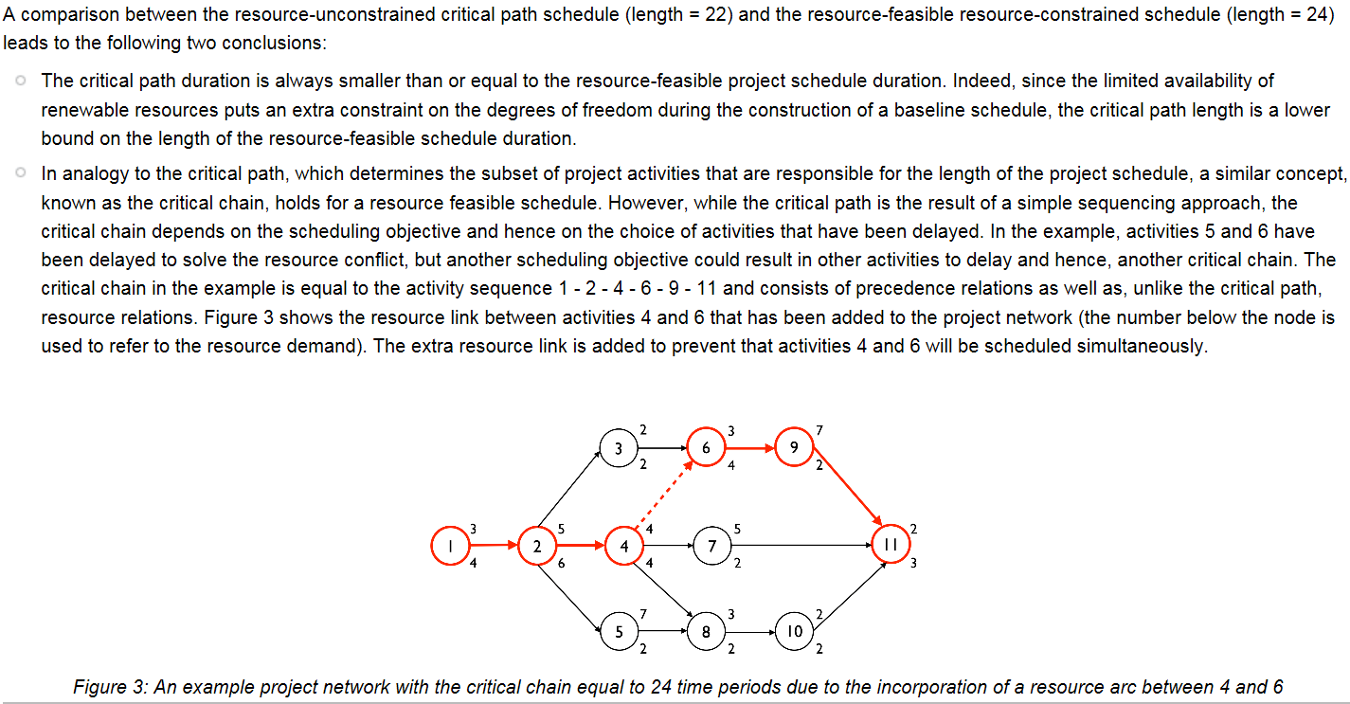
Source: http://www.pmknowledgecenter.com/dynamic_scheduling/baseline/critical-path-or-critical-chain-difference-caused-resources
Prepared by: Celeste Ng 2016

Slide 4
Source: http://www.simplilearn.com/what-is-critical-chain-project-management-rar68-article
Prepared by: Celeste Ng 2016

Slide 5
Source: http://www.simplilearn.com/what-is-critical-chain-project-management-rar68-article
Prepared by: Celeste Ng 2016

