Slide 1
Time in Different Culture
(C ross-country)
Prepared by: Celeste Ng
Date: April, 2016
Source: as indicated on each slide

Slide 2
Time Orientation
(Source: http://www.exactlywhatistime.com/time-in-different-cultures/ )
Cultural attitudes to time also differ throughout history.
One way of looking at cultural attitudes to time is in terms of time orientation, a cultural or national preference toward past, present, or future thinking.
  The time orientation of a culture affects how it values time, and the extent to which it believes it can control time. For example,
    America – often considered to be future-orientated
    France – more present-orientated and
    Britain – the past-orientated
  Often (but not always), a past orientation arises in cultures with a long history, like India or China, and a future orientation in younger countries, like the USA.
Prepared by: Celeste Ng 2016

Slide 3
Chronemic (1)
(Source: http://www.exactlywhatistime.com/time-in-different-cultures/ )
Chronemics is the study of the use of time, and the way that time is perceived and valued by individuals and cultures, particularly as regards non-verbal communication.
These time perceptions include things like
  Punctuality,
  Willingness to wait,
  Approaches to face-to-face interactions, and
  Reactions to time pressure.
Prepared by: Celeste Ng 2016

Slide 4
Chronemic (2)
(Source: http://www.exactlywhatistime.com/time-in-different-cultures/ )
Different cultures may be considered to be:
  Monochronic –
    where things are typically done one at a time,
    where time is segmented into precise, small units, and
    where time is scheduled, arranged and managed.
    In such a culture, time is viewed as a
      tangible commodity than can be spent, saved or wasted, and
      paramount value is placed on regimented schedules, tasks and “getting the job done”.
      This perception of time is probably rooted in the Industrial Revolution of the 18th and 19th Century, and
      The archetypal examples are the United States, Germany and Switzerland, to which could be added Britain, Canada, Japan, South Korea, Turkey, and the Scandinavian countries.
Prepared by: Celeste Ng 2016

Slide 5
Chronemic (3)
(Source: http://www.exactlywhatistime.com/time-in-different-cultures/ )
Different cultures may be considered to be:
  Polychronic –
    where several things can be done at once, and
    a more fluid approach is taken to scheduling time.
    Such cultures tend to be less focused on the precise accounting of each and every moment, and
    much more steeped in tradition and relationships rather than in tasks.
    Polychronic cultures have a much less formal perception of time, and are not ruled by precise calendars and schedules.
    The arbitrary divisions of clock time and calendars have less importance to them than the cycle of the seasons, the invariant pattern of rural and community life, and the calendar of religious festivities.
    Many Latin American, African, Asian and Arab cultures fall into this category, especially countries like Mexico, Pakistan, India, rural China, the Philippines, Egypt and Saudi Arabia.
Prepared by: Celeste Ng 2016

Slide 6
Chronemic (4)
(Source: http://www.exactlywhatistime.com/time-in-different-cultures/ )
Different cultures may be considered to be:
  Variably Monochronic –
    a group of “in between” countries, including Russia, Southern Europe and much of East-Central Europe are sometimes referred to as variably monochronic cultures.
Prepared by: Celeste Ng 2016

Slide 7
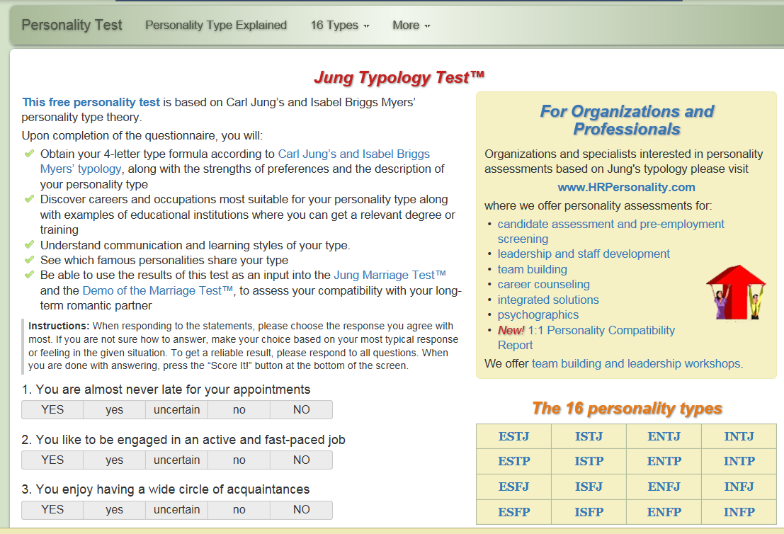
Time Orientation
(Source: http://www.humanmetrics.com/cgi-win/jtypes2.asp )
Prepared by: Celeste Ng 2016
Prepared by: Celeste Ng 2017

