Slide 1
Jung and Meyers-Briggs Type Indicators
Prepared by: Celeste Ng
Date: April, 2017
Source: http://www.humanmetrics.com/cgi-win/jtypes2.asp

Slide 2
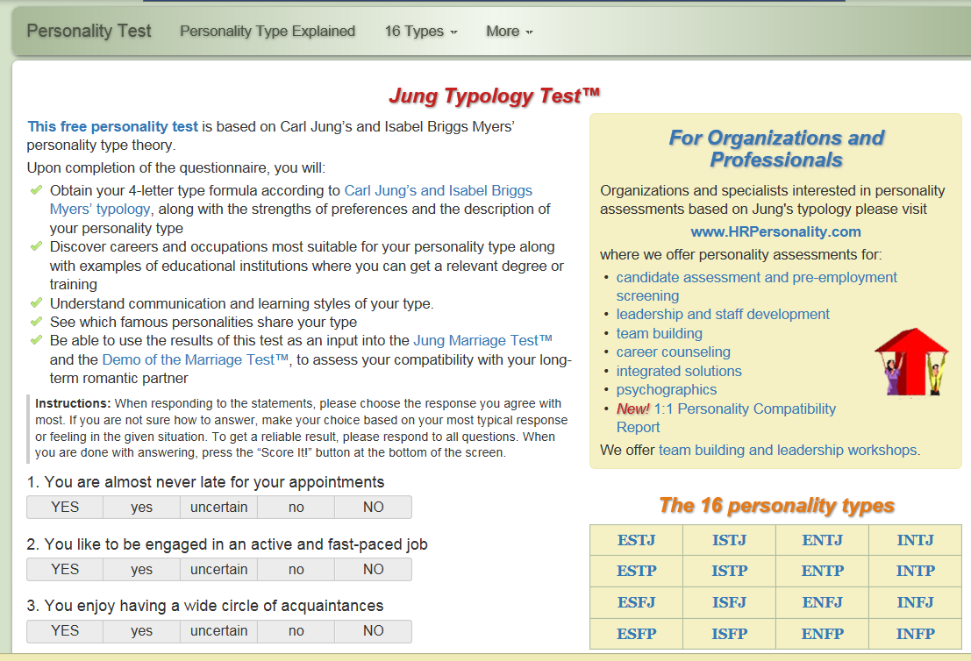
Time Orientation
(Source: http://www.humanmetrics.com/cgi-win/jtypes2.asp )
Prepared by: Celeste Ng 2017

