Slide 1
Examples of Various Organizational Culture
Prepared by: Celeste Ng
Updated: Mar, 2022
Source: as indicated on each slide

Slide 2
Ten Characteristics of Organizational Culture (1)
Member identity
1. Member identity*成員身分
Employee identity with the organization as a whole
2. Group emphasis*強調小組
Work activities are organized around groups
3. People focus關注在人
Management’s decisions take into account the effect of outcomes on people
4. Unit integration*部門整合
The degree to which departments within an organization are encouraged to coordinate with each other
5. Control
Group emphasis
People focus
Unit integration
Control
*Project work is most successful in an organizational culture where these items are strong/high and other items are balanced.
Source: Kathy Schwalbe, 2014, Information Technology Project Management, Seventh Edition, Course Technology, Canada

Slide 3
Ten Characteristics of Organizational Culture (2)
Risk tolerance
6. Risk tolerance*風險容忍
7. Reward criteria*獎勵標準
8. Conflict tolerance*衝突容忍
9. Means-ends orientation目標導向
The degree to which management focuses on outcomes rather than on techniques and processes.
10. Open-systems focus*開放系統導向
The degree to which the organization monitors and responds to changes in the external environment
Reward criteria
Conflict tolerance
Means-ends orientation
Open-systems focus
Refer to “The case of Costco vs GE leadership style – 2018 report on course website ---- #3People-focus, #6Risk-tolerance, #7Reward-criteria
Source: Kathy Schwalbe, 2014, Information Technology Project Management, Seventh Edition, Course Technology, Canada

Slide 4
Organizational Culture Examples – Twitter (source: http://www.entrepreneur.com/article/249174)
Founders: Jack Dorsey, Noah Glass, Biz Stone, Evan Williams

Slide 5
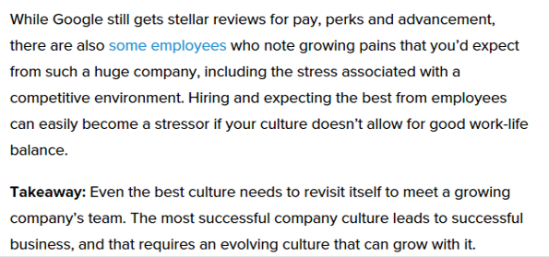
Organizational Culture Examples – Google (source: http://www.entrepreneur.com/article/249174)
financial bonuses金融相關的獎金
Founders: Larry Page, Sergey Brin

Slide 6
Organizational Culture Examples – Facebook (source: http://www.entrepreneur.com/article/249174)
On-site laundry現場洗衣
Outdoor roaming space室外漫步空間

Slide 7
Organizational Culture Examples – Adobe (source: http://www.entrepreneur.com/article/249174)
Trust employee信任員工
Risk-taking without fear of penalty冒險，不用擔心受罰
Founders: John Warnock, Charles Geschke

Slide 8
Source: https://www.adobe.com/#

