Slide 1
Scope Management Plan
&
Requirements Management Plan
Prepared by: Celeste Ng
Date: April, 2017
Source: As given on each slide

Slide 2
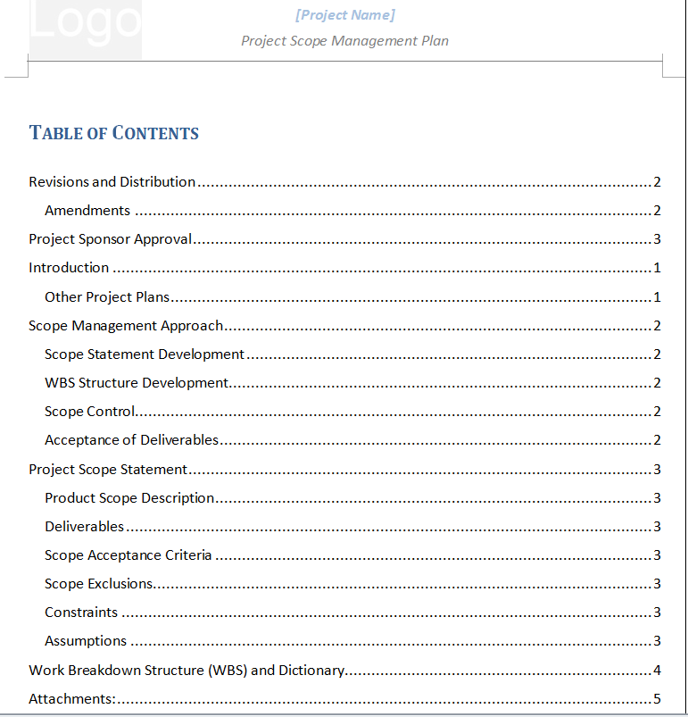
Scope Management Plan
(source: http://project-management.magt.biz/templates/02-scope-mgmt/ )

Slide 3
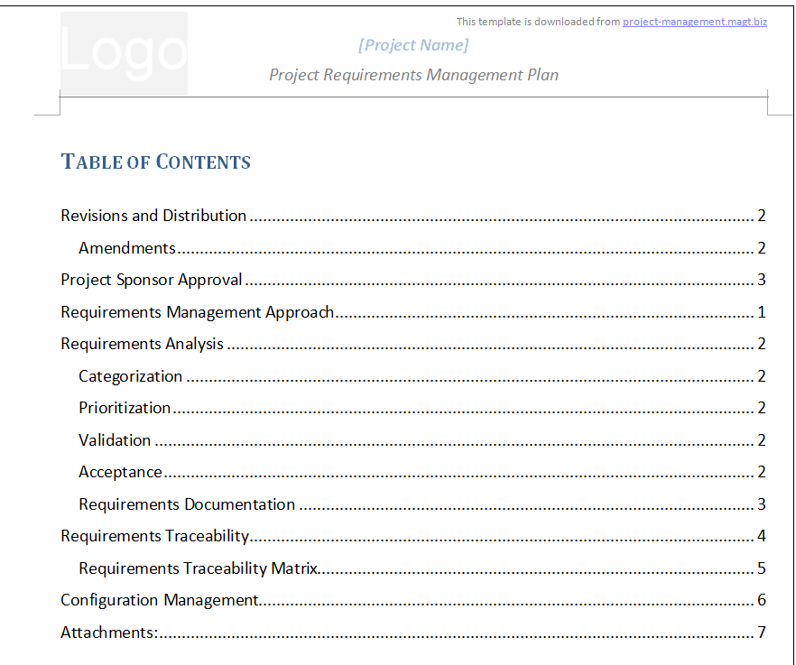
Requirements Management Plan
(source: http://project-management.magt.biz/templates/02-scope-mgmt/ )

