Slide 1
Machine Learning Projects
10 best machine learning projects that can help beginners kick start their ML journey
February 2022
Prepared & Edited by: Celeste SP Ng
Direct quote from Source: 2021, https://analyticsindiamag.com/machine-learning-101-ten-projects-for-high-school-students-to-get-started/

Slide 2
Examples of Machine Learning Projects
1| Sentiment Analysis of Product Reviews
About: Sentiment analysis is an application in text mining and computational linguistics research to tease out the underlying sentiment in source texts. The in-depth analysis will help uncover market trends and consumer opinions, and offer insights for the overall improvement of products.
Research paper: http://cs229.stanford.edu/proj2018/report/122.pdf
Dataset Available:
Amazon Product Review: This dataset is collected from customer reviews of Amazon products. Get the data here.
Twitter US Airline Sentiment: Twitter data scraped from February of 2015 about each of the major US airlines. Get the data here.
Source: 2021, https://analyticsindiamag.com/machine-learning-101-ten-projects-for-high-school-students-to-get-started/

Slide 3
Examples of Machine Learning Projects
You need to create an account in Kaggle
Source: https://www.kaggle.com/datafiniti/consumer-reviews-of-amazon-products/version/5?select=1429_1.csv

Slide 4
Examples of Machine Learning Projects
2| Stock Prices Prediction
About: Predicting stock prices is a challenging task as it depends on various factors including but not limited to geopolitics, global economy, company’s financial reports and performance, etc. There are two main approaches to predicting the stock price: Technical analysis method uses metrics like closing and opening price, the volume traded, adjacent close values etc. of the stock for prediction, whereas qualitative analysis looks at external factors like company profile, market situation, political and economic factors, textual information in news, social media and even blogs by the economic analyst.
Research paper: https://www.sciencedirect.com/science/article/pii/S1877050920307924 .
Dataset Available:
Huge Stock Market Dataset: The dataset is a collection of the daily prices and volumes of all US stocks and ETFs. Get the dataset here.
Daily News for Stock Market Prediction: The dataset is a collection of historical news headlines from Reddit WorldNews Channel and stock data. Get the data here.
Source: 2021, https://analyticsindiamag.com/machine-learning-101-ten-projects-for-high-school-students-to-get-started/

Slide 5
Examples of Machine Learning Projects
3| Sales Forecasting
About: The objective of sales forecasting is to estimate the future demand for products or services. Some standard variables used in sales forecasting are
past sales data,
website visits,
economic trends, etc.
More details: https://www.neuraldesigner.com/solutions/sales-forecasting .
Dataset Available:
Walmart Store Sales Forecasting: It is a collection of historical sales data for 45 Walmart stores located in different regions. Get the data here.
Retail Sales Forecasting: This dataset contains a lot of historical sales data extracted from a Brazilian top retailer. Get the data here.
Source: 2021, https://analyticsindiamag.com/machine-learning-101-ten-projects-for-high-school-students-to-get-started/

Slide 6
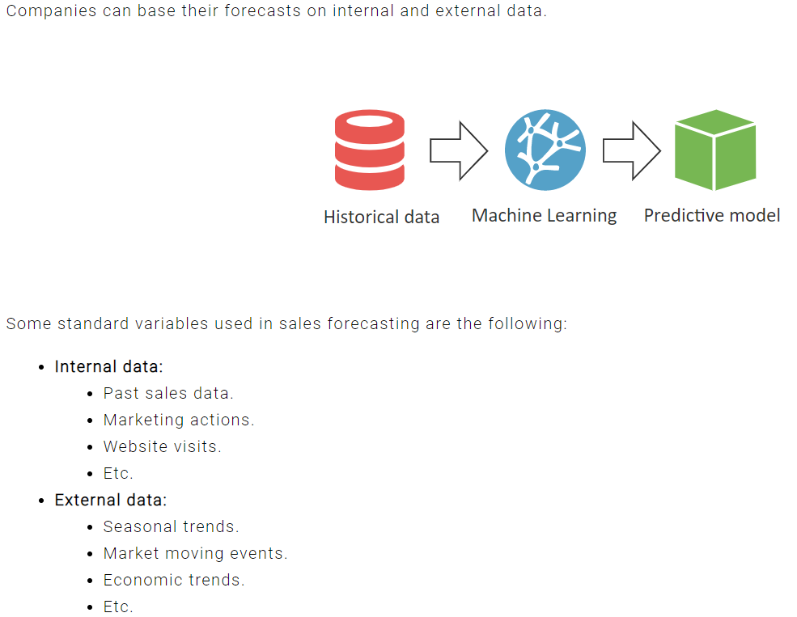
Examples of Machine Learning Projects
3| Sales Forecasting
Source: 2021, https://www.neuraldesigner.com/solutions/sales-forecasting

Slide 7
Examples of Machine Learning Projects
4| Movie Ticket Pricing Prediction
About: Machine learning techniques can be used to create personalized services, such as dynamic pricing, which can be used for movie ticket booking.
Related site: https://www.skyfilabs.com/project-ideas/movie-ticket-pricing-system-using-machine-learning#
Dataset Available:
TMDB Box Office Prediction: In this dataset, you are provided with 7,398 movies and a variety of metadata obtained from The Movie Database (TMDB). Get the data here.
Cinema Tickets: It includes historical data of sale and movies details e.g. cost, cast and crews, and other project details like schedule. Get the data here.
Source: 2021, https://analyticsindiamag.com/machine-learning-101-ten-projects-for-high-school-students-to-get-started/

Slide 8
Examples of Machine Learning Projects
4| Movie Ticket Pricing Prediction
Dynamic Pricing:
Dynamic pricing is used to create different prices for different customers, based on their location or other circumstances. This method was first used for American Airlines in the year 1980.
They figured out that not all customers are the same, they all have different concerns and different priorities.
While some customers want tickets at a cheaper price while others want good service.
This method is now used in all movie booking systems. There are some parameters, depends on which the price varies, like whether the customer wants to book a
ticket in the front row or the back,
an executive seat or a couple of seats.
where the movie hall is located and
which show timing the customer has chosen.
Source: 2021, https://www.skyfilabs.com/project-ideas/movie-ticket-pricing-system-using-machine-learning#

Slide 9
Examples of Machine Learning Projects
5| Music Recommendation
About: Music recommender system can suggest songs to users based on their listening pattern.
Related research paper: https://www.sciencedirect.com/science/article/pii/S1877050919310646
Dataset Available:
WSDM – KKBox’s Music Recommendation: KKBOX provides a training data set consisting information of the first observable listening event for each unique user-song pair within a specific time duration. Get the data here.
Last.FM: This dataset contains social networking, tagging, and music artist listening information from a set of 2k users from Last.fm online music system. Get the data here.
Source: 2021, https://analyticsindiamag.com/machine-learning-101-ten-projects-for-high-school-students-to-get-started/

Slide 10
Examples of Machine Learning Projects
6| Handwritten Digit Classification
About: The handwritten digit recognition can identify handwritten digits.
Related project: https://data-flair.training/blogs/python-deep-learning-project-handwritten-digit-recognition/ .
Dataset Available:
Digit Recognizer: The data files, train.csv and test.csv, contain grey-scale images of hand-drawn digits, from zero through nine. Get the data here.
MNIST Database: The MNIST database of handwritten digits has a training set of 60,000 examples and a test set of 10,000 examples. Get the data here.
Source: 2021, https://analyticsindiamag.com/machine-learning-101-ten-projects-for-high-school-students-to-get-started/

Slide 11
Examples of Machine Learning Projects
7| Fake News Detection
About: In this project, one can use a machine learning ensemble approach for automated classification of news articles.
Related research: https://www.hindawi.com/journals/complexity/2020/8885861/ .
Dataset Available:
Fake News: It includes training and a dataset with a unique id for a news article, author of the news article, among others. Get the data here.
Fake News Inference Dataset: This database is provided for the Fake News Detection task. Get the data here.
Source: 2021, https://analyticsindiamag.com/machine-learning-101-ten-projects-for-high-school-students-to-get-started/

Slide 12
Examples of Machine Learning Projects
8| Sports Prediction
About: Sports prediction is usually treated as a classification problem, with one class (win, lose, or draw) to be predicted. In sports prediction, large numbers of factors including the historical performance of the teams, results of matches, and data on players, have to be accounted for to help different stakeholders understand the odds of winning or losing.
Related research: https://www.sciencedirect.com/science/article/pii/S2210832717301485 .
Dataset Available:
ATP World Tour tennis data: This dataset contains tennis data from the ATP World Tour website. Get the data here.
FIFA 19 Dataset: FIFA 19 complete player dataset is a collection of detailed attributes for every player registered in the latest edition of FIFA 19 database. Get the data here.
Source: 2021, https://analyticsindiamag.com/machine-learning-101-ten-projects-for-high-school-students-to-get-started/

Slide 13
Examples of Machine Learning Projects
9| Object Detection
About: One of the fundamental computer vision problems, object detection provides valuable information for semantic understanding of images and videos, and has many applications in image classification, human behaviour analysis, among others.
Related study: https://arxiv.org/pdf/1807.05511.pdf .
Dataset Available:
COCO: COCO is large-scale object detection, segmentation, and captioning dataset. Get the data here.
Oxford Pets Dataset: It is a collection of images and annotations labelling various breeds of dogs and cats. Get the data here.
Source: 2021, https://analyticsindiamag.com/machine-learning-101-ten-projects-for-high-school-students-to-get-started/

Slide 14
Examples of Machine Learning Projects
10| Disease Prediction
About: Traditional disease risk model uses machine learning and supervised learning algorithm on training data (with labels) for improving the models.
Related research work: https://www.irjet.net/archives/V6/i5/IRJET-V6I5977.pdf .
Dataset Available:
Heart Disease Dataset: This database contains 76 biomarkers of heart disease. Get the data here.
Mental Disorders: This dataset is a collection of mental disorders, impairments associated with these disorders, and their treatment patterns from representative samples of majority and minority adult populations in the US. Get the data here.
Source: 2021, https://analyticsindiamag.com/machine-learning-101-ten-projects-for-high-school-students-to-get-started/

Slide 15
THANK YOU!
Celeste SP Ng
Email: celeste@saturn.yzu.edu.tw
Phone: 2614
Website: http://celesteng.mis.yzu.edu.tw/

