Slide 1
Project Influences
Prepared by: Celeste Ng, 2019
Source: PMI, 2017, “A guide to the project management body of knowledge (PMBOK guide),” Sixth edition, Newtown Square, PA: Project Management Institute, Inc.

Slide 2
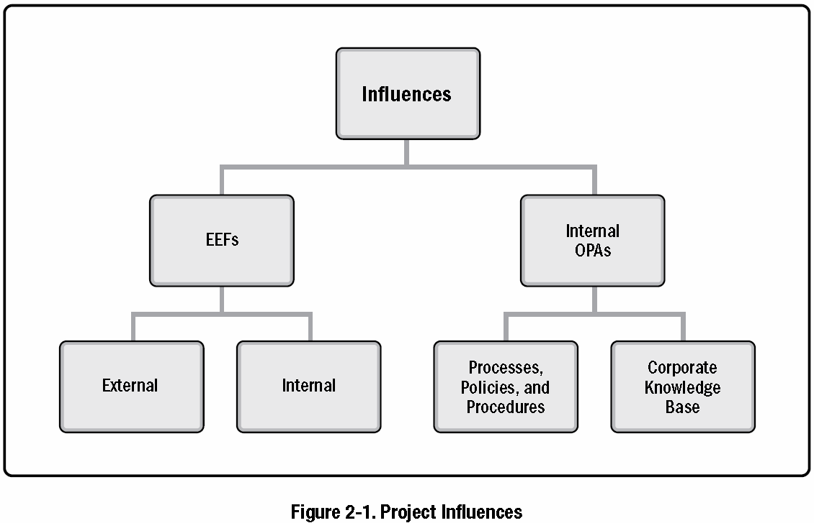
Project influences (1)
Enterprise Environmental Factors (EEFs)
Internal Organizational Process Assets (OPAs)
Categories
Categories
Source: PMI, 2017, “A guide to the project management body of knowledge (PMBOK guide),” Sixth edition, Newtown Square, PA: Project Management Institute, Inc.

Slide 3
Project influences (2)
Two major categories of influences are
  Enterprise environmental factors (EEFs)
    Refer to conditions, not under the control of the project team, that influence, constrain, or direct the project.
  Organizational process assets (OPAs)
    are the plans, processes, policies, procedures, and knowledge bases specific to and used by the performing organization.
Source: PMI, 2017, “A guide to the project management body of knowledge (PMBOK guide),” Sixth edition, Newtown Square, PA: Project Management Institute, Inc.

Slide 4
Project influences (2)
Two major categories of influences are
Enterprise environmental factors (EEFs)
Refer to conditions, not under the control of the project team, that influence, constrain, or direct the project.
Organizational process assets (OPAs)
are the plans, processes, policies, procedures, and knowledge bases specific to and used by the performing organization.
Source: PMI, 2017, “A guide to the project management body of knowledge (PMBOK guide),” Sixth edition, Newtown Square, PA: Project Management Institute, Inc.

Slide 5
Project influences – EEFs: INTERNAL TO THE ORGANIZATION
Organizational culture, structure, and governance.
  Examples include vision, mission, values, beliefs, cultural norms, leadership style, hierarchy and authority relationships, organizational style, ethics, and code of conduct.
Geographic distribution of facilities and resources.
  Examples include factory locations, virtual teams, shared systems, and cloud computing.
Infrastructure.
  Examples include existing facilities, equipment, organizational telecommunications channels, information technology hardware, availability, and capacity.
Information technology software.
  Examples include scheduling software tools, configuration management systems, web interfaces to other online automated systems, and work authorization systems.
Resource availability.
  Examples include contracting and purchasing constraints, approved providers and subcontractors, and collaboration agreements.
Employee capability.
  Examples include existing human resources expertise, skills, competencies, and specialized knowledge.
Source: PMI, 2017, “A guide to the project management body of knowledge (PMBOK guide),” Sixth edition, Newtown Square, PA: Project Management Institute, Inc.

Slide 6
Project influences – EEFs: INTERNAL TO THE ORGANIZATION
Organizational culture, structure, and governance.
Examples include vision, mission, values, beliefs, cultural norms, leadership style, hierarchy and authority relationships, organizational style, ethics, and code of conduct.
Geographic distribution of facilities and resources.
Examples include factory locations, virtual teams, shared systems, and cloud computing.
Infrastructure.
Examples include existing facilities, equipment, organizational telecommunications channels, information technology hardware, availability, and capacity.
Information technology software.
Examples include scheduling software tools, configuration management systems, web interfaces to other online automated systems, and work authorization systems.
Resource availability.
Examples include contracting and purchasing constraints, approved providers and subcontractors, and collaboration agreements.
Employee capability.
Examples include existing human resources expertise, skills, competencies, and specialized knowledge.
Source: PMI, 2017, “A guide to the project management body of knowledge (PMBOK guide),” Sixth edition, Newtown Square, PA: Project Management Institute, Inc.

Slide 7
Project influences – EEFs: EXTERNAL TO THE ORGANIZATION
Marketplace conditions.
  Examples include competitors, market share brand recognition, and trademarks.
Social and cultural influences and issues.
  Examples include political climate, codes of conduct, ethics, and perceptions.
Legal restrictions.
  Examples include country or local laws and regulations related to security, data protection, business conduct, employment, and procurement.
Commercial databases.
  Examples include benchmarking results, standardized cost estimating data, industry risk study information, and risk databases.
Academic research.
  Examples include industry studies, publications, and benchmarking results.
Government or industry standards.
  Examples include regulatory agency regulations and standards related to products, production, environment, quality, and workmanship.
Financial considerations.
  Examples include currency exchange rates, interest rates, inflation rates, tariffs, and geographic location.
Physical environmental elements.
  Examples include working conditions, weather, and constraints.
Source: PMI, 2017, “A guide to the project management body of knowledge (PMBOK guide),” Sixth edition, Newtown Square, PA: Project Management Institute, Inc.

Slide 8
Project influences – EEFs: EXTERNAL TO THE ORGANIZATION
Marketplace conditions.
Examples include competitors, market share brand recognition, and trademarks.
Social and cultural influences and issues.
Examples include political climate, codes of conduct, ethics, and perceptions.
Legal restrictions.
Examples include country or local laws and regulations related to security, data protection, business conduct, employment, and procurement.
Commercial databases.
Examples include benchmarking results, standardized cost estimating data, industry risk study information, and risk databases.
Academic research.
Examples include industry studies, publications, and benchmarking results.
Government or industry standards.
Examples include regulatory agency regulations and standards related to products, production, environment, quality, and workmanship.
Financial considerations.
Examples include currency exchange rates, interest rates, inflation rates, tariffs, and geographic location.
Physical environmental elements.
Examples include working conditions, weather, and constraints.
Source: PMI, 2017, “A guide to the project management body of knowledge (PMBOK guide),” Sixth edition, Newtown Square, PA: Project Management Institute, Inc.

