Slide 1
Open data source
Prepared by: Celeste Ng

Slide 2
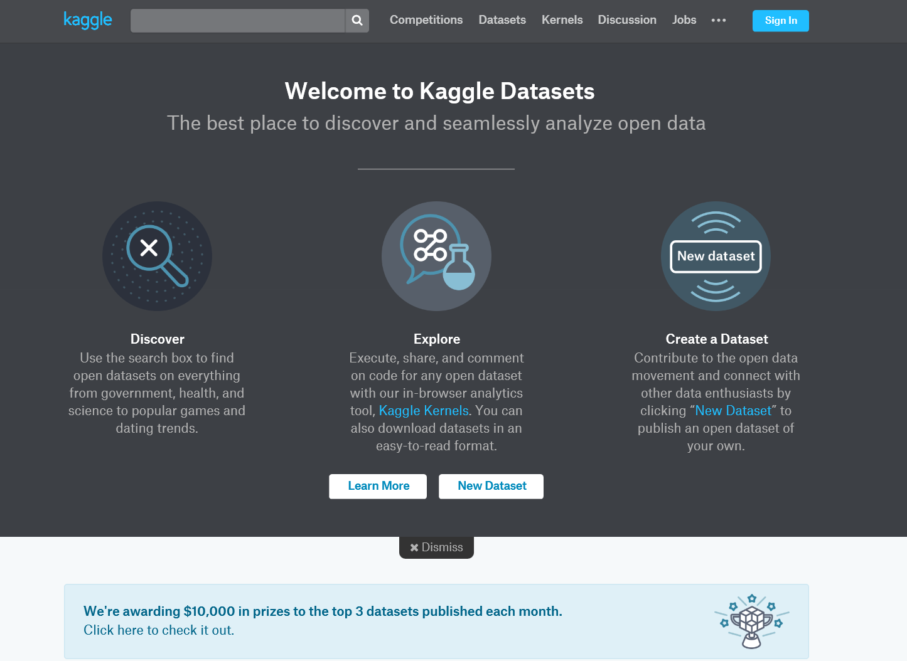
kaggle

Slide 3
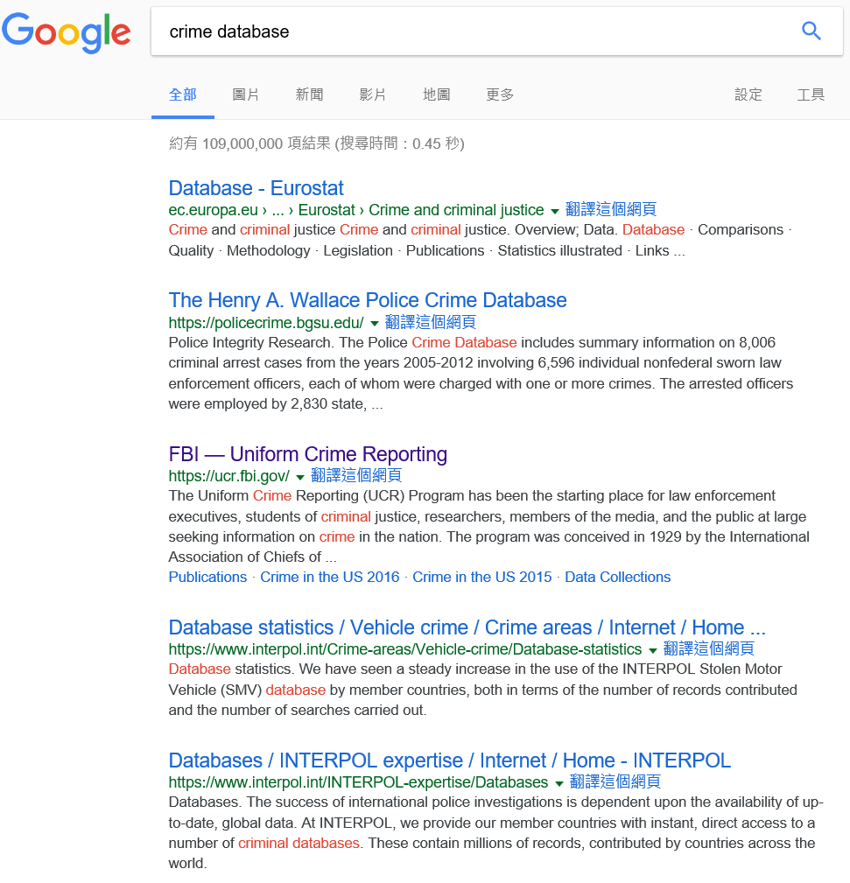
google

Slide 4
Specific – Japan tourism data
url: https://www.tourism.jp/en/tourism-database/stats/

