Slide 1
Tableau – Basic concepts and hands-on steps
Prepared by: Celeste Ng
Date: December, 2017

Slide 2
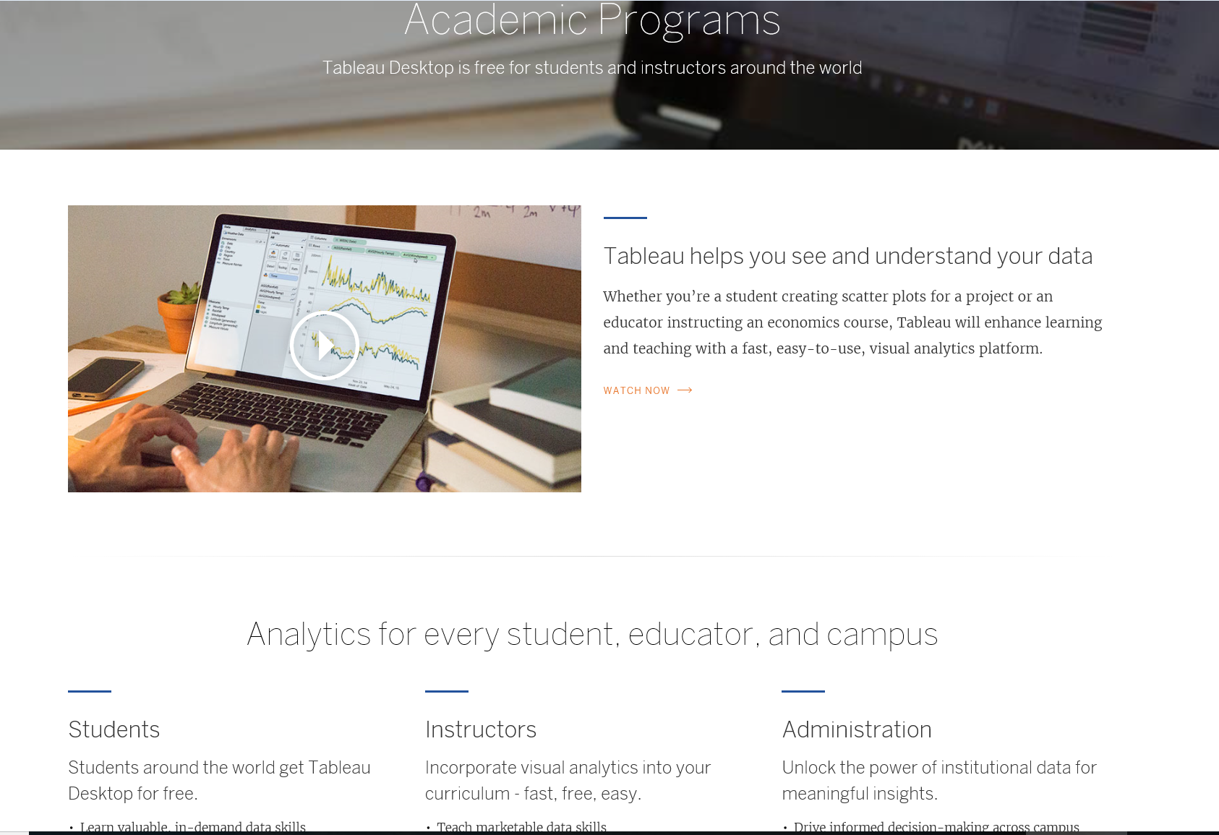
1. Introduction - website
URL: https://www.tableau.com/academic

Slide 3
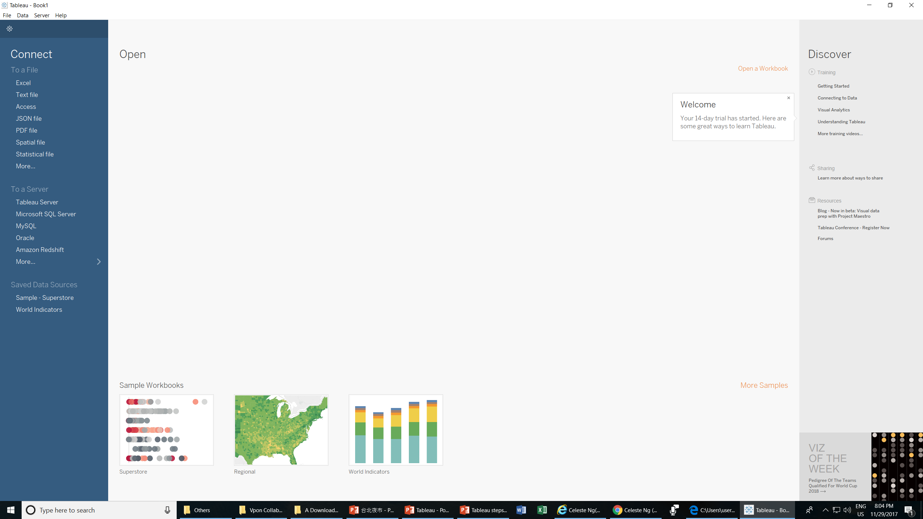
1. Introduction – Tableau interface (1)

Slide 4
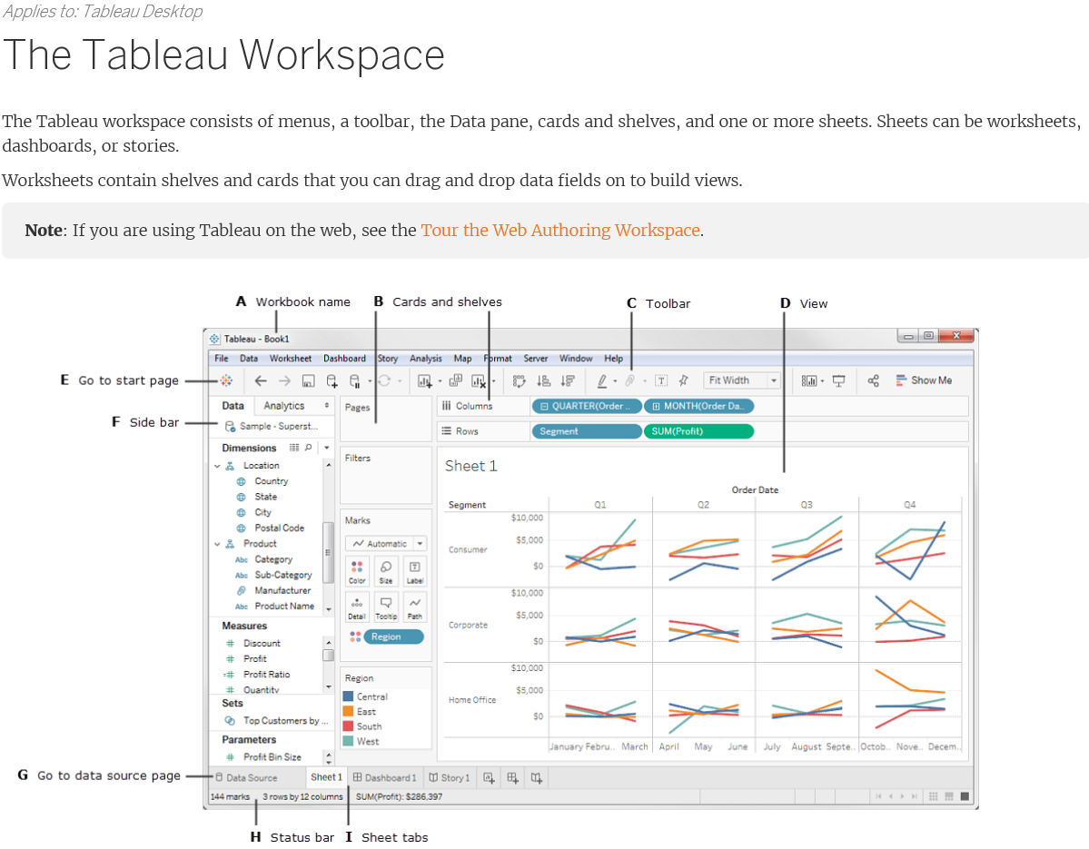
1. Introduction – Tableau interface (2)
Source: http://onlinehelp.tableau.com/current/pro/desktop/en-us/environment_workspace.html/

Slide 5
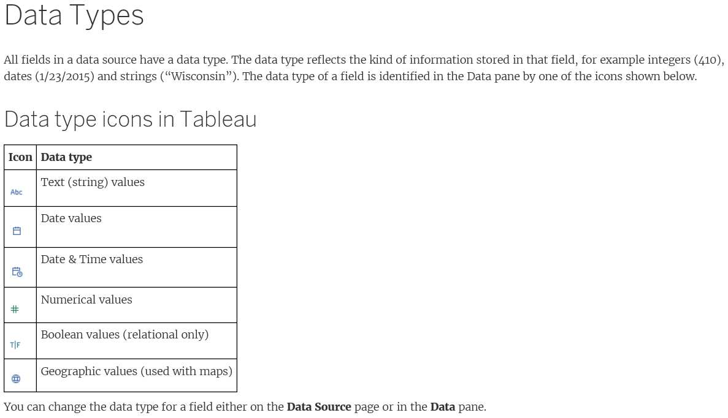
1. Introduction – basic concepts – data types (1)
Source: http://onlinehelp.tableau.com/current/pro/desktop/en-us/concepts.html

Slide 6
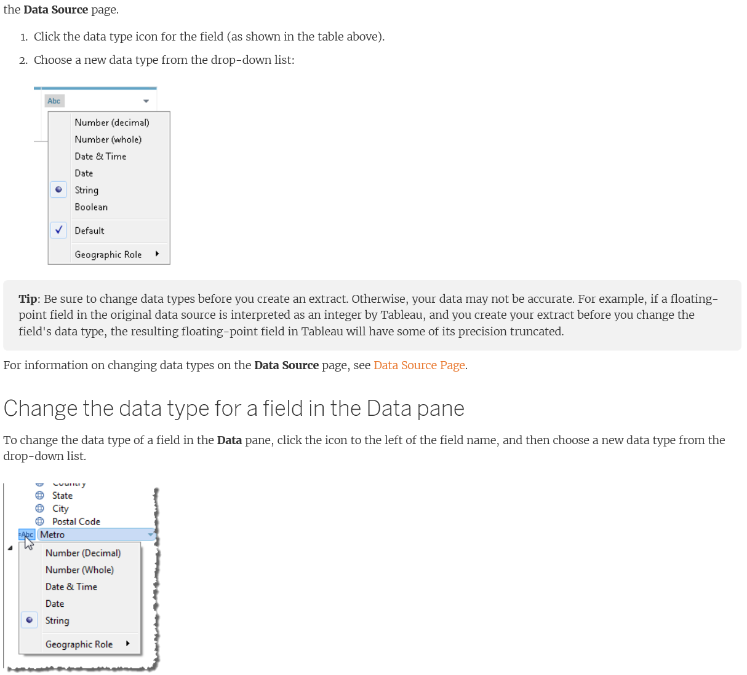
1. Introduction – basic concepts – data types (2)
Source: http://onlinehelp.tableau.com/current/pro/desktop/en-us/concepts.html

Slide 7
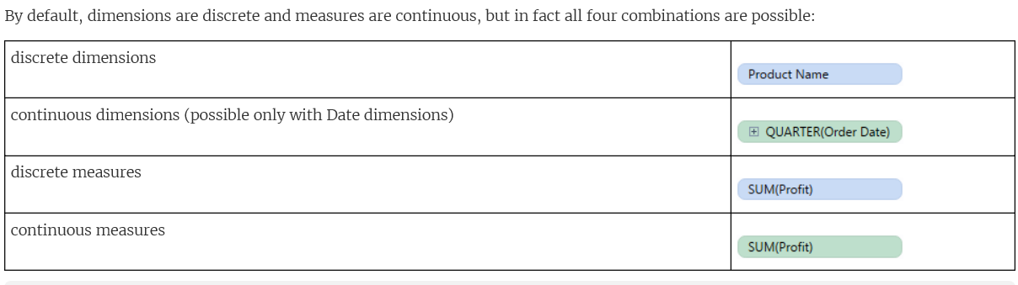
1. Introduction – basic concepts – Field types (1)
Field types – dimensions and measures
Source: http://onlinehelp.tableau.com/current/pro/desktop/en-us/concepts.html

Slide 8
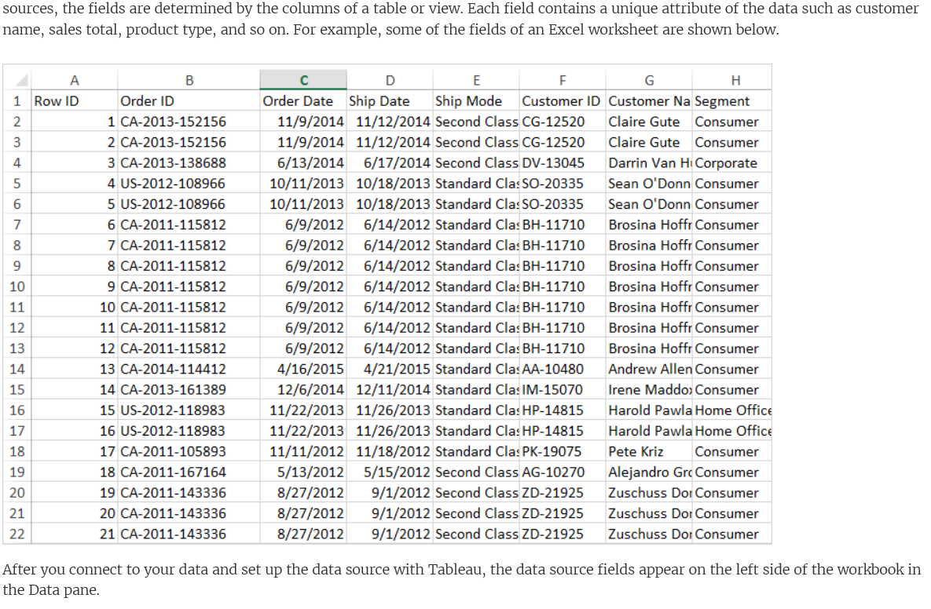
1. Introduction – basic concepts – Field types (2)
The Data pane organizes fields into different areas:
Dimensions – Fields that typically hold discrete qualitative data. Examples of dimensions include dates, customer names, and customer segments.
Measures – Fields that typically hold numerical data that can be aggregated. Examples of measures include sales, profit, number of employees, temperature, frequency, and pressure.
Sets – An additional area that stores custom fields based on existing dimensions and criteria that you specify. Named sets from an MS Analysis Services server or from a Teradata OLAP connector also appear in Tableau in this area of the Data pane. You can interact with these named sets in the same way you interact with other custom sets in Tableau.
Parameters – An additional area that stores parameters that you have created. Parameters are dynamic variables that can be used as placeholders in formulas.
Source: http://onlinehelp.tableau.com/current/pro/desktop/en-us/datafields_understanddatawindow.html

Slide 9
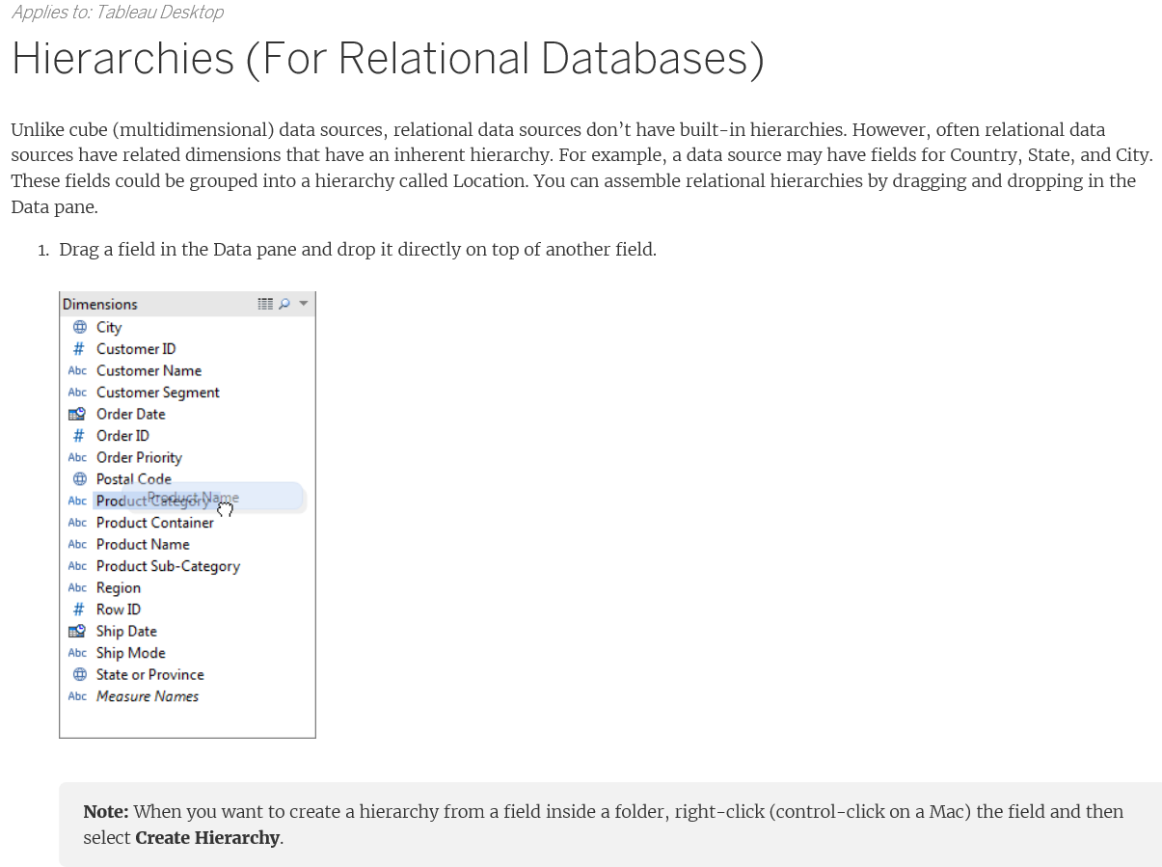
1. Introduction – basic concepts – hierarchy
Source: http://onlinehelp.tableau.com/current/pro/desktop/en-us/datafields_understanddatawindow.html

Slide 10
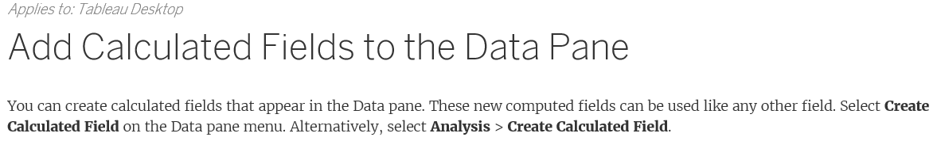
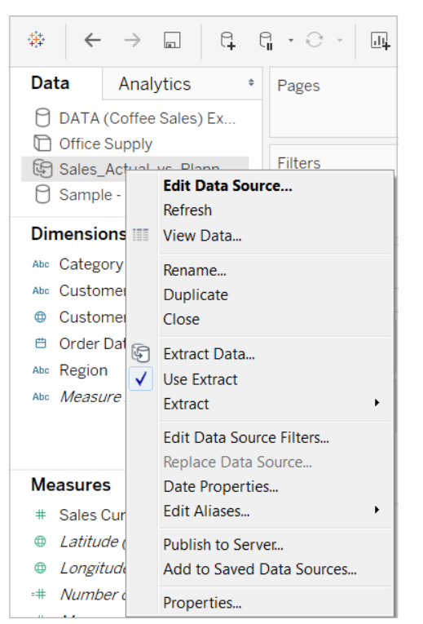
1. Introduction – basic concepts – calculated Fields & Navigate data sources
Source: http://onlinehelp.tableau.com/current/pro/desktop/en-us/datafields_understanddatawindow.html

Slide 11
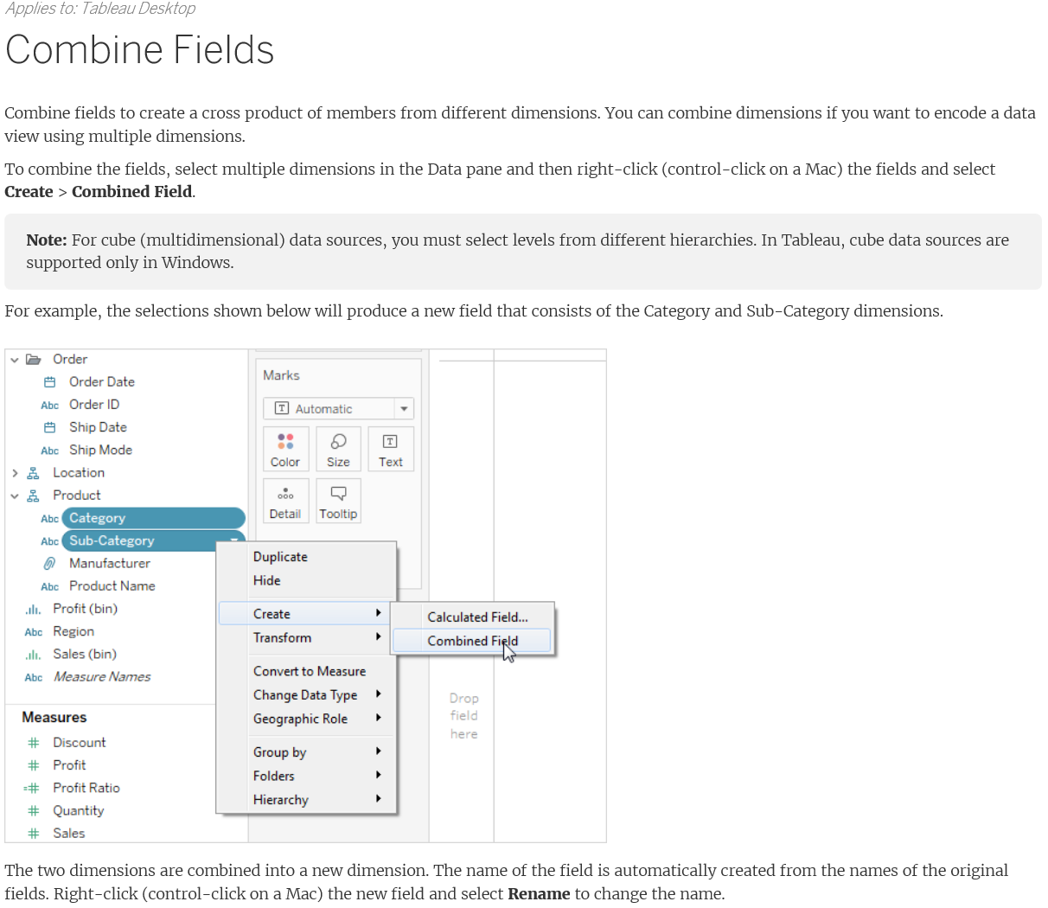
1. Introduction – basic concepts – combine Fields
Source: http://onlinehelp.tableau.com/current/pro/desktop/en-us/datafields_understanddatawindow.html

Slide 12
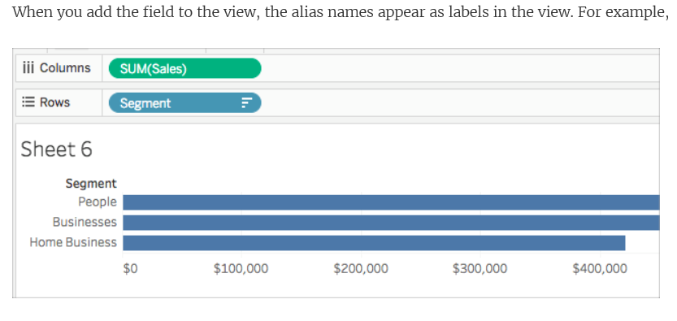
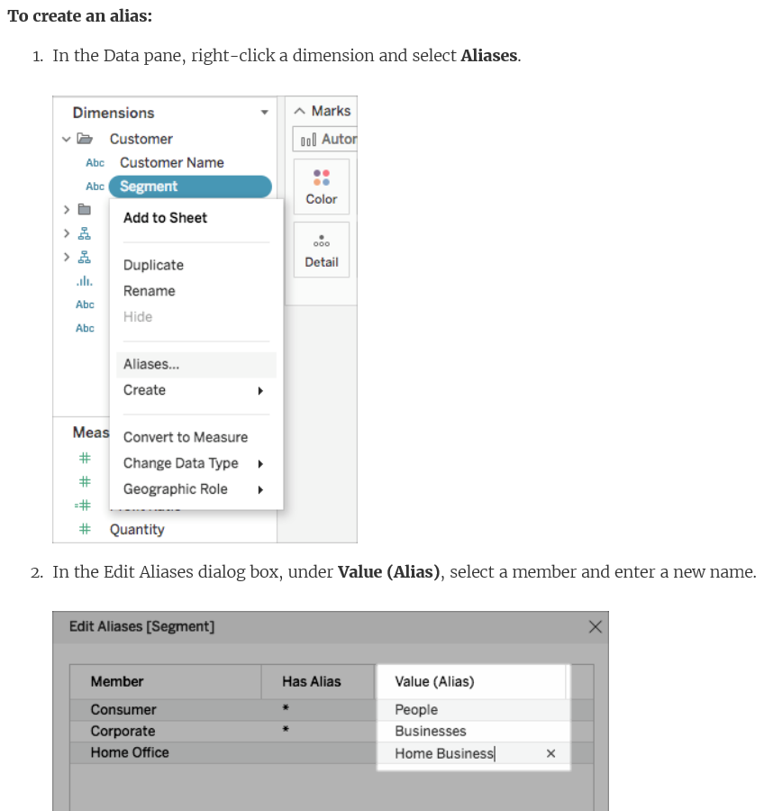
1. Introduction – basic concepts – create alias
Source: http://onlinehelp.tableau.com/current/pro/desktop/en-us/datafields_understanddatawindow.html

Slide 13
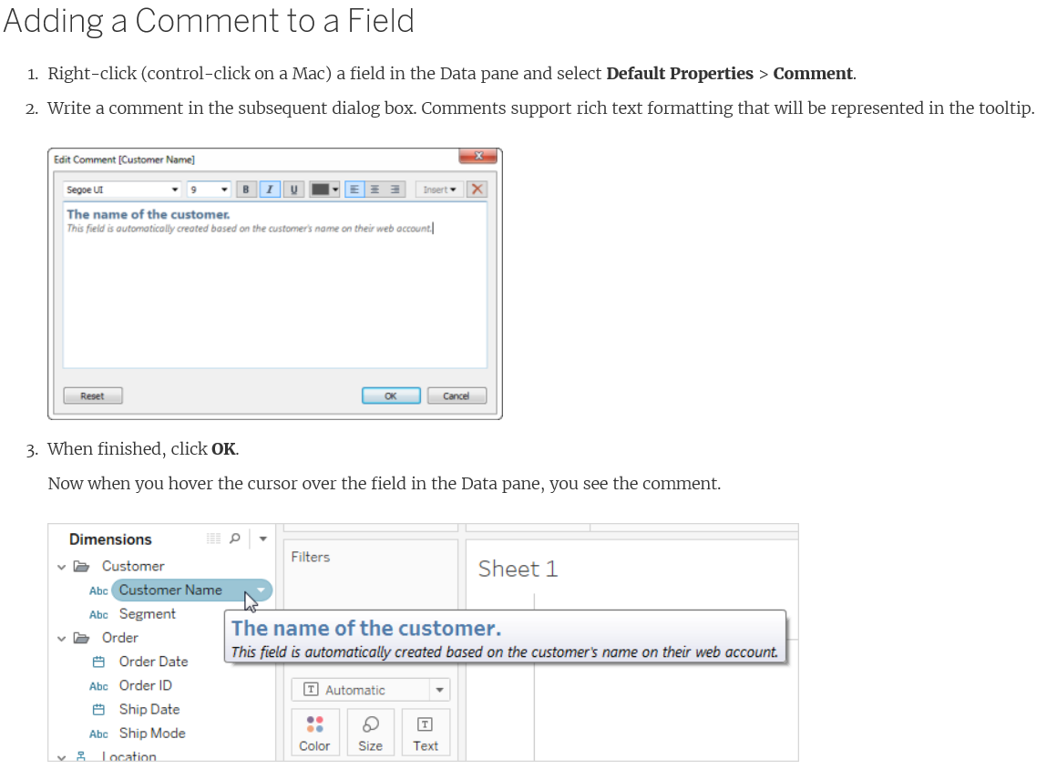
1. Introduction – basic concepts – add comment to a field
Source: http://onlinehelp.tableau.com/current/pro/desktop/en-us/datafields_understanddatawindow.html

Slide 14
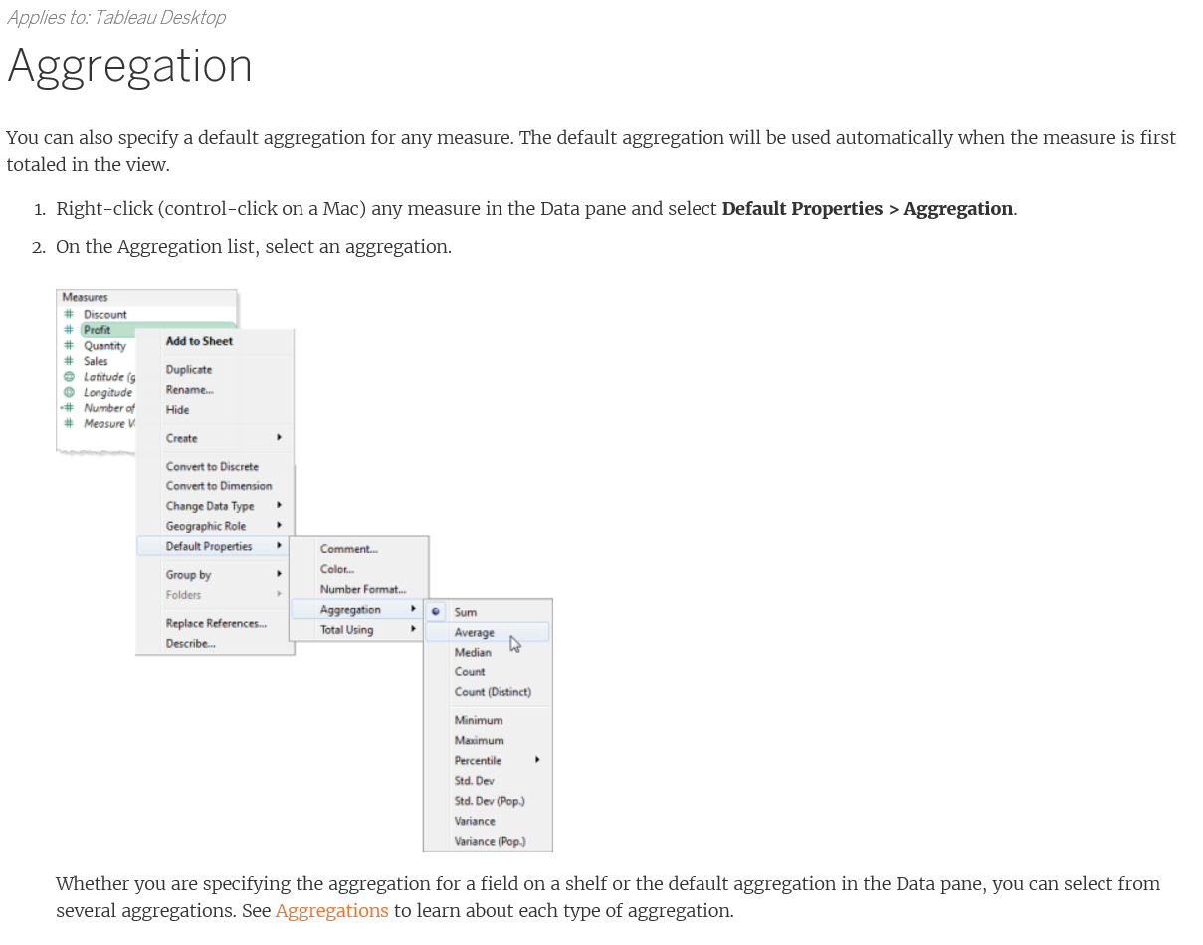
1. Introduction – basic concepts – aggregation of a field
Source: http://onlinehelp.tableau.com/current/pro/desktop/en-us/datafields_understanddatawindow.html
Additional - http://onlinehelp.tableau.com/current/pro/desktop/en-us/calculations_aggregation.html?tocpath=Get%20Started%7CTableau%20Concepts%7CAggregations%7C_____0

Slide 15
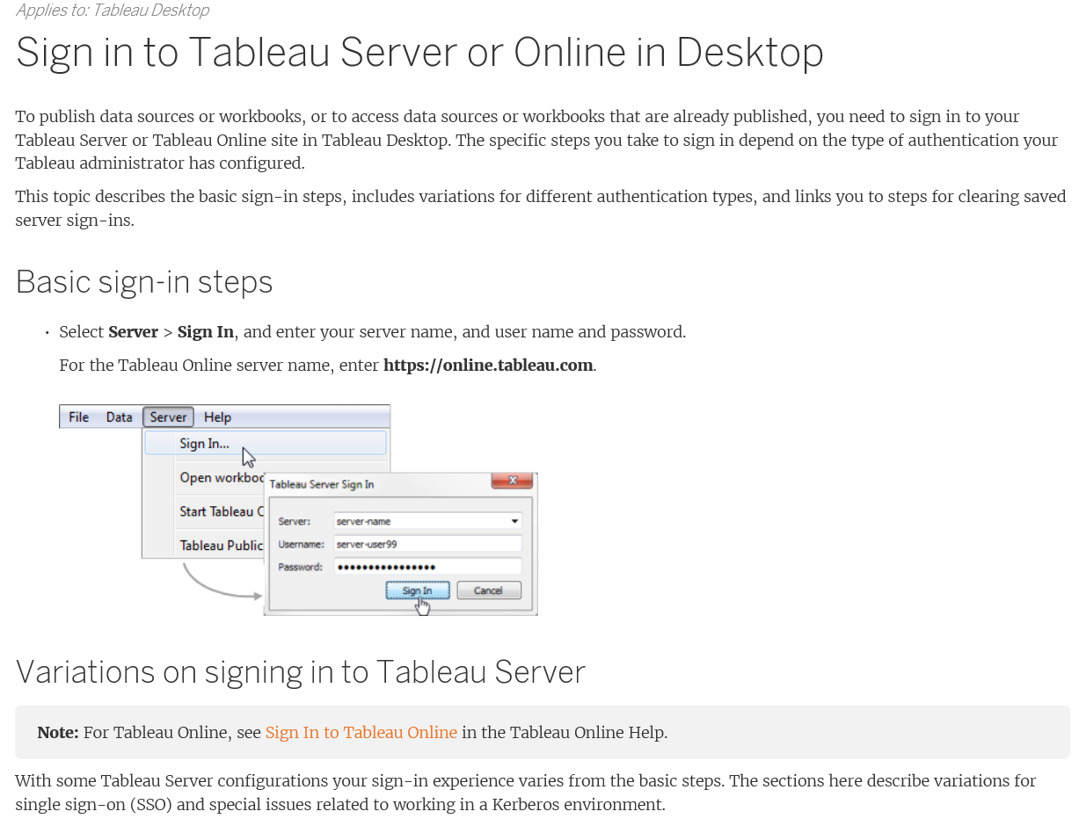
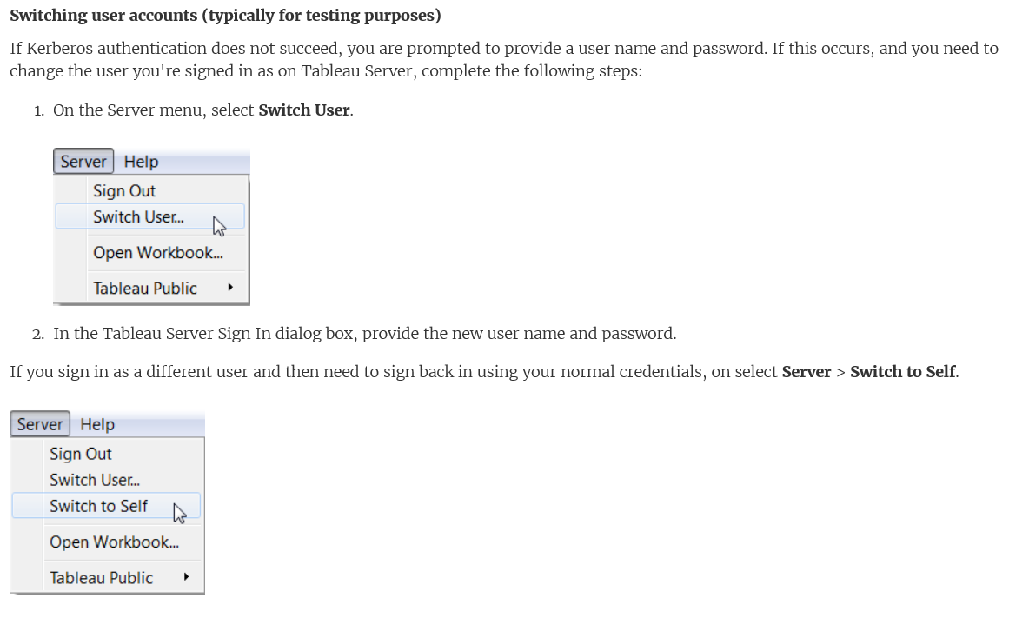
1. Introduction – basic concepts – sign in
Source: http://onlinehelp.tableau.com/current/pro/desktop/en-us/datafields_understanddatawindow.html

Slide 16
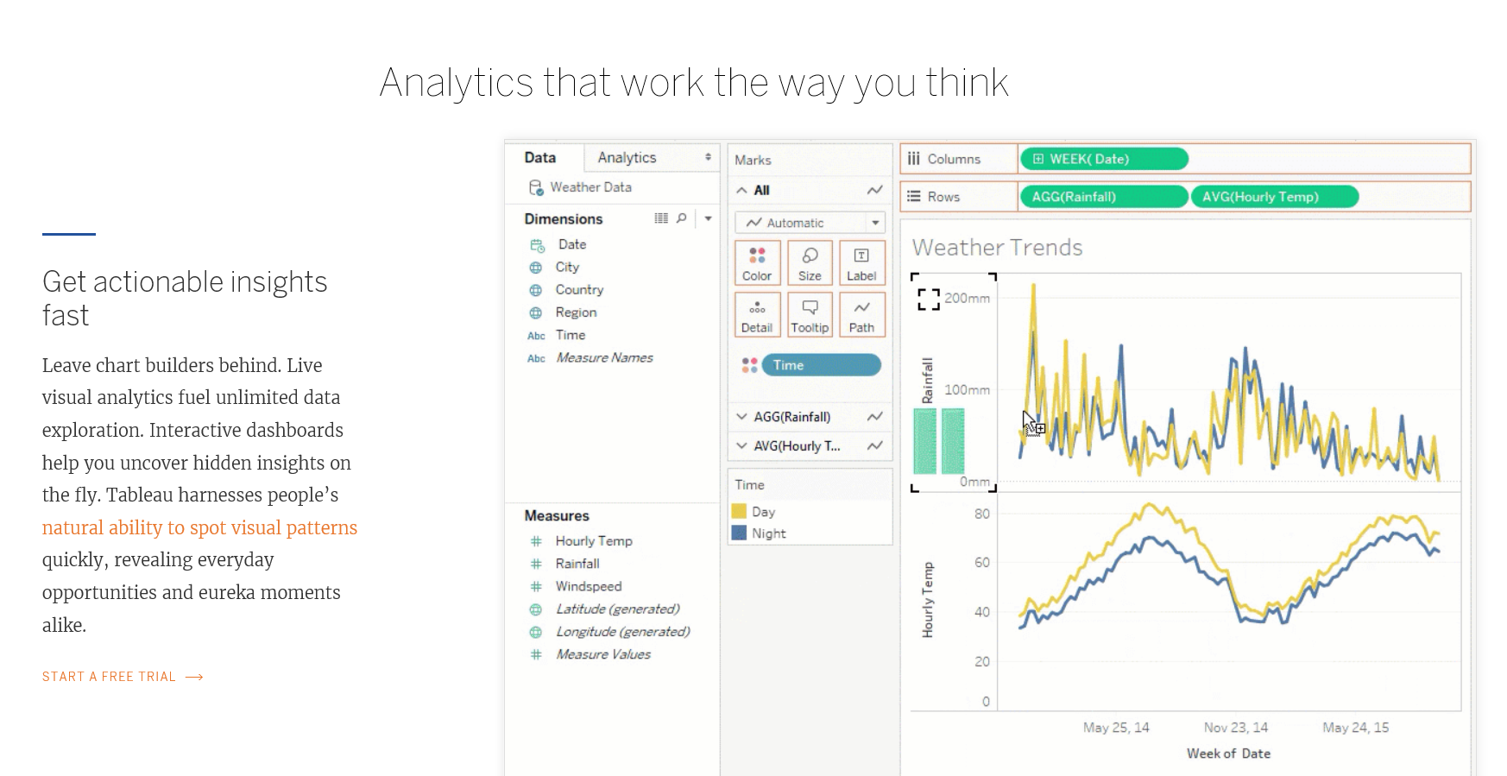
2. Tutorial - brief
URL: https://www.tableau.com/products/desktop

Slide 17
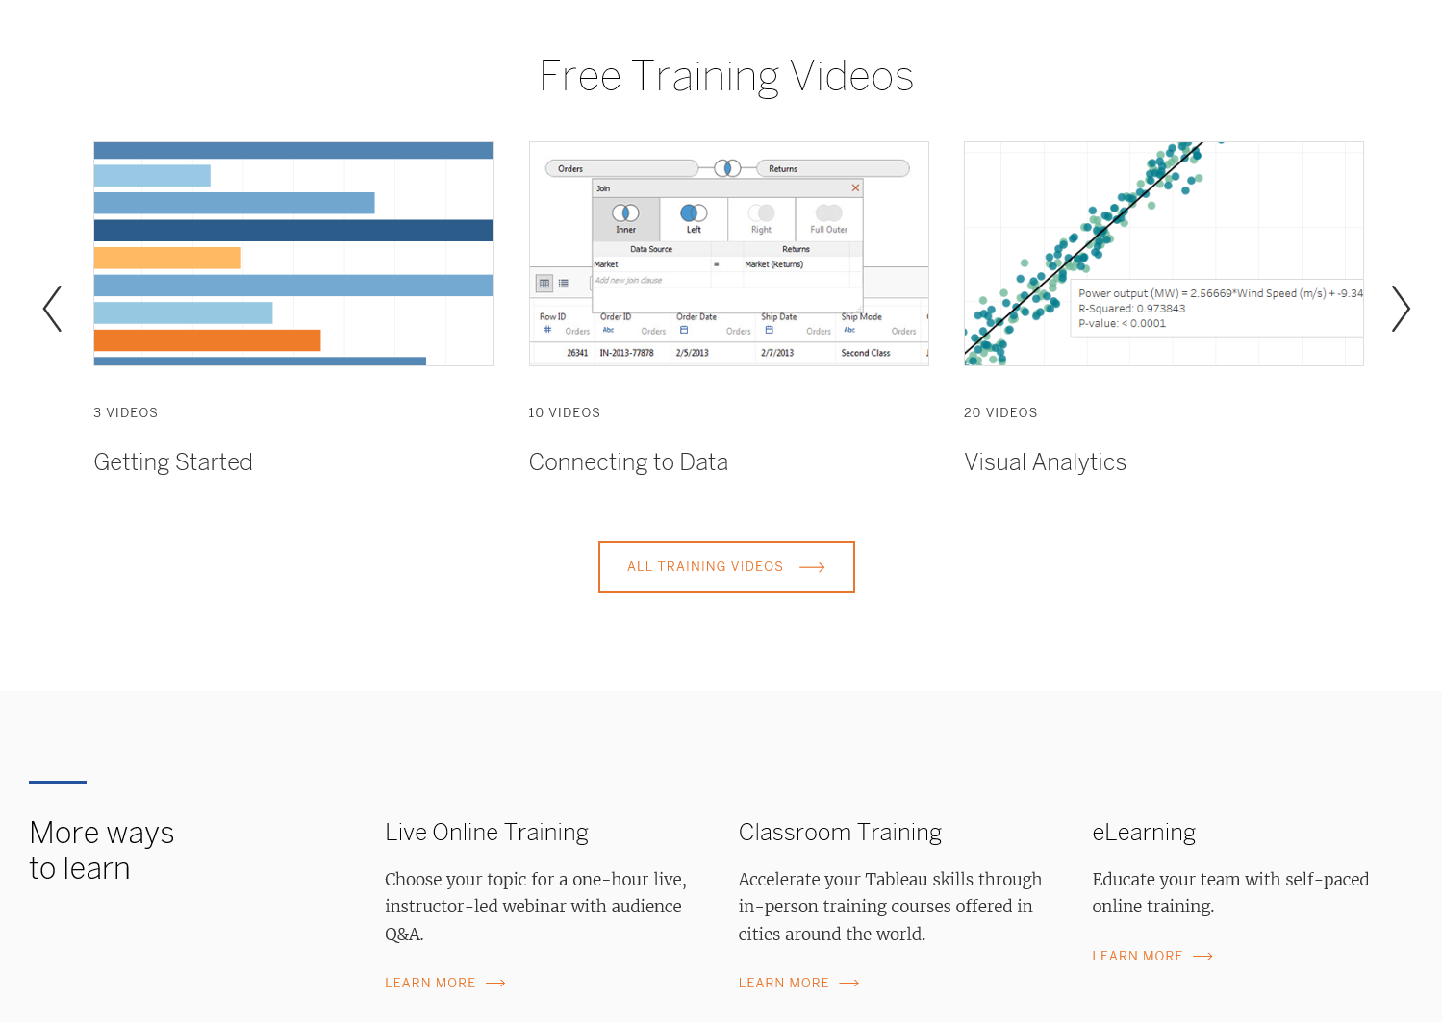
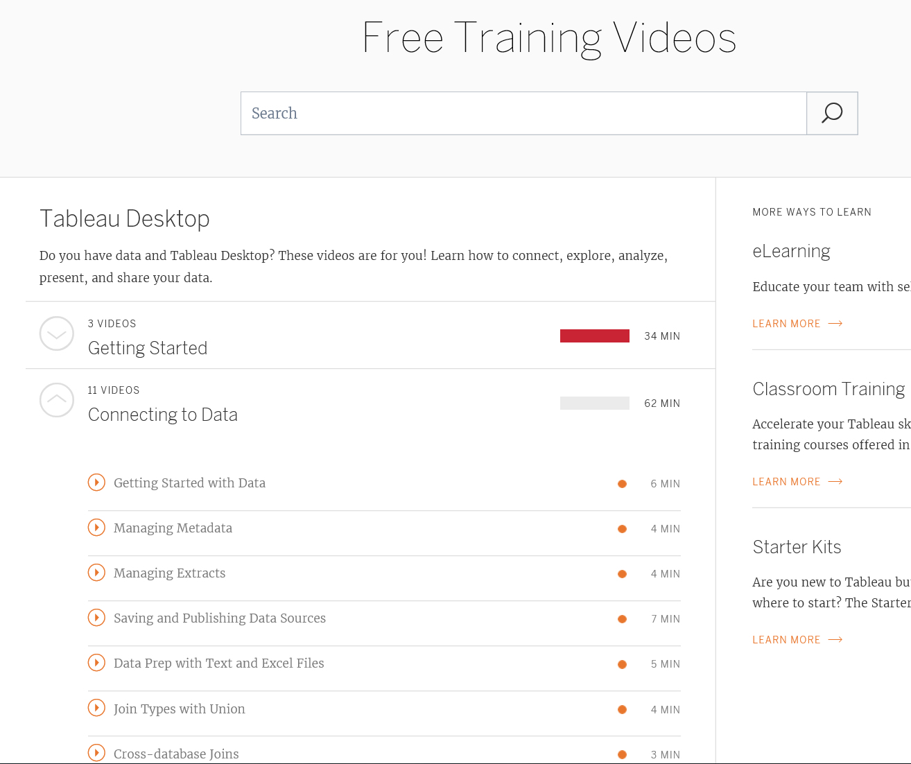
2. Tutorial – e-learning
URL: (a) https://www.tableau.com/learn
(b) https://www.tableau.com/learn/training

Slide 18
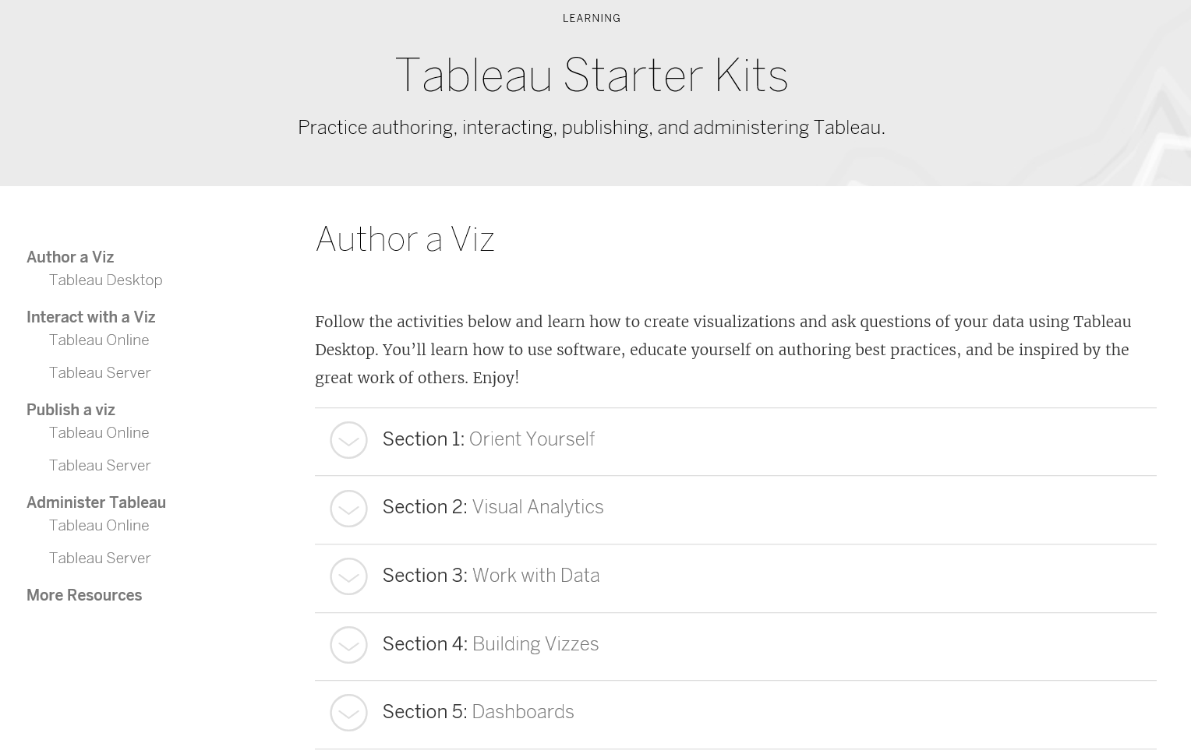
2. Tutorial – e-learning – starter kit
URL: https://www.tableau.com/learn/starter-kits
More details: http://onlinehelp.tableau.com/current/pro/desktop/en-us/help.htm#getstarted_buildmanual_ex1basic.html

Slide 19
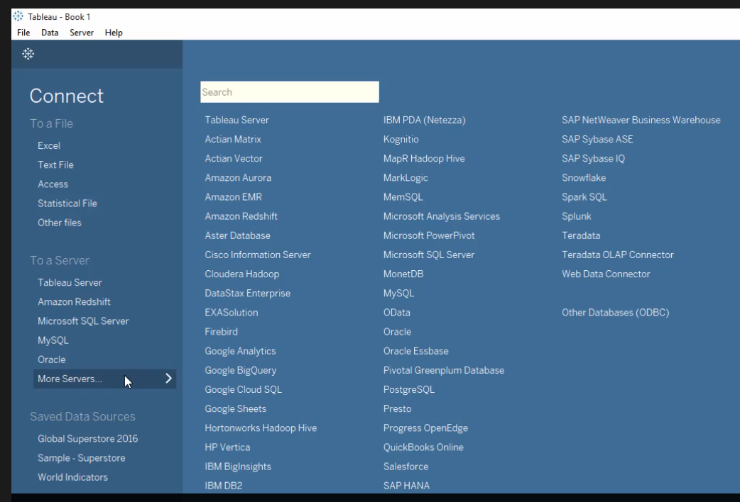
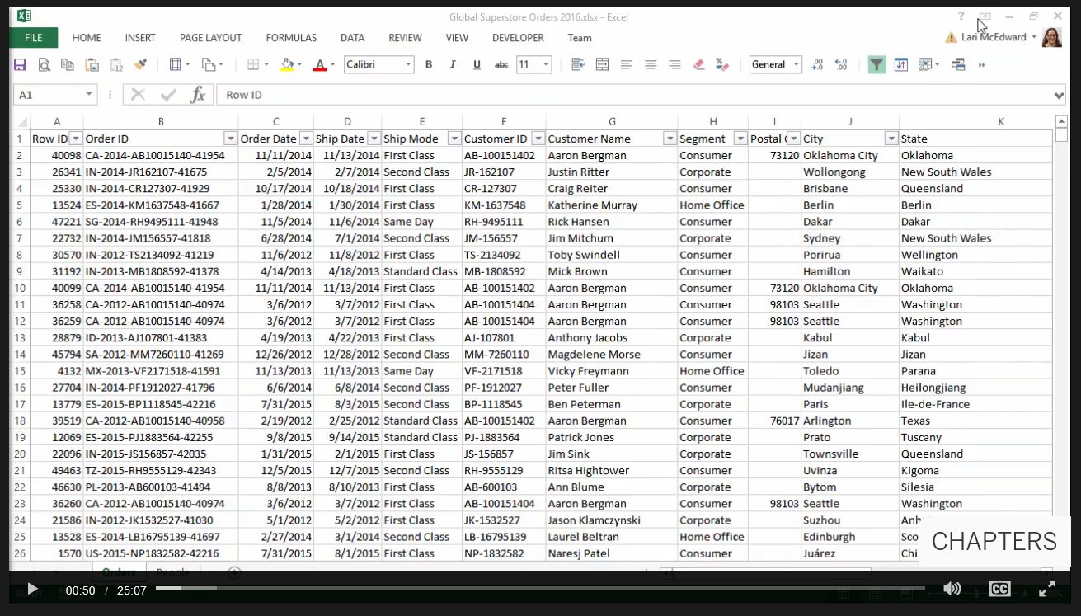
3. Hands-on --- can connect to various data sources – (1)
URL: https://www.tableau.com/learn

Slide 20
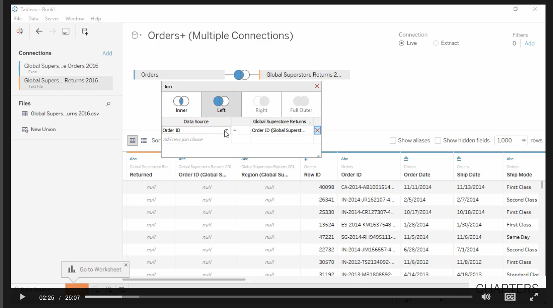
3. Hands-on --- Join tables– (2)
URL: https://www.tableau.com/learn

Slide 21
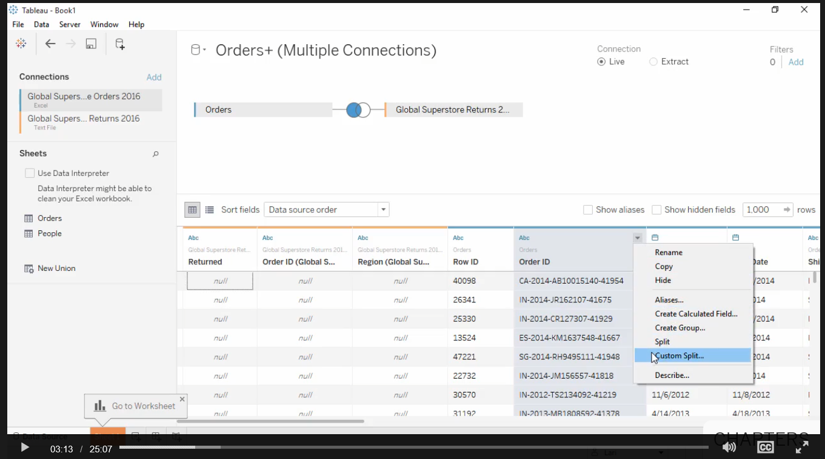
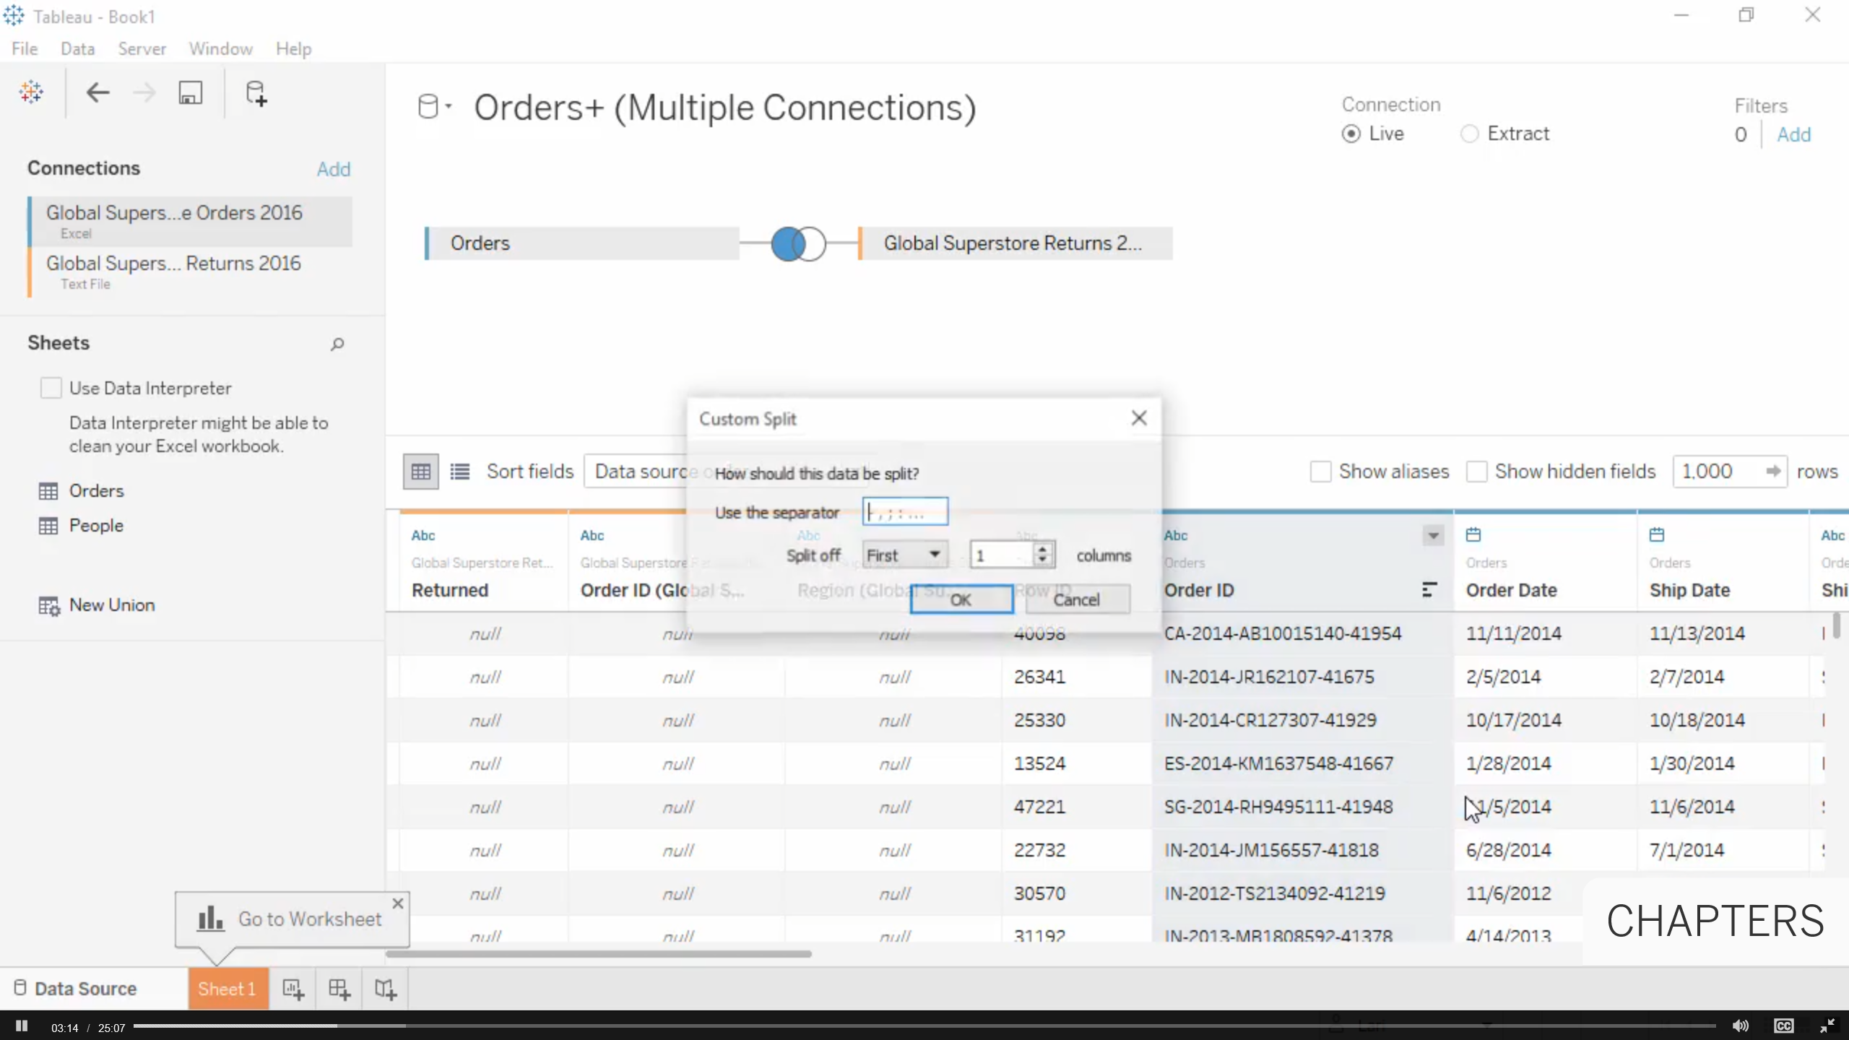
3. Hands-on --- custom split a column – (3)
URL: https://www.tableau.com/learn

Slide 22
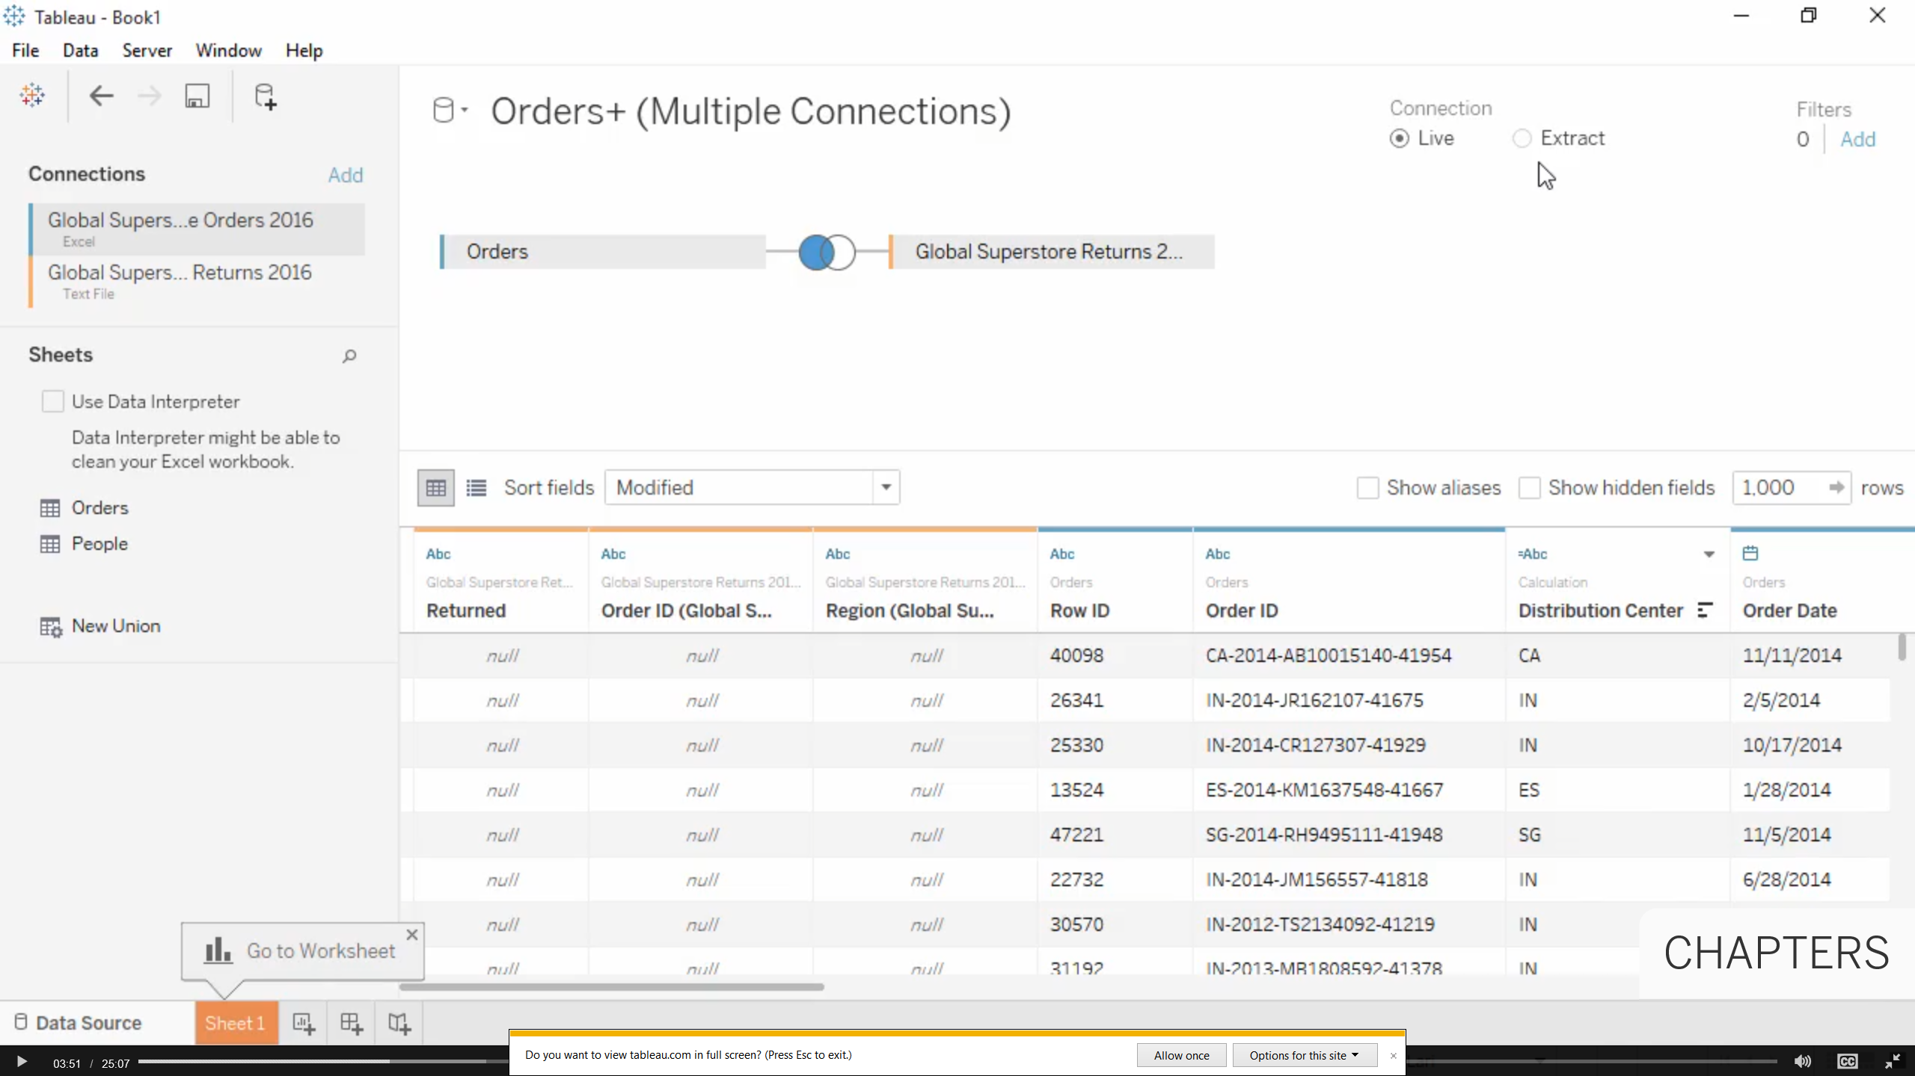
3. Hands-on --- click on “Live” and “Go To worksheet” – (4)
URL: https://www.tableau.com/learn

Slide 23
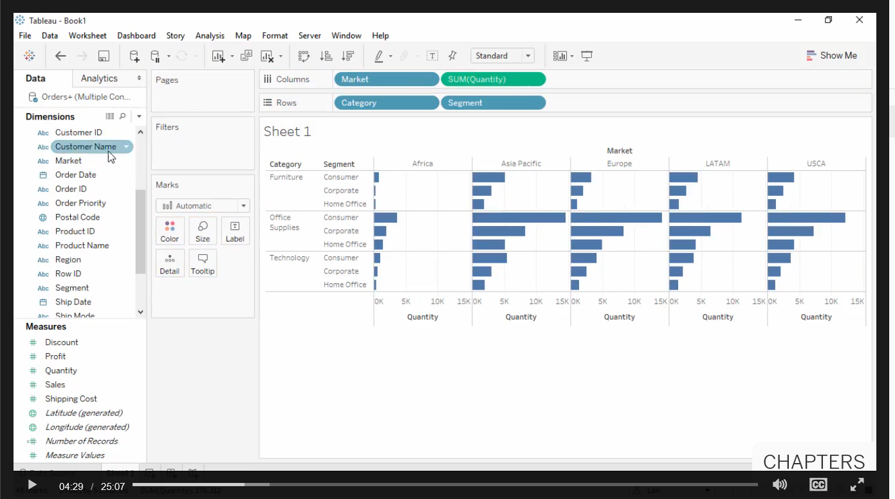
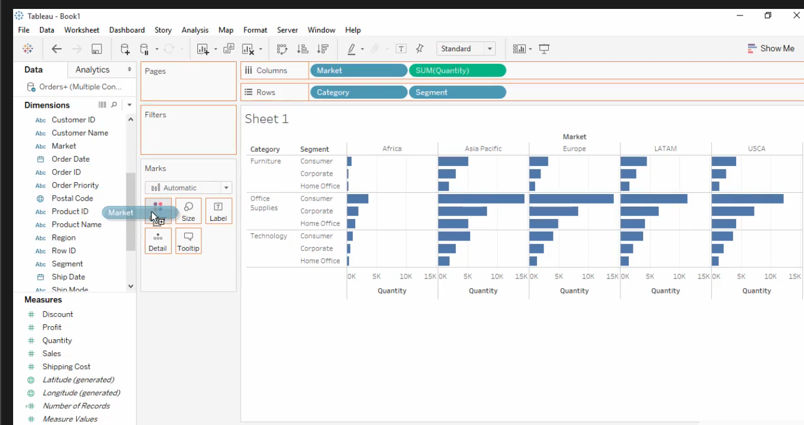
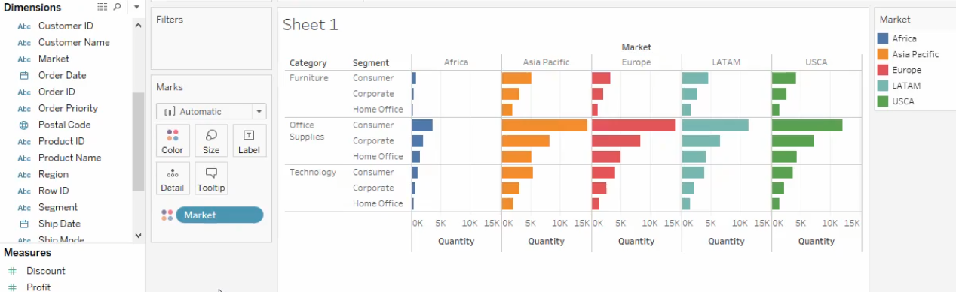
3. Hands-on --- adding “Value” to rows and columns – (5)
URL: https://www.tableau.com/learn
Color the “market” column

Slide 24
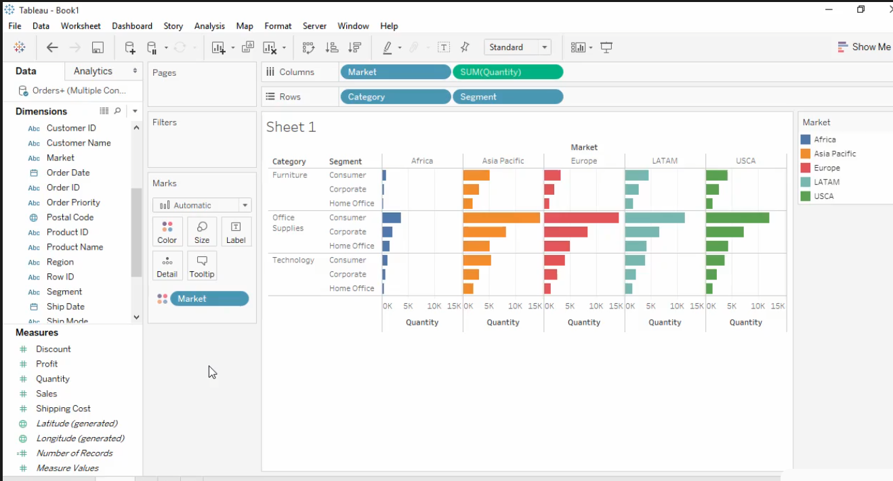
3. Hands-on --- insight “Africa an emerging market – (6)
URL: https://www.tableau.com/learn

Slide 25
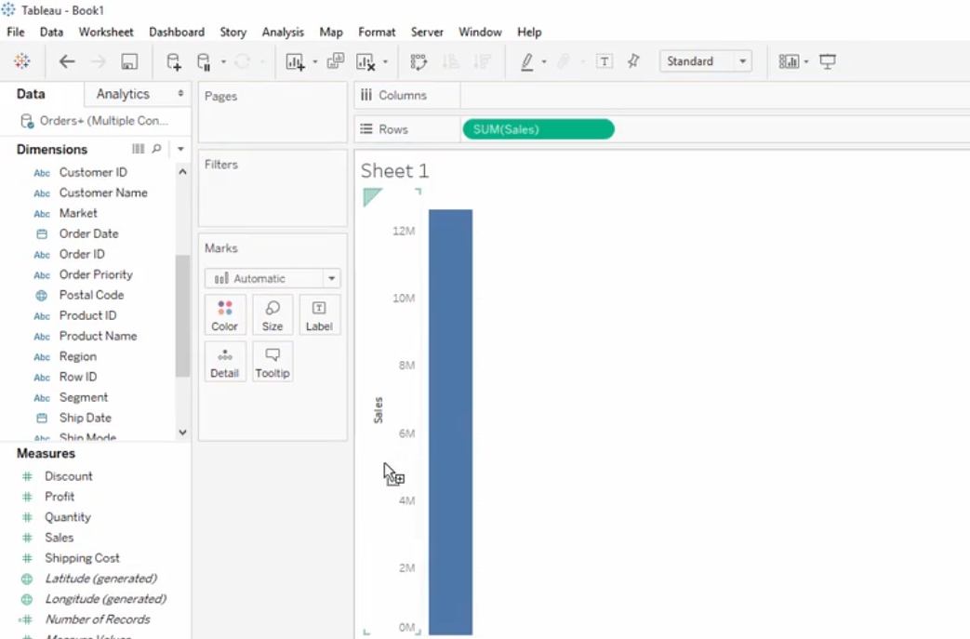
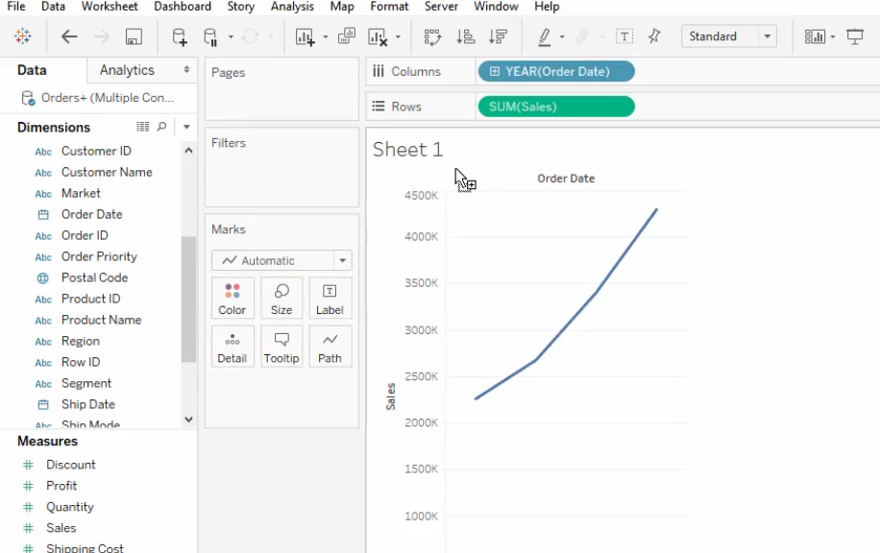
3. Hands-on --- Assume we are interested in “sales number” – (7)
URL: https://www.tableau.com/learn
Sales over time --- drag “date” over the top of the graph

Slide 26
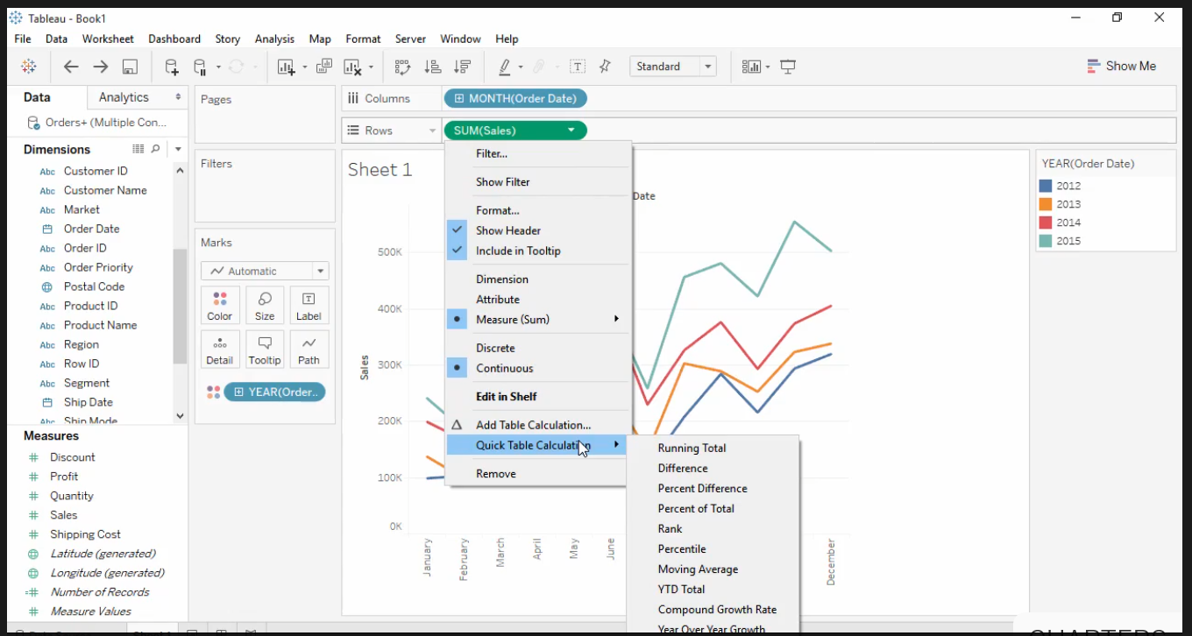
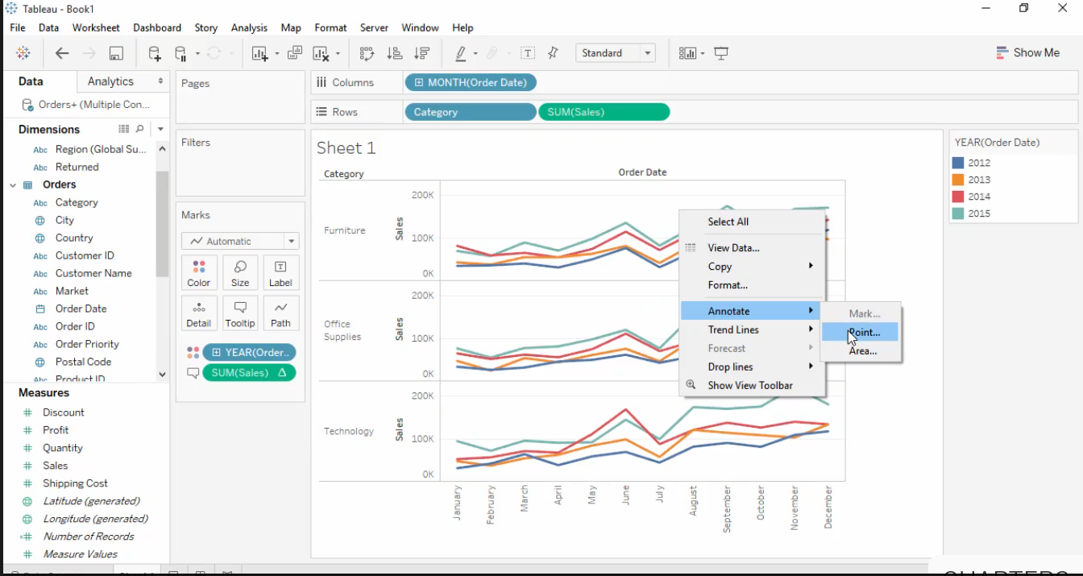
3. Hands-on --- Quick Table calculation & add “Annotation” – (8)
URL: https://www.tableau.com/learn

Slide 27
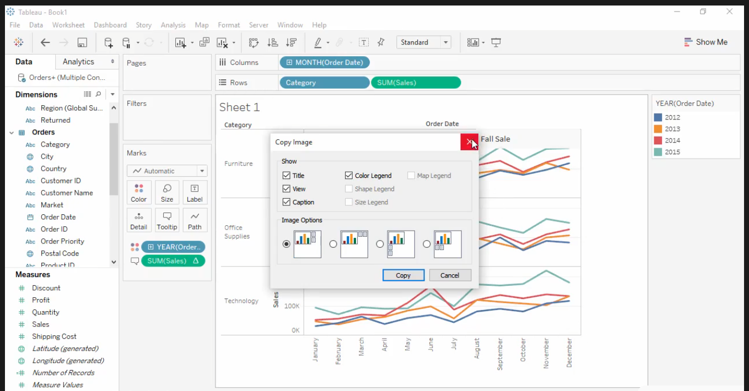
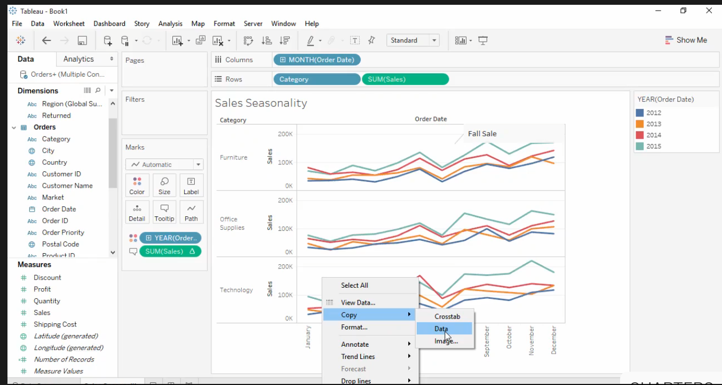
3. Hands-on --- to “share” - copy an image & copy data (& directly paste) to “excel” – (9)
URL: https://www.tableau.com/learn

Slide 28
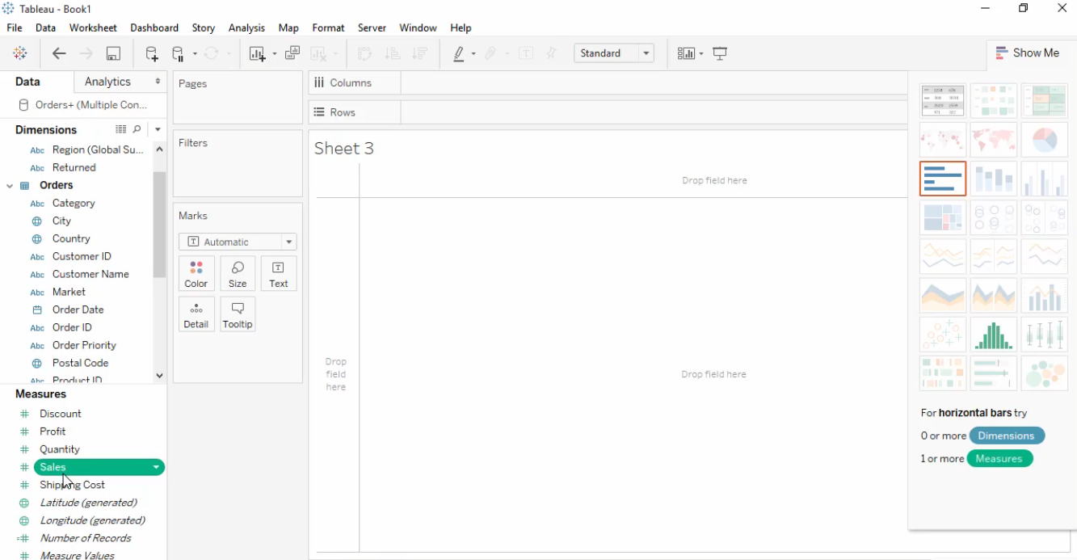
3. Hands-on --- hold on the “atl” key and select different “measure and dimension” to see the “suggested graph” in “show me” – (10)
URL: https://www.tableau.com/learn

Slide 29
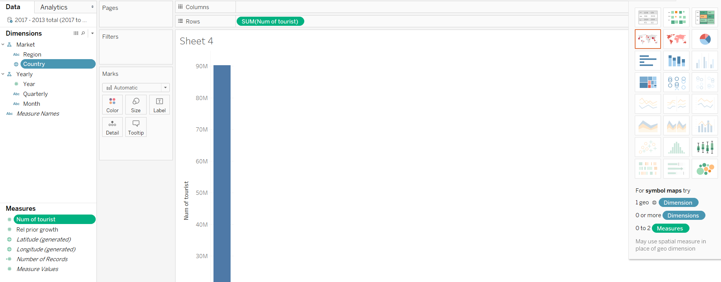
3. Hands-on --- hold on the “atl” key and select different “measure and dimension” to see the “suggested graph” in “show me” – (11)
URL: https://www.tableau.com/learn

Slide 30
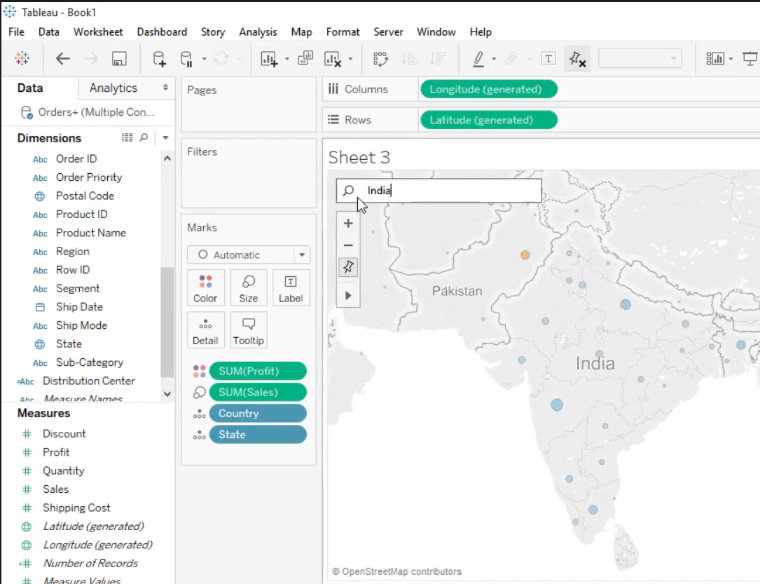
3. Hands-on --- Do a “geographic search” – (12)
URL: https://www.tableau.com/learn

Slide 31
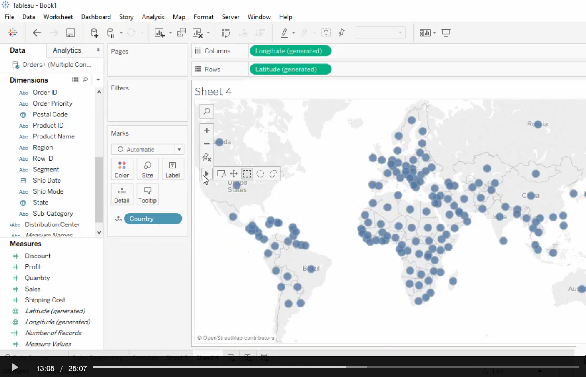
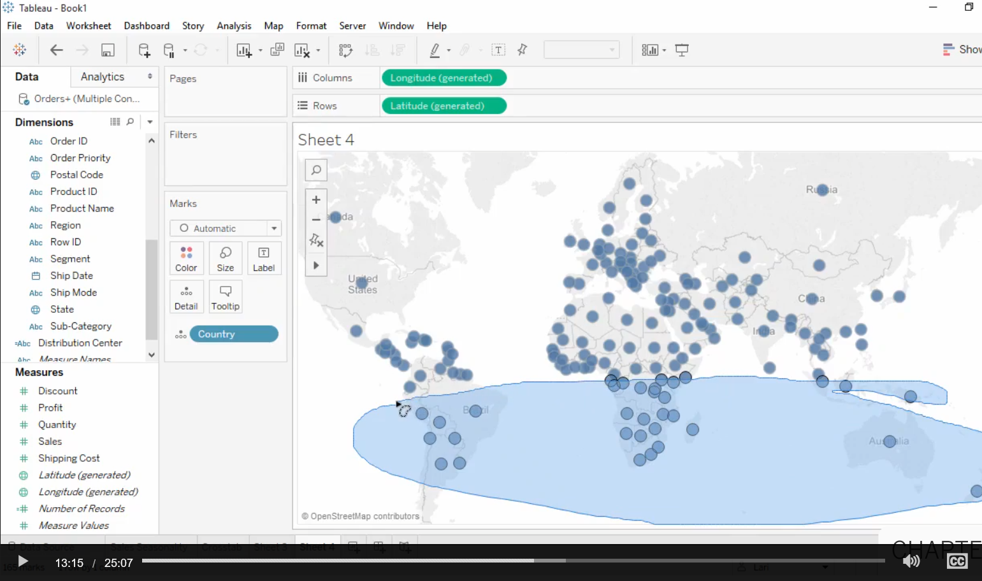
3. Hands-on --- sales “seasonal” issue & hemisphere issue check – (13-1)
URL: https://www.tableau.com/learn
1. Stripping out every thing, except country.
2. Create “country/territory” custom-group by using lasso

Slide 32
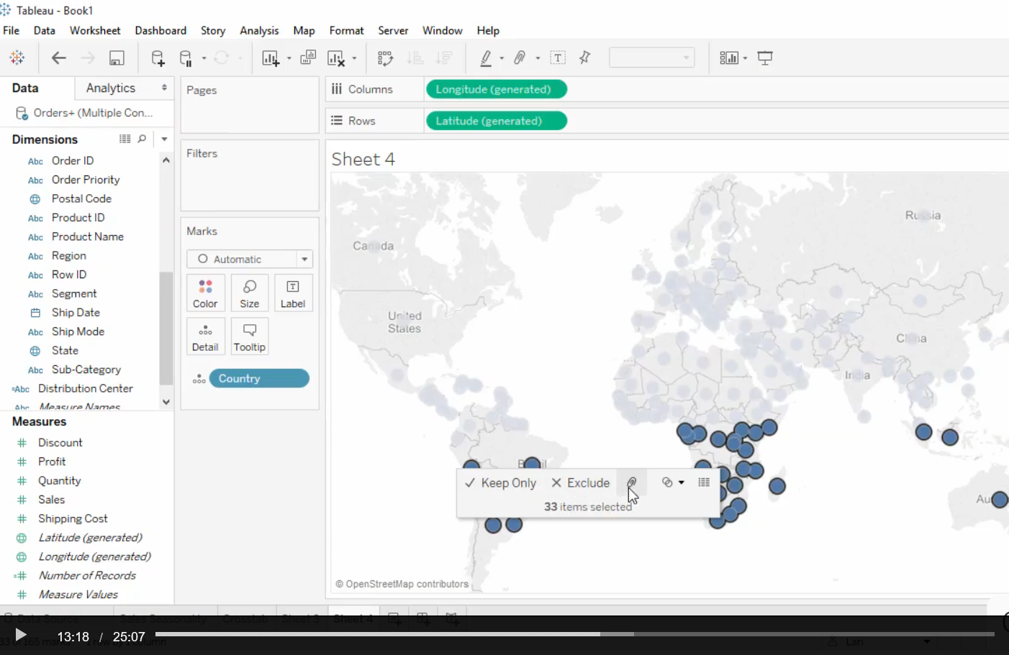
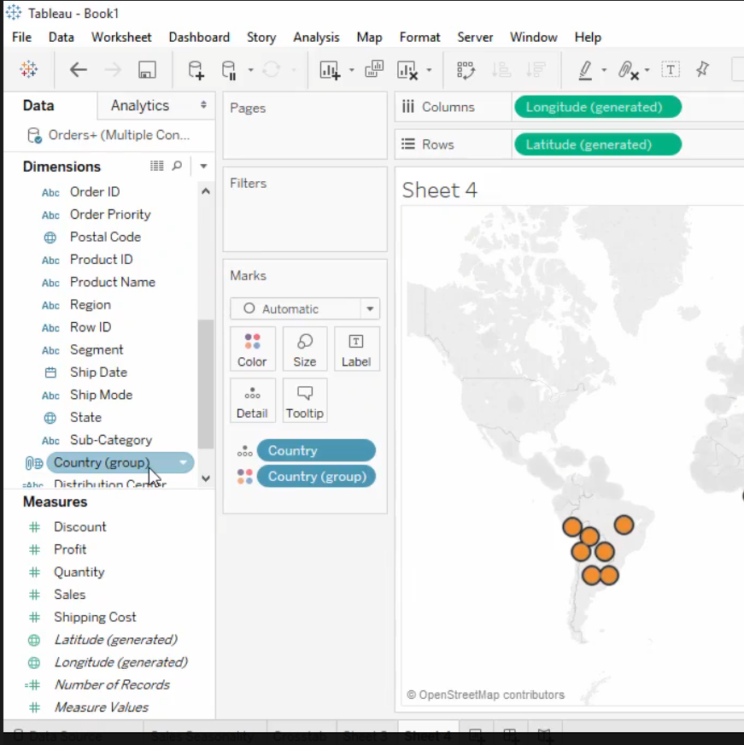
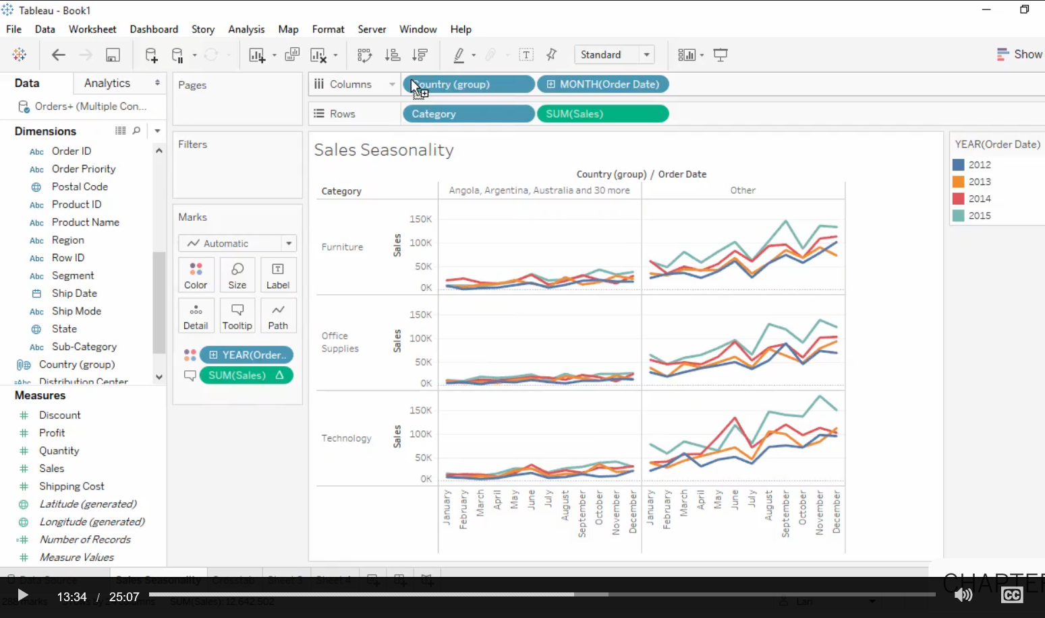
3. Hands-on --- sales “seasonal” issue & hemisphere issue check – (13-2)
URL: https://www.tableau.com/learn
3. Click on the “paper clip” icon to create “country group
4. Go back to “sales seasonality” sheet.

Slide 33
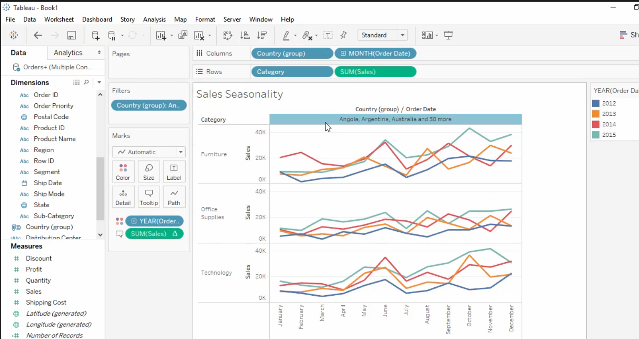
3. Hands-on --- sales “seasonal” issue & hemisphere issue check – (13-3)
URL: https://www.tableau.com/learn
4. Go back to “sales seasonality” sheet.
5. Show no sales seasonality issue.

Slide 34
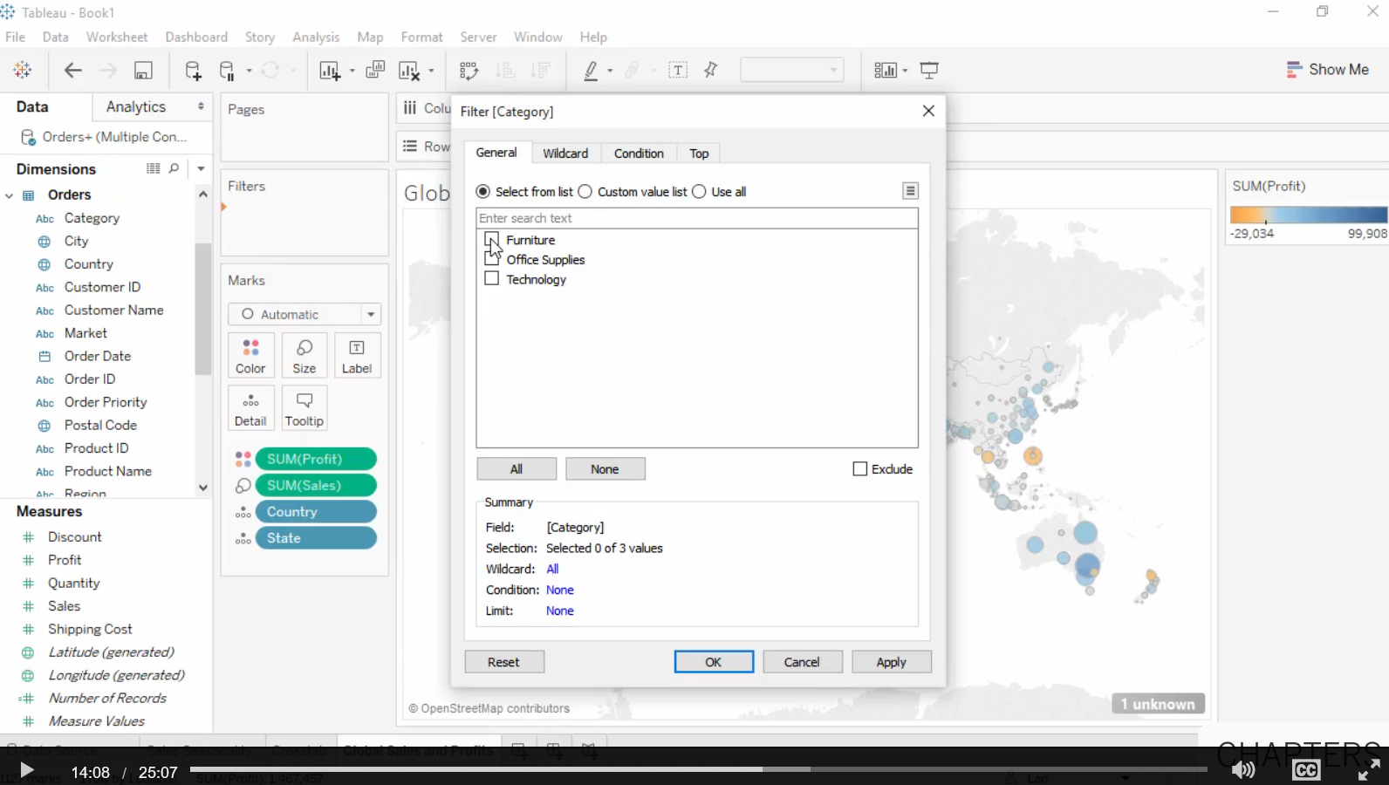
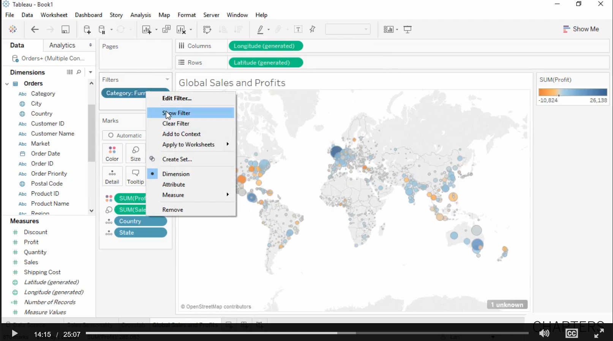
3. Hands-on --- investigate individual product sales problem – (14)
URL: https://www.tableau.com/learn
1. Move [product] “Category” into the “Filters” box
2. To make filter interactive….. Select “show filter”

Slide 35
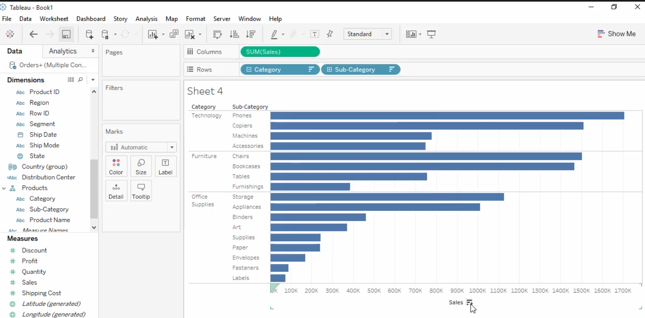
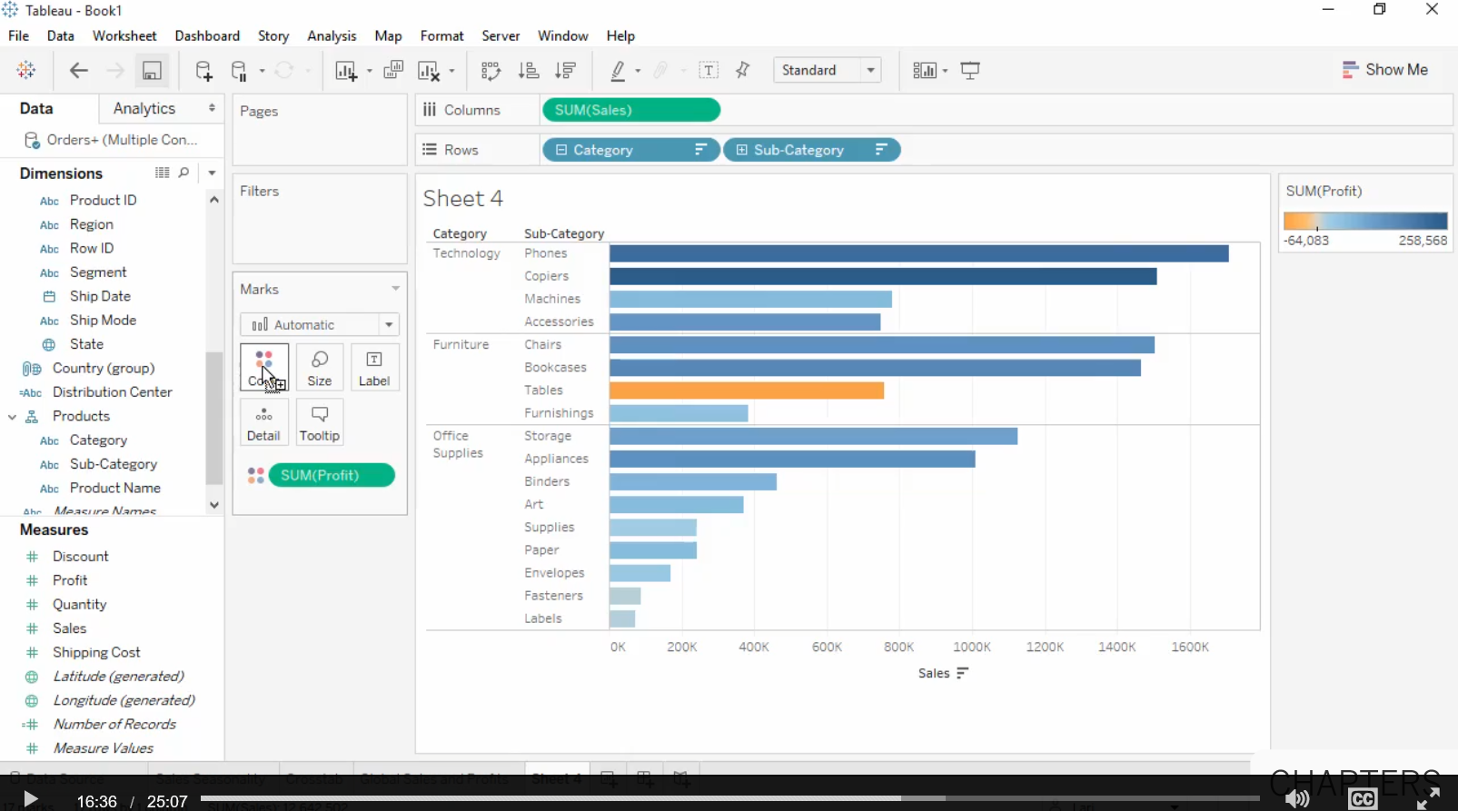
3. Hands-on --- sorting sales amount & checking on profit– (15-1)
URL: https://www.tableau.com/learn
Problem: “Table” sales amount is good but profit is negative !!!!

Slide 36

3. Hands-on --- sorting sales amount & checking on profit – (15-2)
URL: https://www.tableau.com/learn
Problem: does profit lost happen to all markets?

Slide 37


3. Hands-on --- sorting sales amount & checking on profit – (15-3)
URL: https://www.tableau.com/learn
Problem: does profit lost cause by shipping costs of various product categories & to different customers?

Slide 38

3. Hands-on --- sorting sales amount & checking on profit – (15-4)
URL: https://www.tableau.com/learn
Problem: does low profit cause by returned? (show returned by “size”)…. Ans.: not many of the low profit orders.

Slide 39


3. Hands-on --- sorting sales amount & checking on profit – (15-5)
URL: https://www.tableau.com/learn
Problem: is there a relationship between low profit and shipping costs? ---- Draw a trend line using the “analytic” ---- select trend line
Ans: Maybe not, the R-square is very low --- not meaningful.

Slide 40


3. Hands-on --- sorting sales amount & checking on profit – (15-5)
URL: https://www.tableau.com/learn
Problem: identifying customer contributing to low profit
List the customers out

Slide 41


3. Hands-on --- Group small items together – (16)
URL: https://www.tableau.com/learn

Slide 42

3. Hands-on --- Labelling sub-categories – (17)
URL: https://www.tableau.com/learn
Use “filter”

Slide 43

3. Hands-on --- multi-dimensional data visualization – (18)
URL: https://www.tableau.com/learn

Slide 44


3. Hands-on --- create a dashboard – (19-1)
URL: https://www.tableau.com/learn

Slide 45


3. Hands-on --- create a dashboard – (19-2)
URL: https://www.tableau.com/learn
Changing the various views of data

Slide 46

3. Hands-on --- create a dashboard – (19-3)
URL: https://www.tableau.com/learn
Zoom into selected market

Slide 47


3. Hands-on --- conduct analytics – Forecast (20-1)
URL: https://www.tableau.com/learn
Select “Analytic” tab
The “forecast” results

Slide 48


3. Hands-on --- conduct analytics – trend line (20-2)
URL: https://www.tableau.com/learn
Select “Analytic” tab, select “trend line”
The “exponential trend line” results for “sum”

Slide 49


3. Hands-on --- build a story – (21-1)
URL: https://www.tableau.com/learn
Select the “global sales and profits”

Slide 50


3. Hands-on --- build a story – (21-2)
URL: https://www.tableau.com/learn
Drag the “sales dashboard” inside …”

Slide 51


3. Hands-on --- build a story – (21-3)
URL: https://www.tableau.com/learn
Fit the “sales dashboard” to the story …”

Slide 52


3. Hands-on --- Publish workbook – (22-1)
URL: https://www.tableau.com/learn

Slide 53

3. Hands-on --- Publish workbook – (22 -2)
URL: https://www.tableau.com/learn
Select what to publish

Slide 54


3. Hands-on --- exporting worksheet (23)
URL: https://www.tableau.com/learn

Slide 55


3. Hands-on --- exporting dashboard – print to PDF (24)
URL: https://www.tableau.com/learn

Slide 56
3. Hands-on --- distributing files (25)
URL: https://www.tableau.com/learn
Workbook file types
Workbooks in tableau desktop can be saved as .Twb files or .Twbx files.
  .Twb workbooks are not packaged with the data itself
    they contain just the information needed for the data connection and construction of the view.
    Opening a twb file requires access to the same data source used to create it.
  .Twbx workbooks are packaged
    they contain the information in a twb and can contain any data and local files such as background images and custom geocoding.
    twbx files are not encrypted and have no data security
    opening a twbx file with data shows all the underlying data.

Slide 57

3. Hands-on --- distributing files – publishing workbook (26-1)
URL: https://www.tableau.com/learn
Packaged workbooks can be opened with Tableau Desktop or Tableau Reader.
  Opening a file in Desktop is the same experience as authoring a workbook – there is full functionality including the ability to edit or create new worksheets from the data.
  Tableau Reader can open packaged workbook files to be viewed, and preserves full interactivity of the workbook contents including dashboards, stories, and any filtering or other actions, but the workbook cannot be edited.

Slide 58

3. Hands-on --- distributing files – publishing workbook (26-2)
URL: https://www.tableau.com/learn
Workbooks can be published to Tableau Online or Tableau Server.
  Workbooks are secure, fully interactive via browser or mobile device, and
  Can be set up for automatic data refreshes or be connected live …..

Slide 59

4. Others --- Prod Category vs. market URL: https://www.tableau.com/learn

